Slide 1
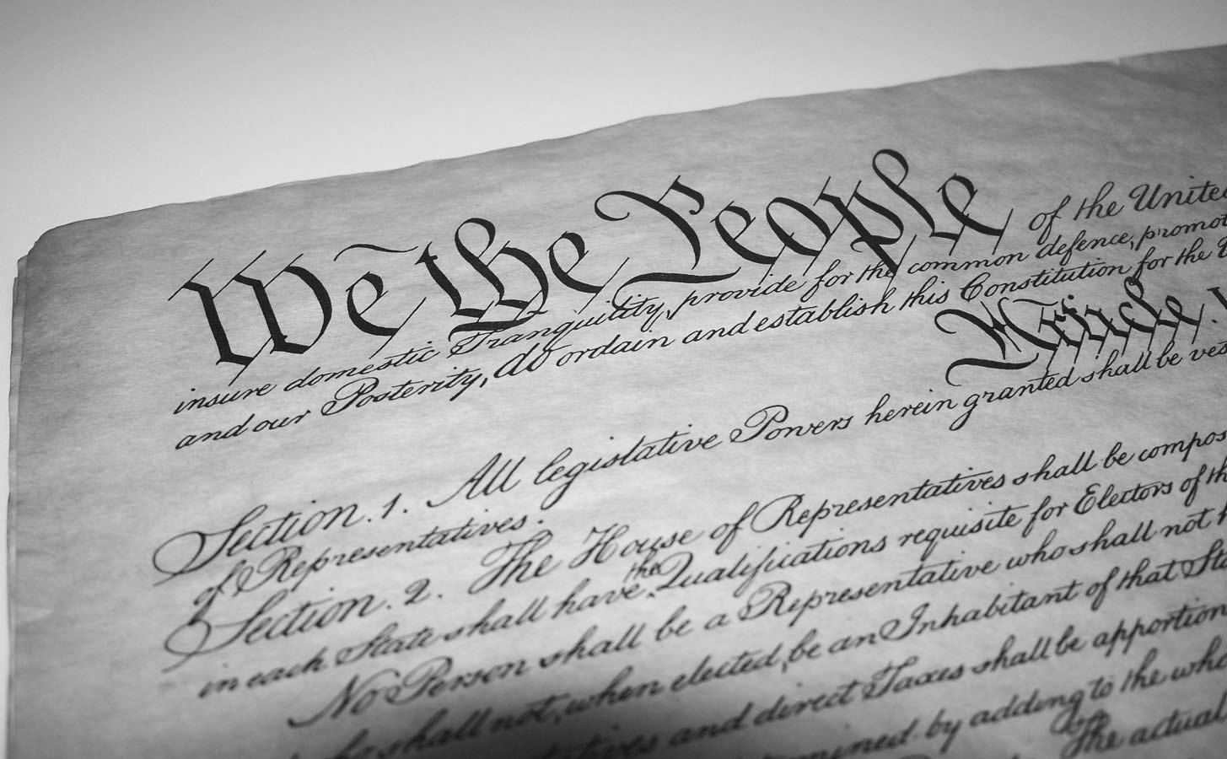
Origins of the State
Chapter 1-Section 1 (pg. 5-9)

Slide 2
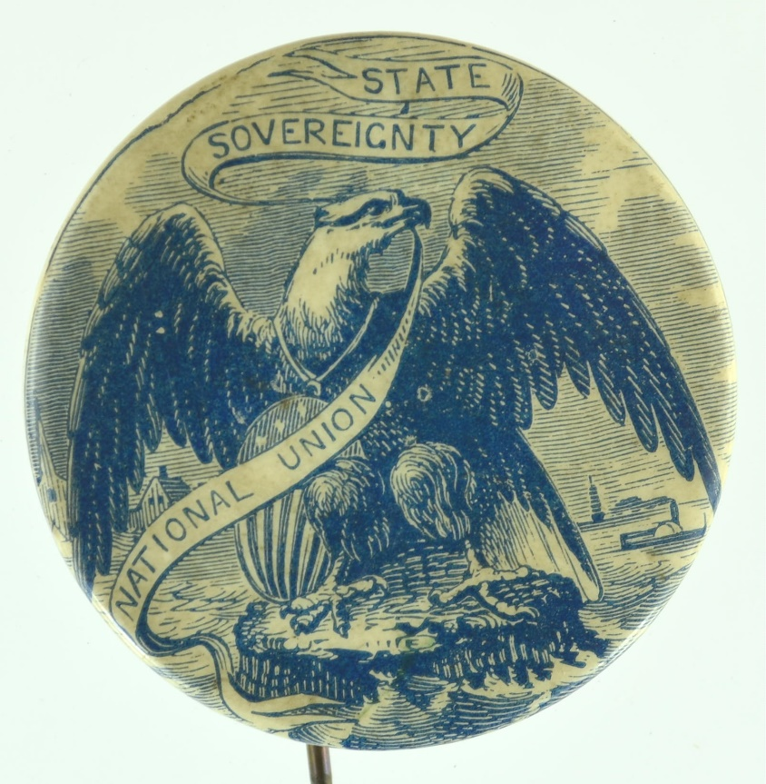
Origins of the State
  When established all the basic elements of a state exist
    Population
    Territory
    Sovereignty
    Government

Slide 3

Origins of the State
There are four theories as to how the idea of a “state” came to be
  The Force Theory
  The Evolutionary Theory
  Divine Right Theory
  Social Contract Theory

Slide 4
The Force Theory
Force Theory-The theory that when one person or one small group claims control over an area they forced all citizens living within it to submit to this groups rule

Slide 5
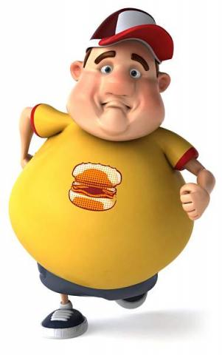




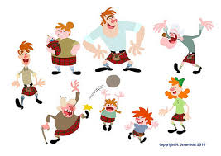
The Evolutionary Theory
The Evolutionary Theory- This theory states that the “state” emerged from the family model where the patriarch (head of the family) governed the family.
  Over time the original family became a clan, the clan then became a tribe and when the clan began farming they gave up nomadic practices thus becoming a “state”

Slide 6
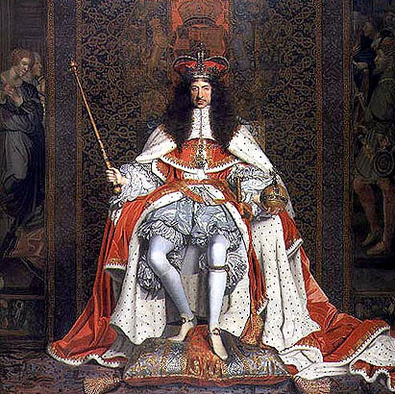
Divine Right Theory
The belief that God created the state and that God had given those of royal birth “divine power” to rule.
  The people were bound to obey their ruler as they would God
  To disobey the “divine right of kings” was considered both treason and a moral sin

Slide 7
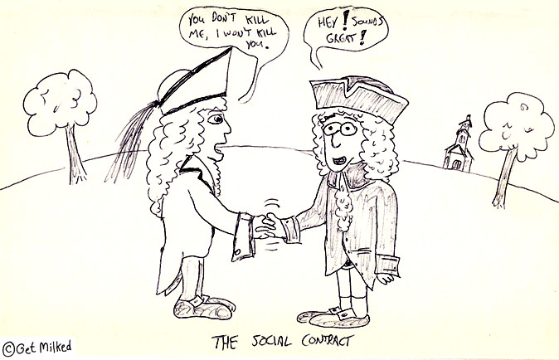
Social Contract Theory
The most significant of all the theories in terms of the American political system
  Best associated with the ideas of Thomas Hobbs that the state arose out of the voluntary act of free people.
  In this theory the states only purpose for existing is to serve the will of the people
  Basically citizens surrender a small amount of their freedom to ensure protection from the government

Slide 8
