Slide 1
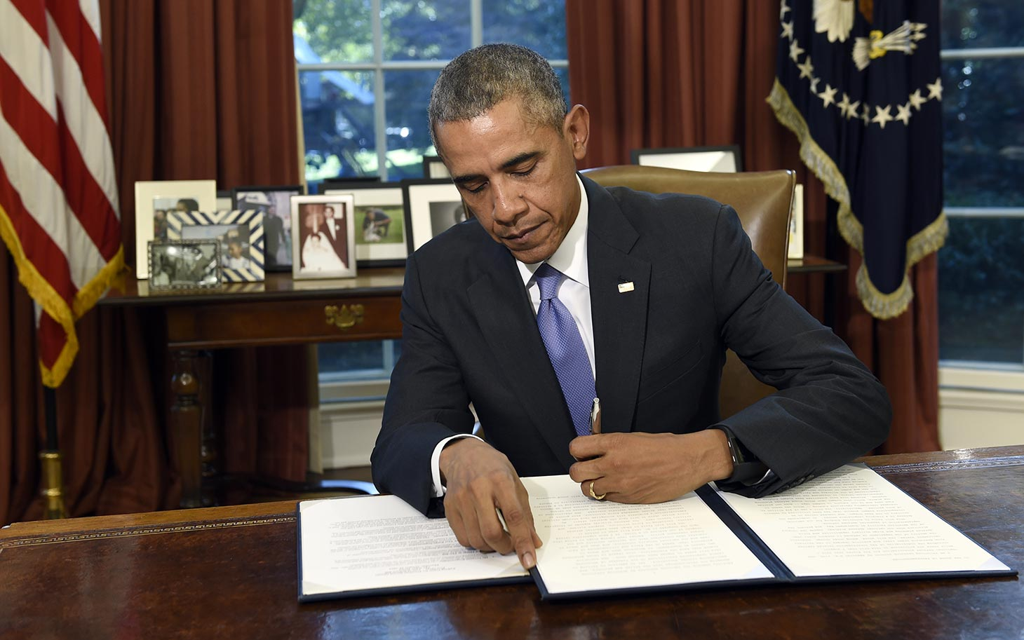
Change by Other Means
(Informal Amendments)
Chapter 3-Section 3 (pg. 85-88)

Slide 2
Informal Amendment Processes
Informal Amendment- The process by which over time many changes have been made in the Constitution which have not involved any changes in its written word.
The informal amendment process can take place by:
1.) The passage of basic legislation by Congress;
2.) Actions taken by the President;
3.) Key decisions of the Supreme Court;
4.) The activities of political parties
5.) Custom and usage

Slide 3
I. Basic legislation by Congress: 2 Ways
1) Passed laws that clarify several of the Constitution’s brief provisions
Ex: Article III, Section I only talks about having a Supreme Court and “such inferior courts a the Congress may from time to time ordain and establish”…. Congress passed the Judiciary Act in 1789 and since then, has created all the federal courts….
2) Congress has added to the Constitution by the way in which it has used many of its powers
Ex: Constitution says that Congress has the power to “regulate foreign and interstate commerce.”…Congress has passed thousands of laws about this so that they expanded the words of the Constitution

Slide 4
II. Executive Action
The way that presidents have used their powers has helped the Constitution to grow.
  Presidential actions such as the use of the military under the power of commander in chief.
Presidents add on to “executive power” based on what they think it means…. Thomas Jefferson took it to mean he can buy more land for the U.S. with the Louisiana Purchase in 1803, even though the Constitution doesn’t say he could
An executive agreement is a pact made by the President directly with the head of a foreign state and they do not need to be approved by Senate…
A treaty is a formal agreement between two or more sovereign states that needs to be approved by Senate

Slide 5
III. Court Decisions
The nation’s courts, most importantly the United States Supreme Court, interpret and apply the Constitution in many cases they hear.

Slide 6
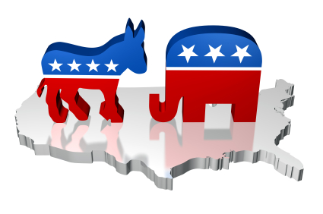
IV. Party Practices
No mention of parties in the Constitution
Ex: No method for nominating a person for the presidency
  Since 1830s, parties have held national conventions to do that
  Changed the purpose of the electoral college
  Congress conducts its business on the basis of parties
  President makes appointments to office based on parties

Slide 7
V. Custom and Usage
Custom: A traditional and widely accepted way of behaving or doing something that is specific to a particular society, place, or time.
Examples:
  Heads of the 15 executive departments make up the Cabinet
  Senate approves the presidential appointments who are acceptable to the senator or senators of the President’s party from the State involved
  “No-third term tradition” was started by George Washington and followed for over 150 years until 1940 and 1944 when President Roosevelt won a third and fourth term…so they added the 22nd Amendment limiting the President to two terms only

