Slide 1
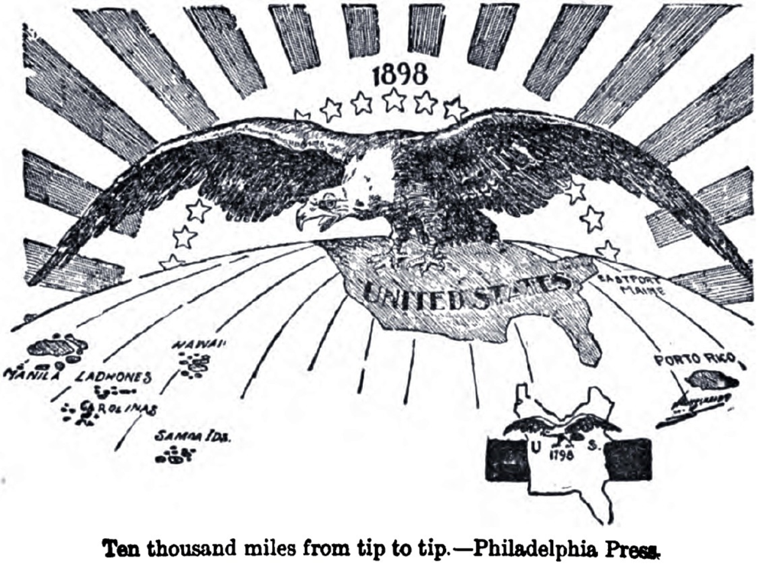
Chapter 10-Test Materials
America Claims an Empire

Slide 2
Short Answer Sentence Stems
19.)
  The concept of imperialism is _________.
  The main reason the United States was so interested in acquiring new territory was _______.
  The strategic territories the U.S. was looking to acquire were (*hint about which what islands we discussed in class)
  The three factors that fueled American expansionism were ____________, ____________, and ____________.
    The first factor ____________ fueled imperialism by
    The second factor ____________ fueled imperialism by
    The final factor ____________ fueled imperialism by

Slide 3
Short Answer Sentence Stems
20.)
  The main reason why the United States played a major role in guiding each nation was due to …
  The Foraker Act helped shape Puerto Rico’s government through __________
  The fact that the U.S. extended citizenship rights was important because______________
  The Platt Amendment helped preserve a place for the U.S. in Cuba despite our uneasy relationship by …..
  The Philippines were able to receive the status of a fully independent republic due to __________________

Slide 4
Short Answer Sentence Stems
21.)
  The theory behind the concept of “missionary diplomacy” is ….
  The main reason it differed from the U.S.’s previous policy of recognizing the sovereignty of a political nation was…
  The U.S. became involved in the Mexican Revolution due to the U.S. ___________ (supporting or disagreeing) with the Mexican government, leading to …..
  The main reason the U.S. became involved in chasing “Pancho” Villa in Mexico was …

Slide 5
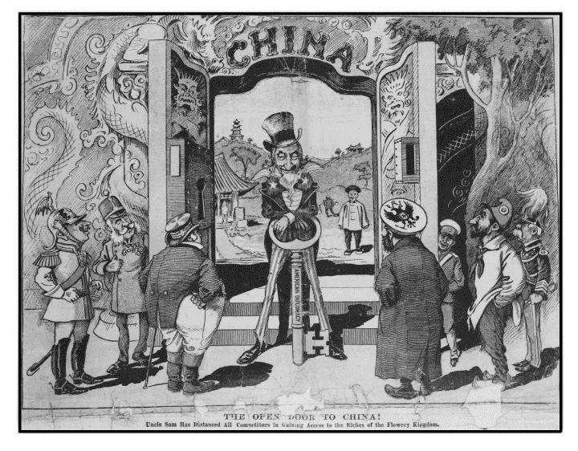

Slide 6
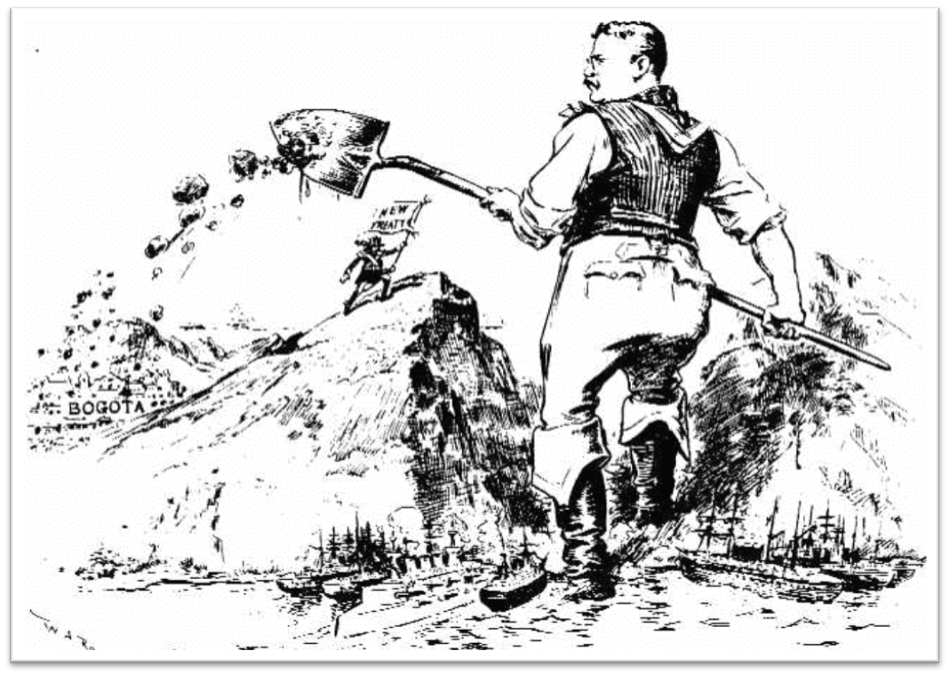

Slide 7
