Slide 1
Chapter 10
America Claims an Empire

Slide 2
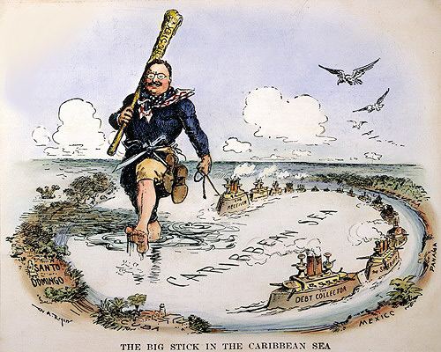
Chapter 10-Section 1
Imperialism and America

Slide 3
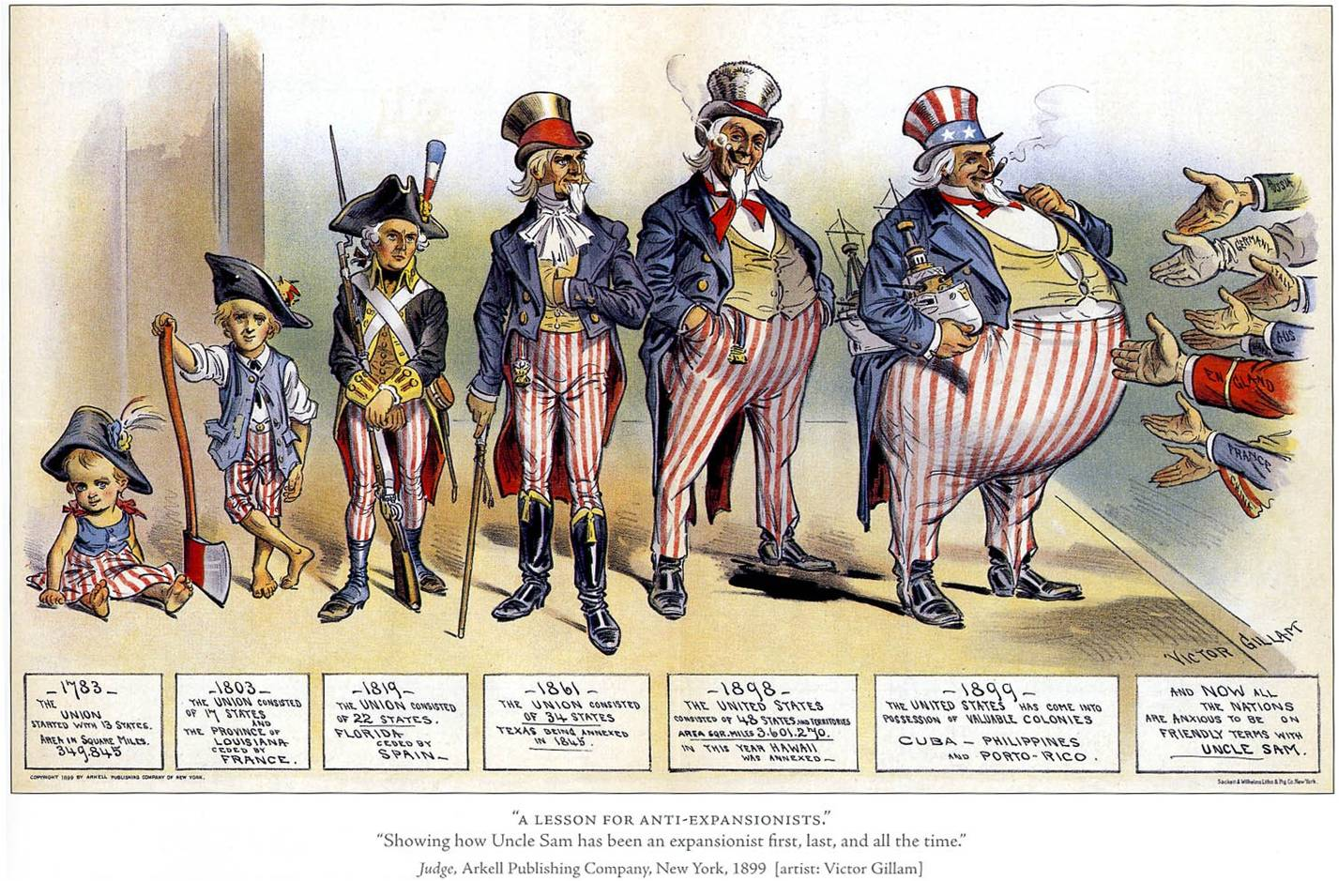
American Expansionism
Imperialism-The policy in which stronger nations extend their economic, political, or military control over weaker territories
Does expansionism differ? Why do we prefer to call it expansionism?

Slide 4
Three Factors Behind American Imperialism/Expansionism
The three driving factors behind the push for American Imperialism was:
  A desire for military strength
  A thirst for new trade markets
  A belief in cultural superiority

Slide 5
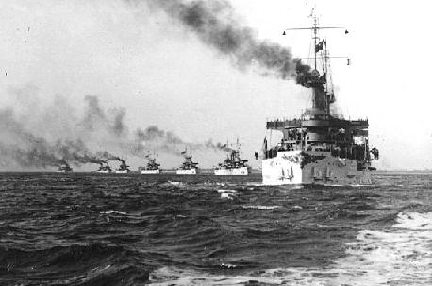
Desire for Military Strength
Other nations were establishing a military presence around the world
Alfred T. Mahan– Admiral in the US Navy
Urged the United States to strengthen the navy in order to compete with other nations

Slide 6
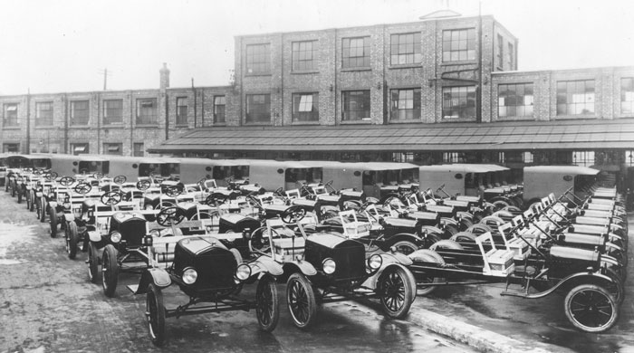
Thirst for New Markets
Advances in technology enabled farmers and factories to produce more than American citizens could use
Needed more raw materials for the factories
New markets to sell the goods to

Slide 7
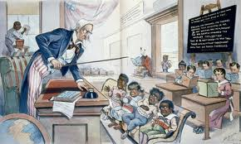
Belief in Cultural Superiority
Some people believed and argued that Americans had a responsibility to spread Christianity and their beliefs to other nations
Social Darwinism-A belief that free-market competition would lead to the survival of the fittest

Slide 8
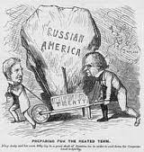
Alaska
Purchased in 1867 from Russia for only $7.2 million dollars
  Arranged by William Seward (Sec. of State under Abe Lincoln & Andrew Johnson)
Become a state in 1959
Rich in timber, minerals and oil

Slide 9
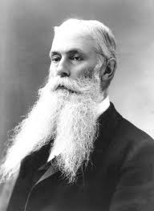
Hawaii
Pearl Harbor-1887 became a naval base and refueling station for American ships
Sugar plantations became a huge part of the Hawaiian economy
1898-Congress proclaimed Hawaii an American territory
Hawaii became a state in 1959

Slide 10
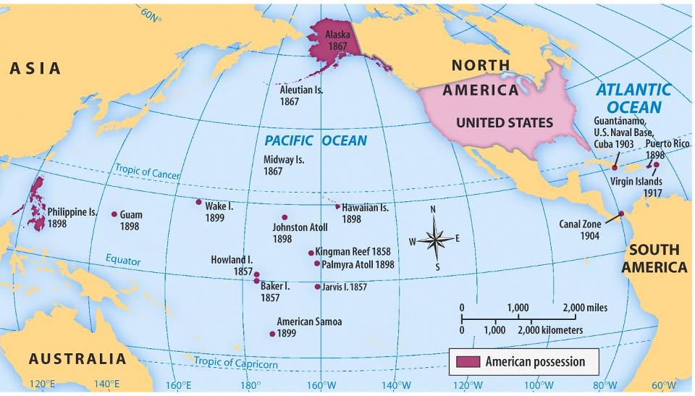
U.S. Imperialism in Hawaii
From 1820 to 1890, Americans moved to Hawaii as missionaries & fruit plantation owners
In 1891, Queen Liliuokalani came to power & tried to reduce the power of Americans living in Hawaii
Americans overthrew Queen Liliuokalani in 1893 & Hawaii was annexed by the USA in 1898

