Slide 1
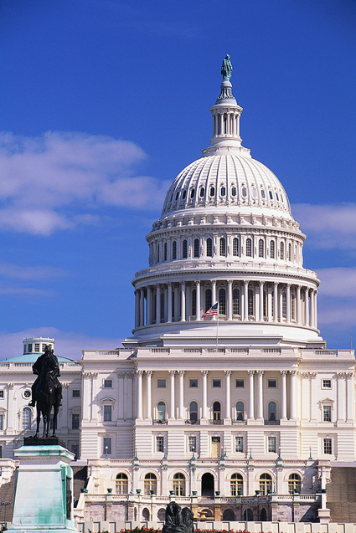
The Purpose of Government
Chapter 1-Section 1 (pg. 9-11)

Slide 2
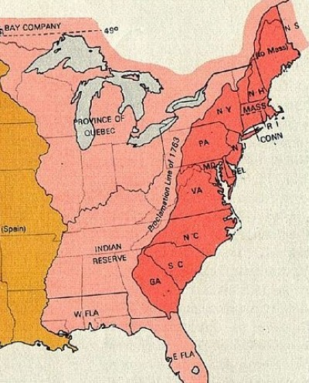
1. Form A More Perfect Union
Following the failure of the Articles of Confederation (1781) which created a weak central government our current Constitution was created (1787) in order to link the states together under the idea that “unity is our greatest strength”

Slide 3
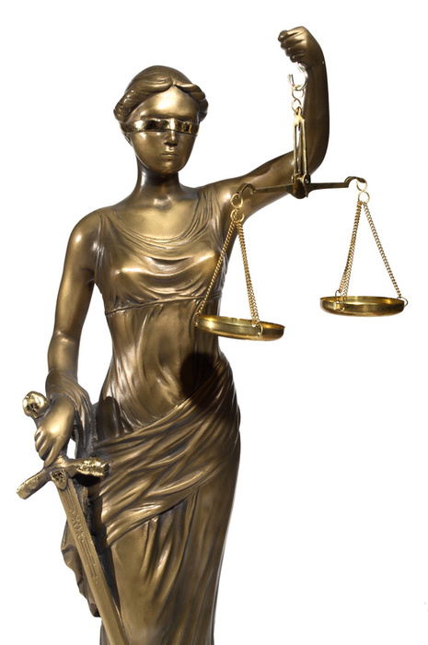
2. Establish Justice
Thomas Jefferson felt that providing justice is “the most sacred of the duties of government”
What does that mean:
The law in both it’s administration and content must be reasonable, fair and impartial”

Slide 4
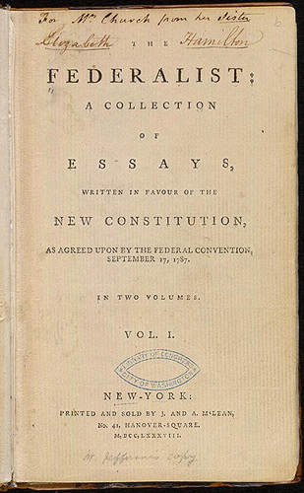
3. Insure Domestic Tranquility
The key to maintaining peace within our nation is establishing order. This is the prime function of government.
James Madison said in The Federalist Papers No. 51 that “If men were angels, no government would be necessary”

Slide 5
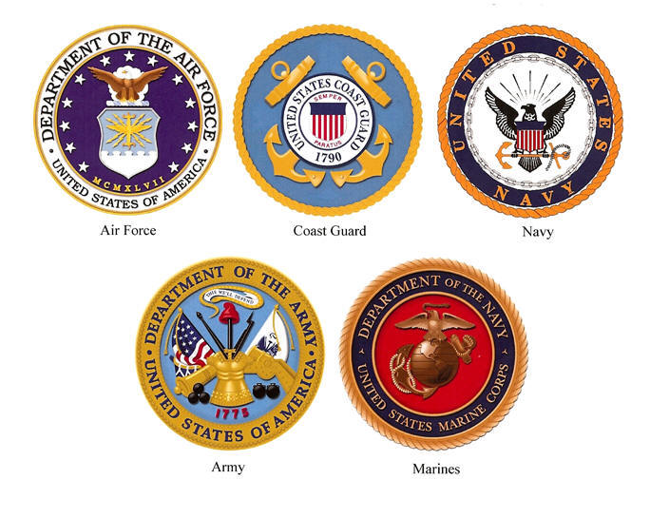
4. Provide for the Common Defense
Defending our nation from attacks both foreign and domestic has always been one of our government's chief responsibilities.
In order to maintain our safety our nation maintains an army, navy, air force and coast guard. While the department of Homeland Security keeps watch for threats entering our country.

Slide 6
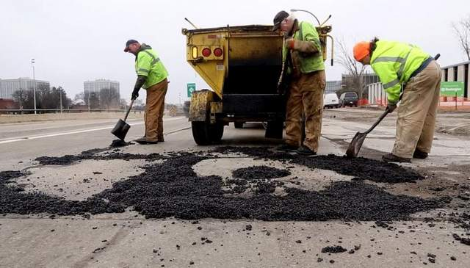
5. Promote the General Welfare
The services our government provides are designed to benefit all or most of our citizens.
Some examples are:
Improving education
Improving Roads
Lowering Taxes
Welfare
Disability
Social Security

Slide 7
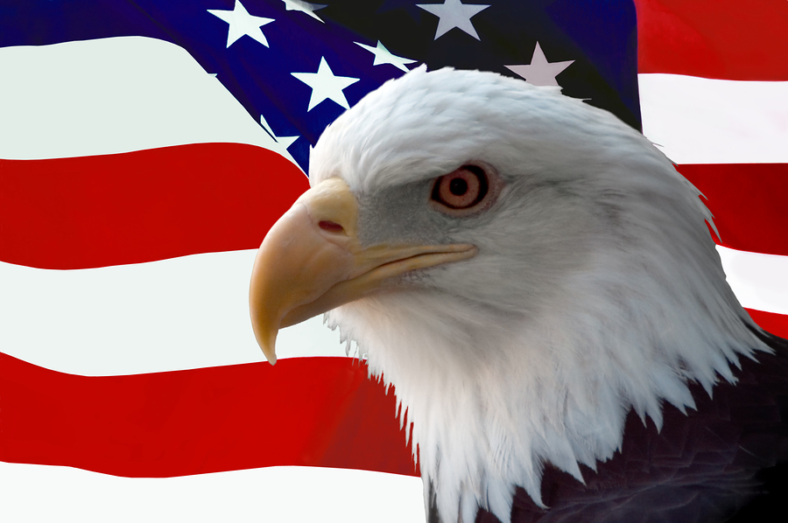
6. Secure the Blessing of Liberty
Although a high priority for our government is the ideas of freedom and liberty they are not considered absolute but relative.
People can not be free to do whatever they want because that would infringe on the freedom of others.
Both Federal and State Constitutions define the rights and liberties of for those living in our country.

