Slide 1
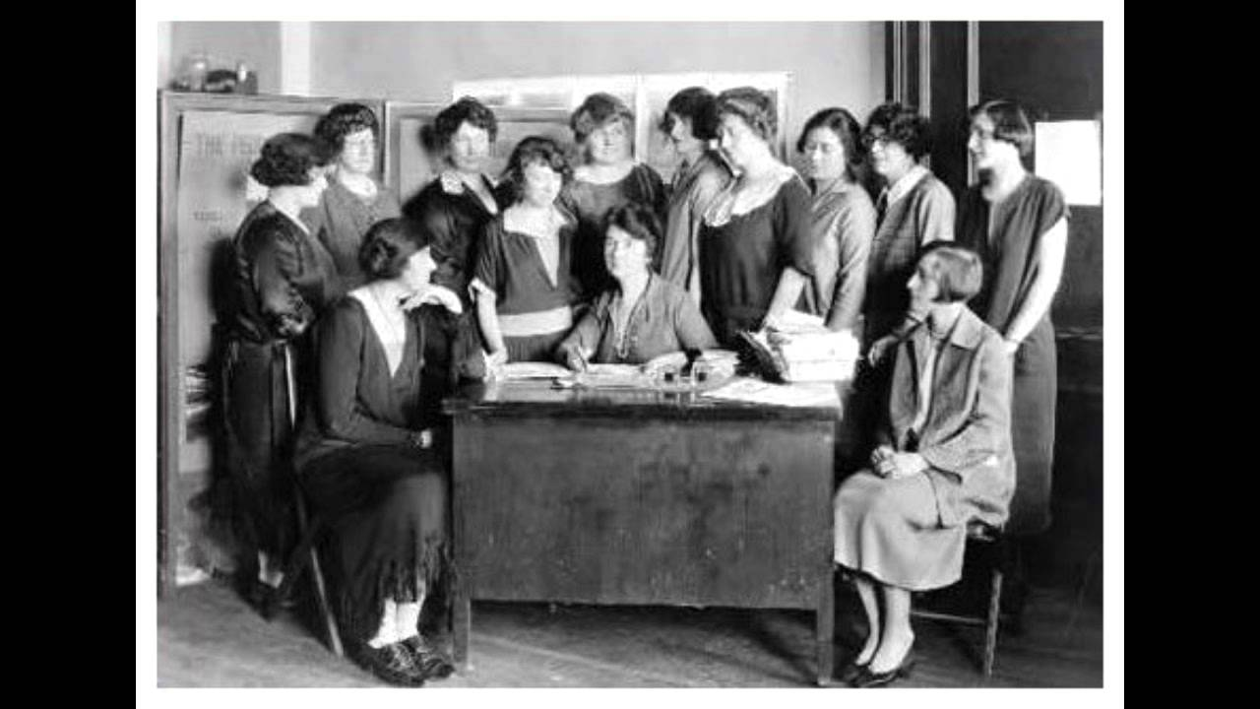
Women in Public Life
Chapter 9-Section 2

Slide 2
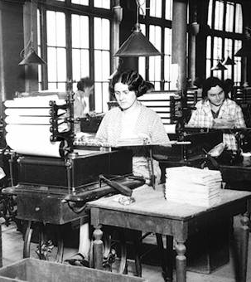
Women in Public Life
Before the Civil War, American women were expected to devote their time to home and family.
By the late 19th and early 20th century, women were visible in the workforce.

Slide 3
Domestic Workers
Before the turn-of-the-century women without formal education contributed to the economic welfare of their families by doing domestic work.
Altogether, 70% of women employed in 1870 were servants.

Slide 4
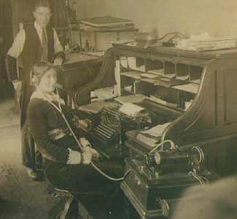
Women in the Work Force
Opportunities for women increased especially in the cities. By 1900, one out of five women worked.
The garment industry was popular as were office work, retail, and education.

Slide 5
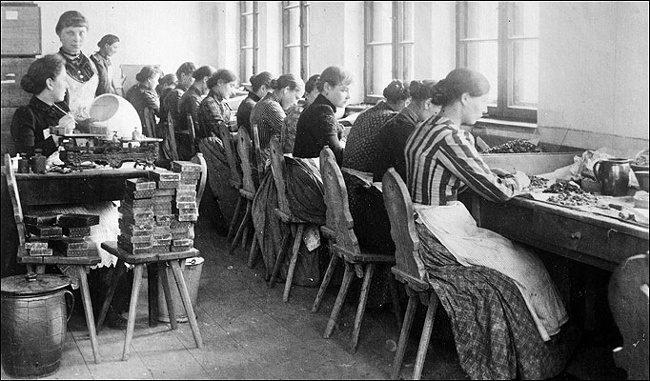
In the Factories
Women had found their way into the factories to help make money for their families
Often excluded from union membership
Often worked in garment industry
Paid about ½ as much as men
Some sought an education which would open more doors for them in the future

Slide 6
Women Lead Reform
Many of the leading Progressive reformers were women.
Middle and upper class women entered the public sphere after graduating from the new women’s colleges.
Colleges like Vassar and Smith allowed women to excel

Slide 7
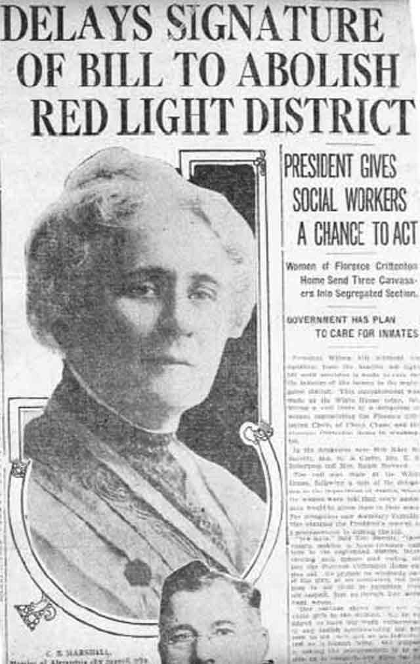
Women and Reform
Women reformers strove to improve conditions at work and home.
In 1896, black women formed the National Association of Colored Women (NACW).
Suffrage was another important issue for women.

Slide 8
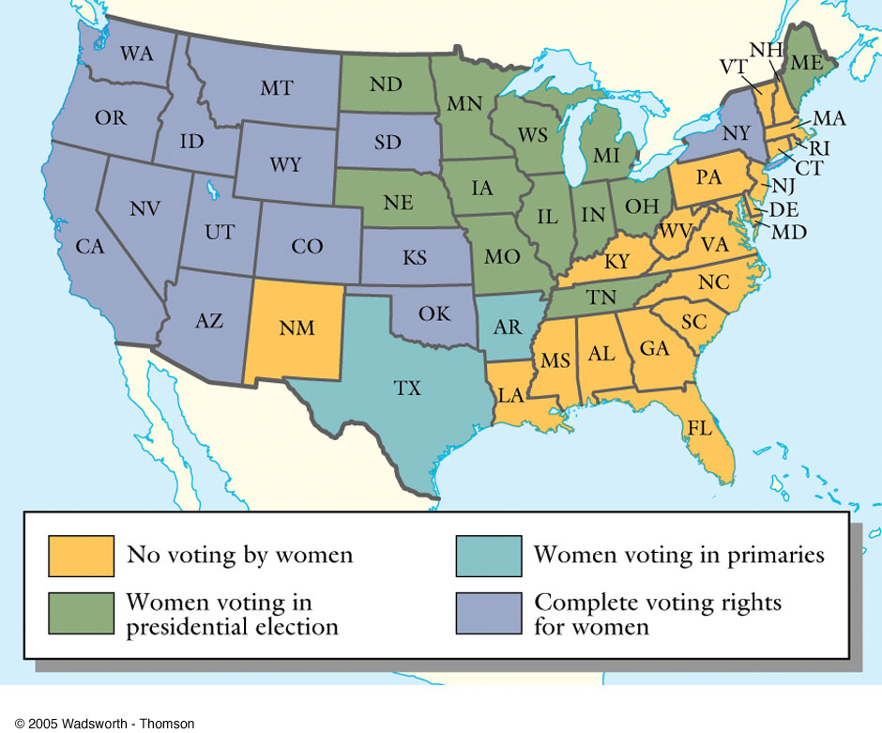
Woman Suffrage Before 1920
Notes:
Thomson Wadsworth Wadsworth.com

Slide 9
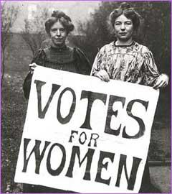
Three-Part Strategy for Winning Suffrage
Suffragettes tried three approaches to winning the vote:
Convincing state legislatures to adopt the vote.
Pursuing court cases to test 14th Amendment.
Pushing for a national Constitutional Amendment.

Slide 10
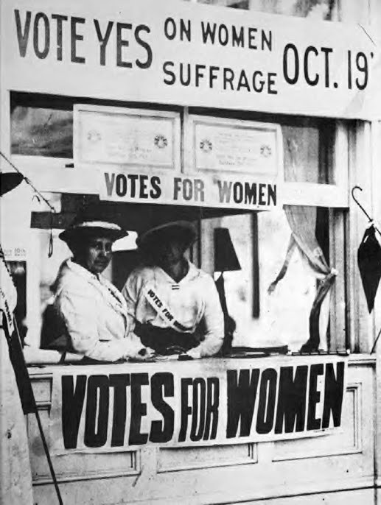
Women’s Suffrage
After a long hard fought battle for voting equality the 19th Amendment was finally passed in 1920 granting women full suffrage in all political elections

