Slide 1
Chapter 21-Civil Rights
Test Materials

Slide 2
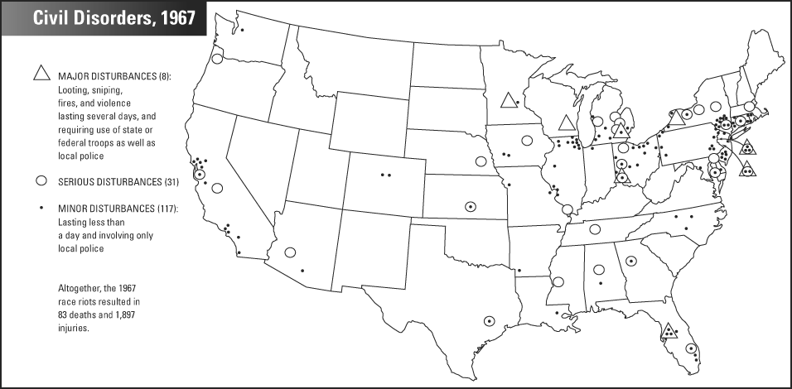

Slide 4
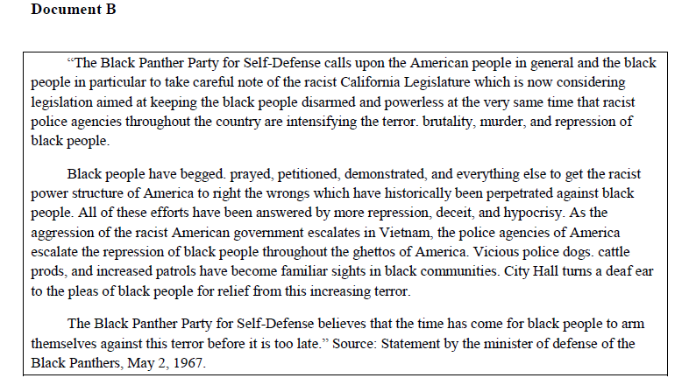
Primary Source

