Slide 1
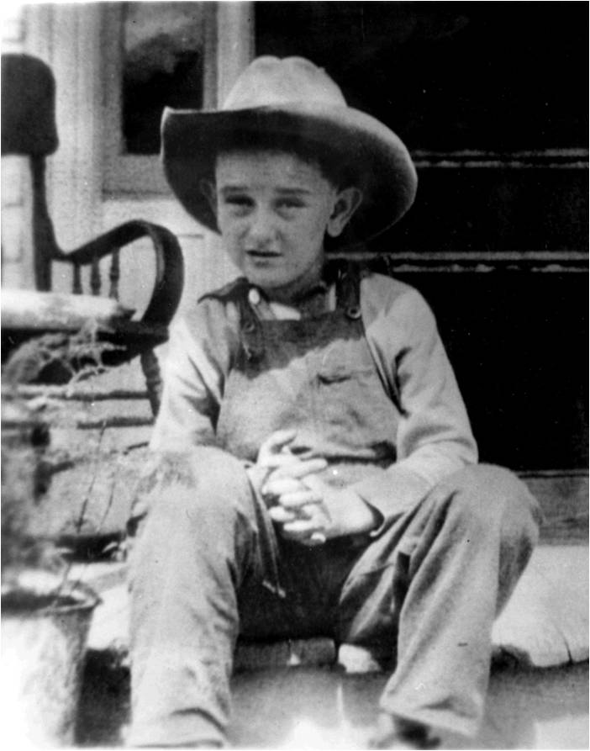
Chapter 20-Section 3-The Great Society

Slide 2
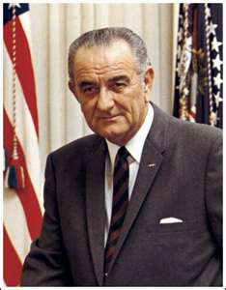
LBJ’s Path to Power
1963-VP LBJ comes to power
Southerner (From Texas)
Long time senator, supported the New Deal
Master politician
Worked for Civil Rights in Congress
Helped pass Civil Rights Act 1957
Picked up to even out ticket for election
Kennedy Strong in North, LBJ strong in South

Slide 3
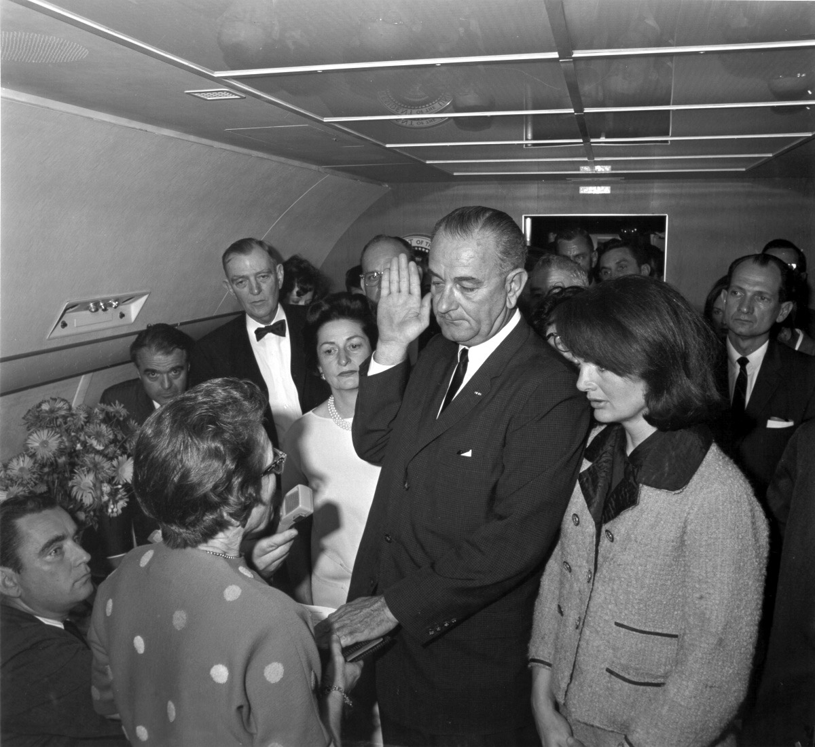

Slide 4
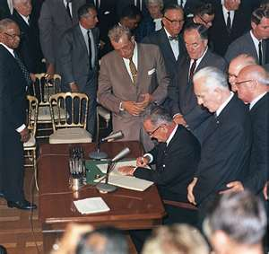
Johnson’s Domestic Agenda
Johnson as President
Focused on Domestic issues
Tax reduction
Increased spending, lowered budget deficit
Civil Rights Act of 1964
No discrimination based on personal background

Slide 5
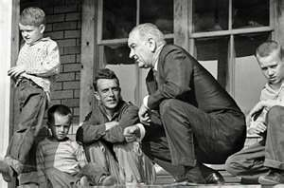
Johnson’s Domestic Agenda
War on Poverty
1964 Economic Opportunity Act
Job Corps
Volunteers to Service America (VISTA)
Offered a head start
Community Action Program:
Poor take part in public works

Slide 6
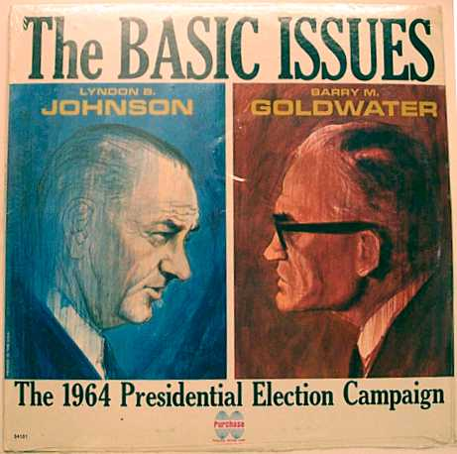
Johnson’s Domestic Agenda
1964 Election: Will LBJ be elected for his own term?
Democrats: LBJ
Most are happy with America’s direction under LBJ
Republicans: Goldwater
Goldwater scares people: Nuke happy
LBJ wins by landslide:
61% of the popular vote
486 electoral votes

Slide 7
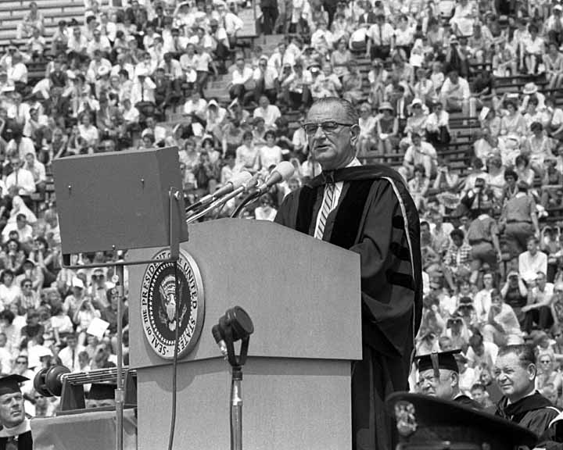
Building the Great Society
Great Society
1964 -LBJ’s shares his vision for America during a speech at U of M
Education
Elementary and Secondary Ed Act provides more money for students
Healthcare
Establish Medicare and Medicaid
Health care for old, poor, and infirmed

Slide 8
Building the Great Society
Housing
More people moving to cities
Developed low cost housing
Created Dept. of Housing and Urban Development
Robert Weaver first app. of an Af/Am cabinet member
Immigration
Immigration Act of 1965
Finally ends quotas, open doors

Slide 9
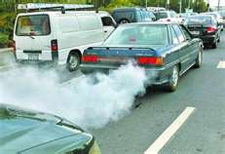
Building the Great Society
Environment
Silent Spring: Carson
Woke up the world to pest. and pollution
Consumer Protection
Ralph Nader: Unsafe at any Speed
Criticized the auto industry
Helped pass safety standards
Wholesome Meat Act of 1967

Slide 10
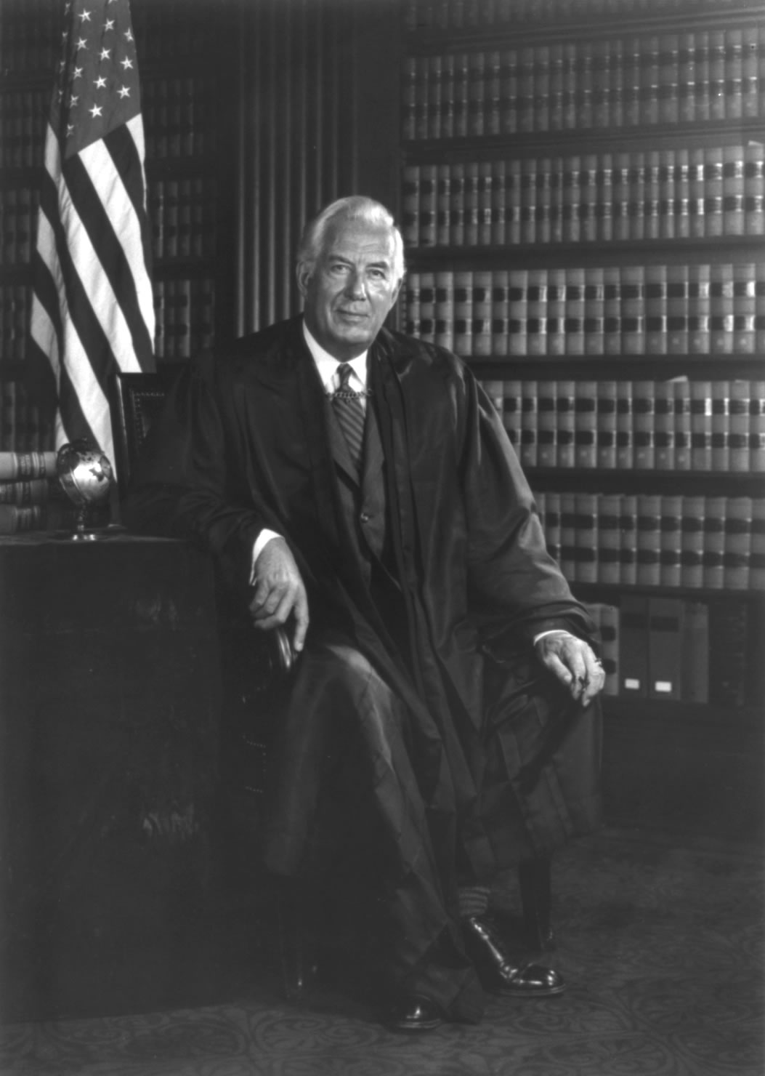
Reforms of Warren Court
Chief Justice Warren
Rights of the individual
No prayer in school
Loyalty oaths unconstitutional
Less censorship
Reapportionment
Constructed district lines so elections would be more fair

Slide 11
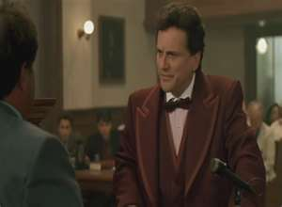
Reforms of Warren Court
Baker v. Car:
States had the right to reapportion districts to ensure equal representation
Mapp v. Ohio:
Illegally seized info could not be used against you
Gideon v. Wainwright
Free counsel if you cannot afford it

Slide 12
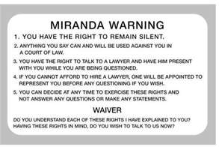
Reforms of Warren Court
Escobedo v. Illinois
Lawyer present during questioning
Miranda v. Arizona
Defendants are read rights before questioning
Some people said this protected, others questioned giving rights to criminals

