Slide 1
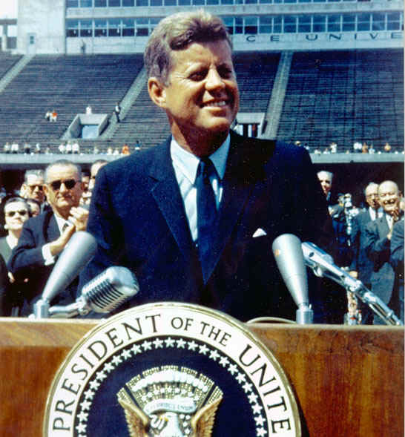
Chapter 20-Section 2-The New Frontier

Slide 2
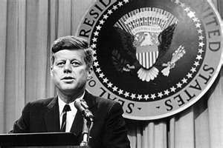
The Promise of Progress
Kennedy claimed we were on the edge of a New Frontier
Goals: Explore new sciences and end poverty
Congress was against JFK and his liberal ideas
JFK did not have the power to sway Congress but he did-
Increase national defense
Provide international aid
Fund space program

Slide 3
The Promise of Progress
Stimulating the Economy-
JFK increased spending and lowered taxes
Increased military spending
Increased minimum wage to $1.25

Slide 4
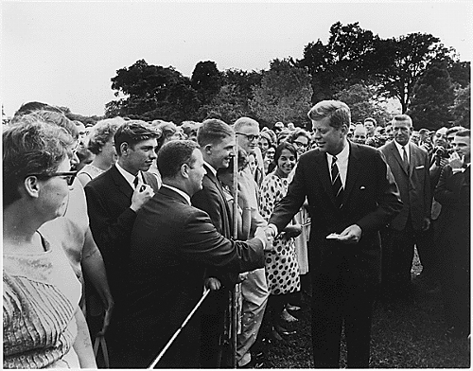
The Promise of Progress
Peace Corps created
Critics called it Kennedy’s Kiddie Korps
Helped underprivileged countries
Alliance for Progress
Economic and technical assistance to L. A.
Created plans to stop communism

Slide 5
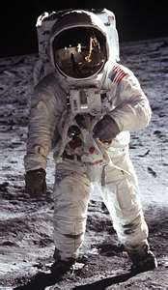
The Promise of Progress
Race to the Moon
Russia beat us to space and for the first man
NASA went into high gear
July 20, 1969 we landed on the moon (or did we?)
Neil Armstrong was the first man on the moon
“One small step for man, one giant leap for mankind”

Slide 6
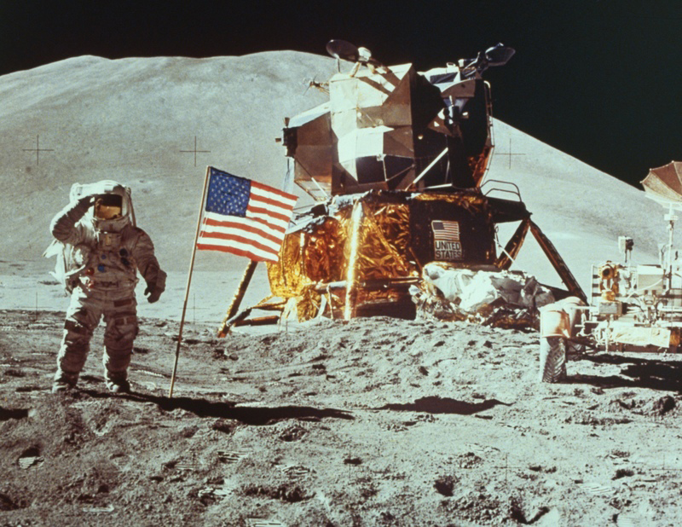

Slide 7
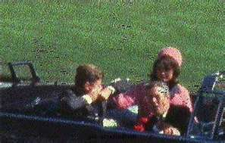
The Tragedy in Dallas
Dallas, TX-Nov. 22nd, 1963
JFK is assassinated while riding in a motorcade
Lee Harvey Oswald arrested
Ex. Marine and communist supporter
LBJ becomes President

Slide 8
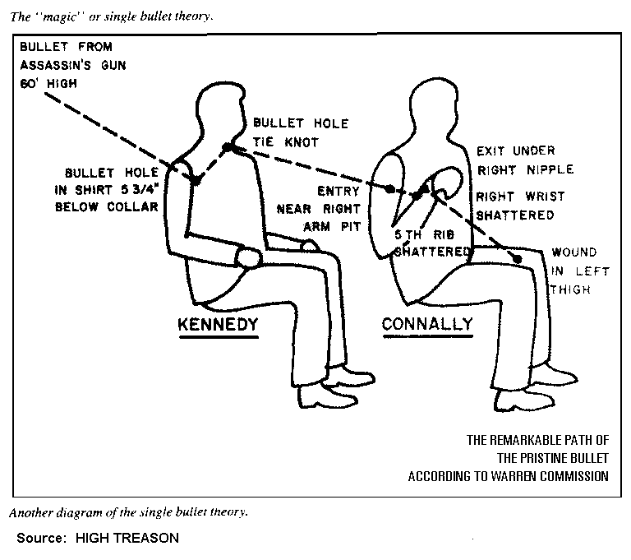

Slide 9
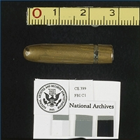
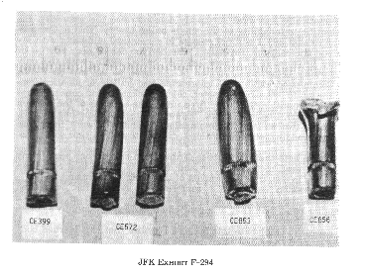
Magic Bullet Theory
What it should look like
What it looks like

Slide 10
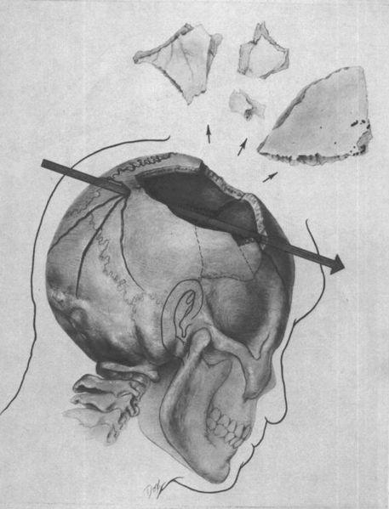
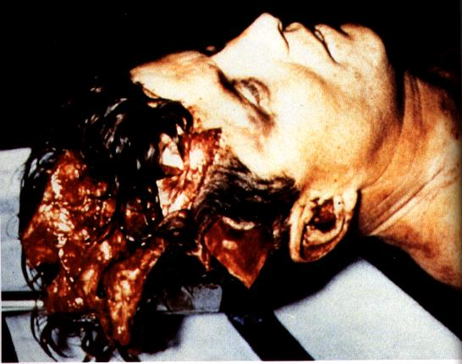

Slide 11
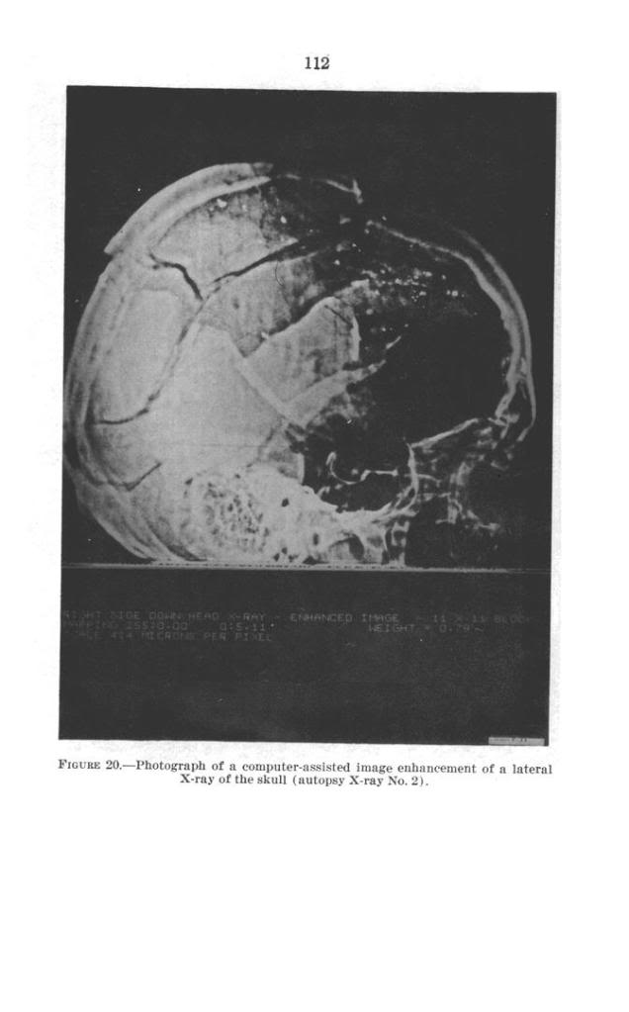
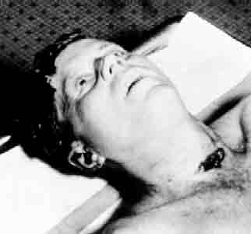

Slide 12
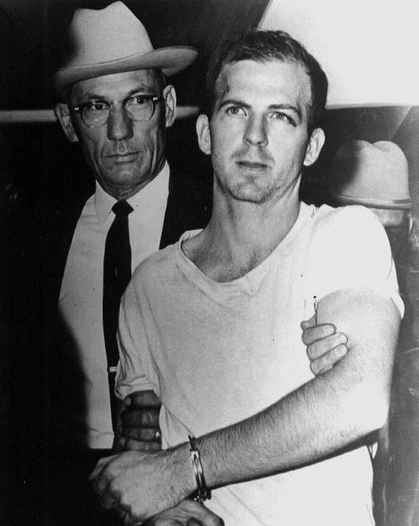
The Tragedy in Dallas
Was there a conspiracy behind who shot Kennedy?
Warren Commission says Oswald acted alone
Killed while being transported between jail by Jack Ruby
Never gets to defend himself
JFK’s assassination proved that America could remain strong during hard times

Slide 13
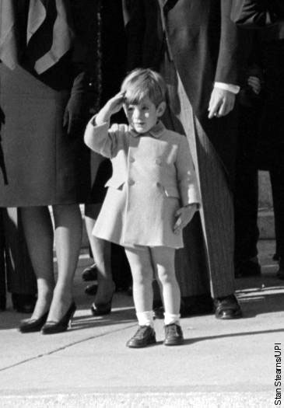
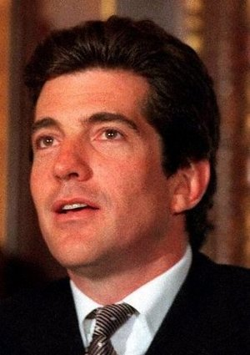
JFK Jr.

