Slide 1
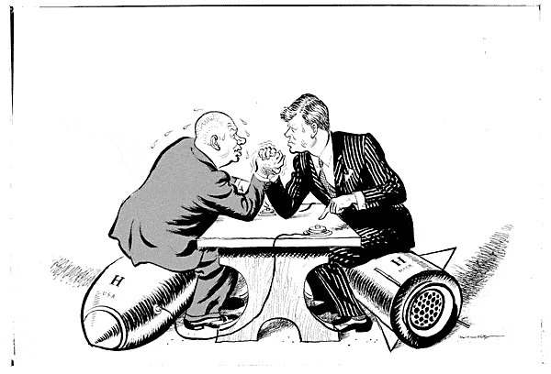
Chapter 20-Section 1-Kennedy and the Cold War

Slide 2
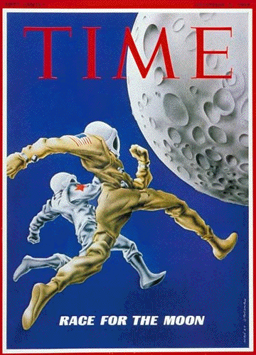
The Election of 1960
Eisenhower’s term comes to an end in 1959
The country was in a recession
We lost the race to space
U-2 was shot down
All of these things led to an anti-republican backlash

Slide 3
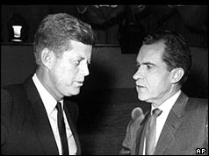
The Election of 1960
Democrats: JFK
Rich, Catholic, young, WWII vet
Republicans: Nixon
WWII vet, looked old compared to Kennedy
Seemed shady b/c of past problems
1960 Election was first broadcast election
TV Debates made the election
Kennedy won, but not by much

Slide 4
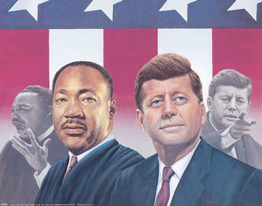
The Election of 1960
Major Issue in 60: Civil Rights
Kennedy called Martin Luther King Jr.’s wife when he was arrested in Birmingham
RFK got him released from the jail
JFK looked like he really cared about civil rights and won the African American Vote

Slide 5
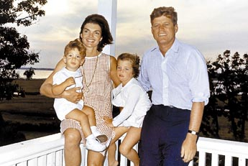
The Camelot Years
Camelot
JFK=Hope b/c of youth
The time he was in office is called Camelot
Jackie and Jack were thought to be perfect
They were what every American wanted to be

Slide 6
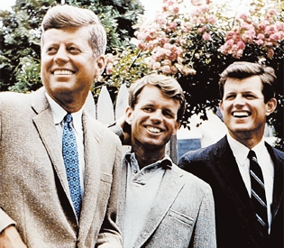

Slide 7
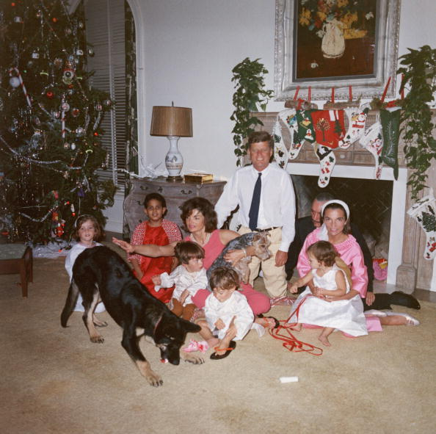

Slide 8
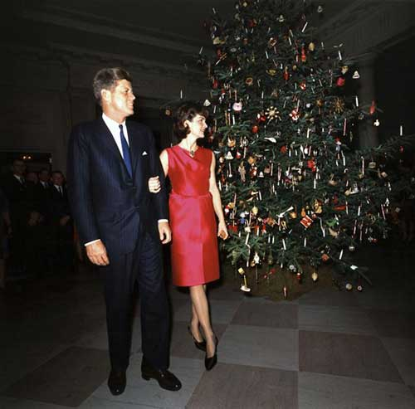

Slide 9
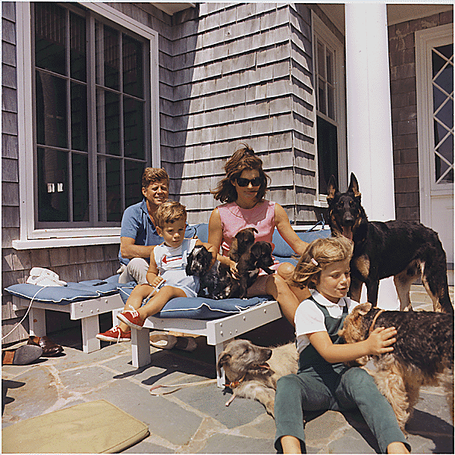

Slide 10
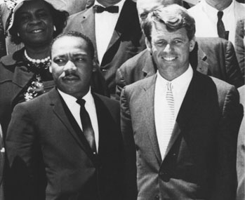
The Camelot Years
Best and Brightest
JFK picked the best people for his cabinet
Robert McNamara came over from Ford
Robert Kennedy as attorney General
They represented youth and intelligence
They were going to create the new Camelot

Slide 11
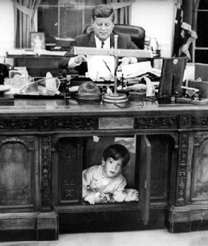
A New Military Policy
Military
Military was a major issue for JFK
Needed new way to fight communism
End to massive retaliation
Begin FLEXIBLE RESPONSE

Slide 12
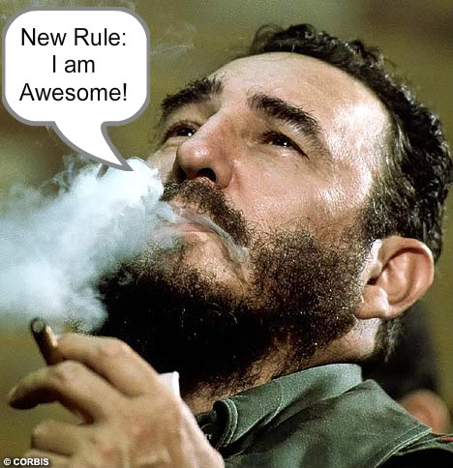
Crisis Over Cuba
Cuba
Kennedy’s testing ground
1959- Fidel Castro takes power
He is communist and Cuba is way too close to home
Castro took American homes and businesses
We had to do something

Slide 13
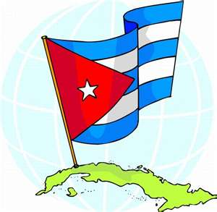
Crisis Over Cuba
U.S. Action: Bay of Pigs
Started under Ike
1961- Invaded Cuba using Cubans
25,000 Soviet and Cuban troops
Invading force defeated
Kennedy had to pay $53 million in food and medical supplies in exchange for men
U.S. and JFK embarrassed, look weak

Slide 14
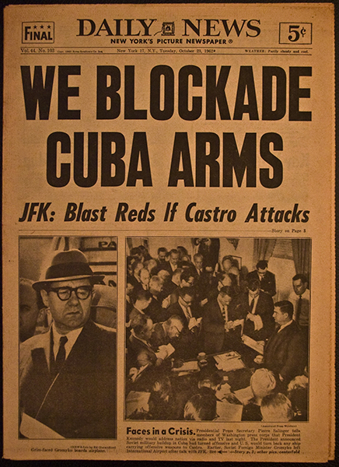
Crisis Over Cuba
Cuban Missile Crisis
Khrushchev promises to defend Cuba
Starts putting Nuclear weapons there
U2 spots missiles: America takes Action
Quarantine of Cuba: 1962
100,000 US troops on standby
Result: Russia took out missiles and we agreed not to invade Cuba
We realized how close we came to another war

Slide 15
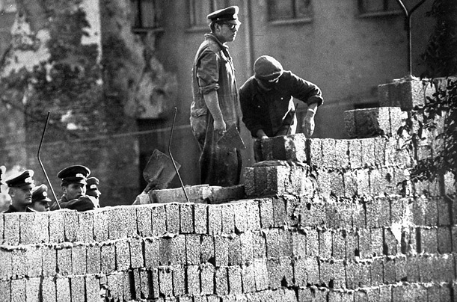
Crisis Over Berlin
Berlin
1961 Berlin wall built
Khrushchev built it because JFK refused to back down
Russia threatened to shut off American supported W. Berlin
It stands the dominant symbol of the cold war until 1989

Slide 16
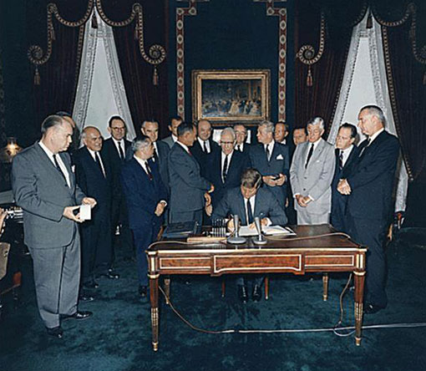
Crisis Over Berlin
Close Calls
The 1960’s were full of close calls
There was a realization of the need for peace
Limited Test Ban Treaty passed
Barred nuclear testing in atmosphere

