Slide 1
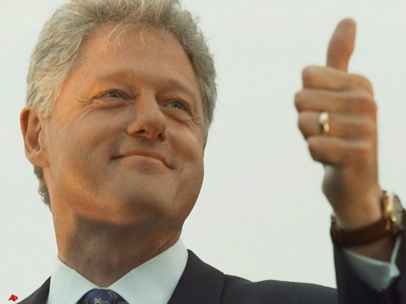
Chapter 13 and 14-Test Materials
Chapter 13-The Presidency and Chapter 14-The Presidency in Action

Slide 2
Political Cartoon #1

Slide 3
Political Cartoon #2

Slide 4
Political Cartoon #3

Slide 5
Primary Source

