Slide 1
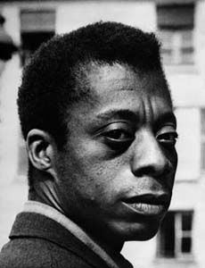
Section 4-The Other America

Slide 2
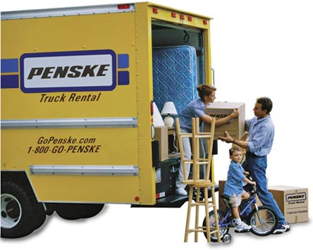
Urban Poor
Not everyone found the American Dream
Poor class starts to rise up
White Flight- Leaving city for suburb
Rural poor moved to cities
Cities were robbed of tax payers

Slide 3
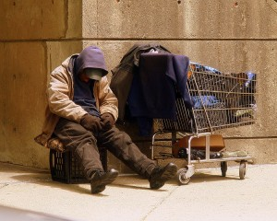
Inner Cities
Suburbanites did not see what was happening
Minimum income level rose every year
People were in trouble
Book: “The Other America”: Harrington
Told the story of poverty in America

Slide 4
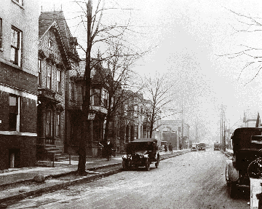
Inner Cities
Fixing Poverty-
Urban Renewal
National Housing Act of 1949
Decent home for every family
Tear down rundown houses
New Cabinet position -Housing on Urban Development
People displaced
Black Bottom in Detroit for I-75

Slide 5
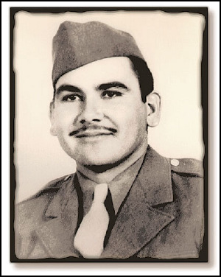
Poverty Leads to Activism
Minorities began to speak out on their behalf
Mexicans:
1942-U.S. initiated program of braceros (hired hands) many stayed and hoped to make a go of U.S.
The Longoria Incident
Felix Longoria-WWII hero: Mexican
Killed in war, town would not bury him
Foundations were started to help fight for rights

Slide 6
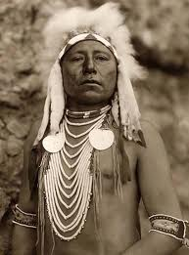
Poverty Leads to Activism
Native Americans
1924-Got citizenship and right to vote
1934-Assimilation stopped and gave Natives autonomy
1944-National Congress of Native Americans ensure civil rights to retain customs on reservations
Native Americans served with honor in WWII and deserved respect

Slide 7
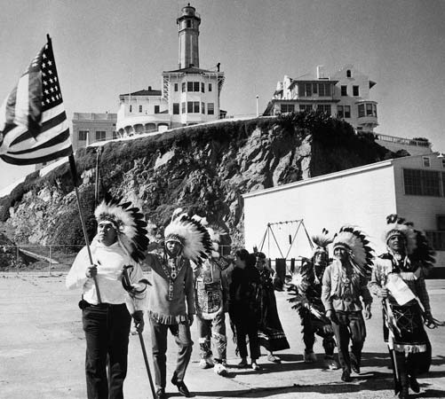
Poverty Leads to Activism
Termination policy
1953-The U.S. would no longer financially support reservations
Natives tried to find places for their people
U.S. government let the Natives down
Not a proud moment in our history ☹

