Slide 1
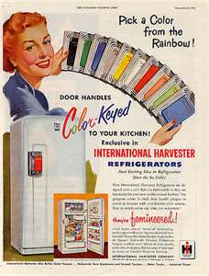
Section 2- The American Dream in the Fifties

Slide 2
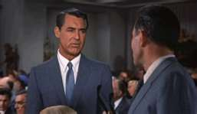
The Organization and the Organization Man
As 1950’s moved forward, there were more White Collar jobs
Service industry jobs increased, especially in advertising

Slide 3
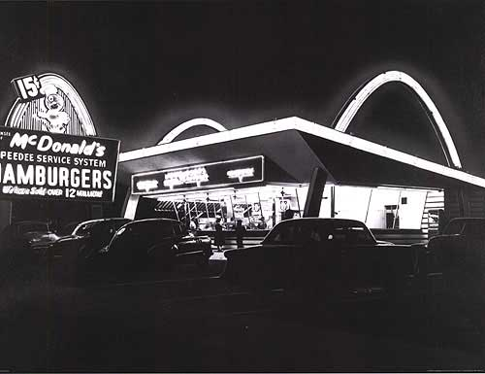
The Organization and the Organization Man
Conglomerates:
Major company that owns smaller ones in unrelated fields
It was a way to help when your company had hard times
Franchising
Similar products in different locations
Right sold to an individual to do business
Ray Kroc:
McDonalds: He bought it from the brothers for 2.7 million
Added the mythic “Golden Arches”

Slide 4
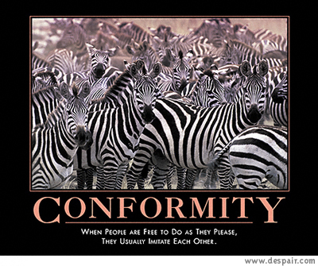
The Organization and the Organization Man
Social Conformity
Standardized what people ate and the way they worked
Loss of individuality
“The Organization Man”: William H. Whyte
Company People: fitting in to corp. culture
Rewards for teamwork, cooperation, loyalty

Slide 5
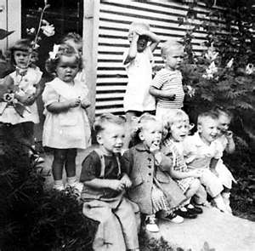
The Suburban Lifestyle
1950-Job security may have cost individuality but provided “good things”
Highways and cars led to Suburbs
Baby Boom:
1957-1 infant born every 7 seconds
Created the largest generation in US history
Cause-Depression, War, Better medicine and childcare

Slide 6
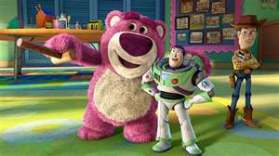
The Suburban Lifestyle
Advances in Medicine- New Drugs to help kids
Dr. Jonas Salk
Vaccine for Polio
Dr. Benjamin Spock: Books on childcare
Wanted gov. to pay moms for staying home
Effects of Baby Boomers-
Toy Sales boomed!
New schools had to be built

Slide 7
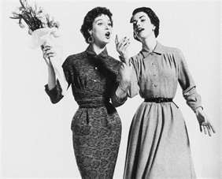
The Suburban Lifestyle
Women’s Roles-
Glorified women’s place in home
TV, magazines, everything said, women should be at home
Some women started to speak out and say it was isolating them
Betty Friedan: The Feminine Mystique
As we neared the 60’s women were taking jobs outside of home, but sometimes stereotypical
Women earned less
Often limited to teaching, nursing, and office jobs
Were not pushed to go to college

Slide 8
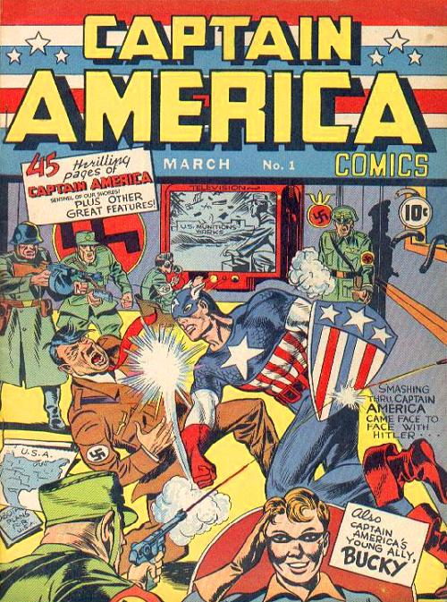
The Suburban Lifestyle
Leisure in the Fifties-
More time then ever before
More labor saving devices then before
More time for sports and games
Readers: Do it yourself, comic books, mysteries

Slide 9
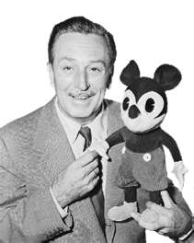
The Automobile Culture
Automania-
After the war the car defined America
Suburbs made car and highways necessary
Interstate Highway Act 1956
Helped some towns, killed others
New vacation ideas popped up due to car
Disneyland in CA-1955
Had negative effects too
Environment, traffic, noise, flight from cities
Created a gap between rich and poor
Increased advertising

Slide 10
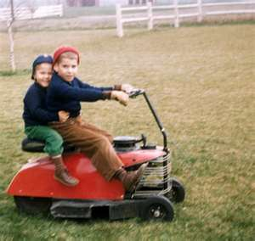
Consumerism Unbound
Consumerism
1950’s Success = Hundreds of new products
TV, tape recorders, HIFI record players
Clothes just for fun
Power mowers, BBQ, lawn decorations!

Slide 11
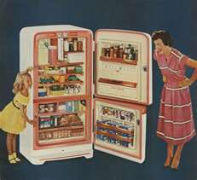
Consumerism Unbound
Planned Obsolescence
Wear out or become obsolete on purpose to get us to buy more
New models every few months
We become a throwaway Society

Slide 12
Consumerism Unbound
Credit
1950- Very 1st Credit Card: Diners Club Card
1958-American Express
Bought large items on installment plans
Increase in mortgages
Private debt grew from $73 billion to $179 billion

Slide 13
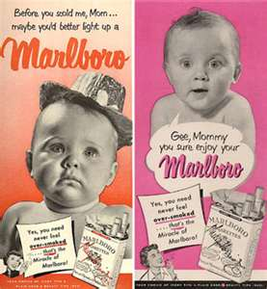
Consumerism Unbound
Advertising Age-
Encouraged more spending
Billions of dollars a year on advertising
Used psychology to convince you what you need
TV commercials became main way to convince you

