Slide 1
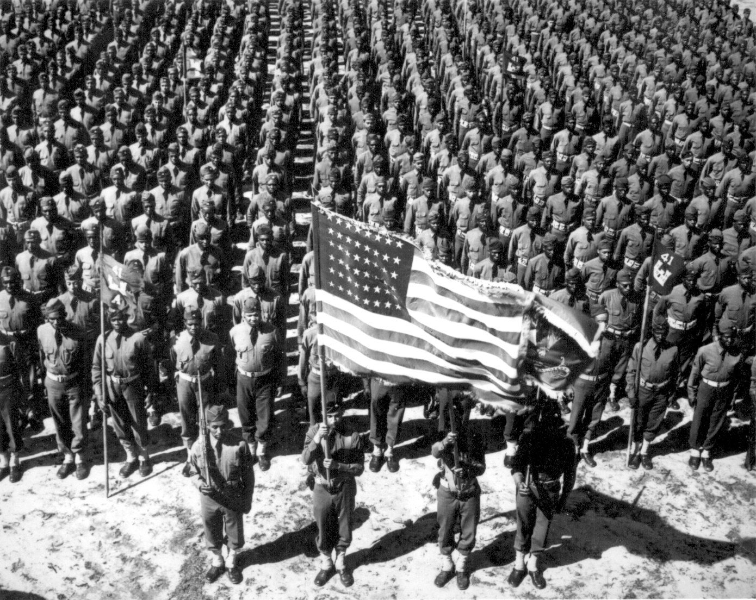
The United States in WWII
Chapter 17

Slide 2
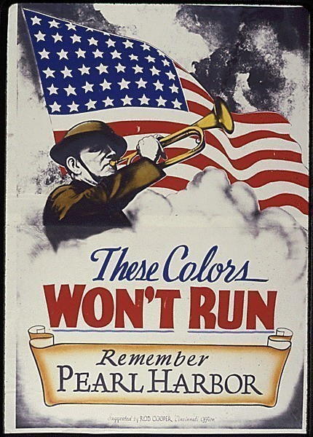
Section 1-Mobilizing for Defense

Slide 3
Americans Join the War Effort
Japan felt that we would shrink after the attack, but the opposite happened
America prepares for war

Slide 4
Americans Join the War Effort
-Selective Service Act: 10 million additional
soldiers added to the military
Rushed basic training to get them ready
Everyone was included = racial tension.
Why should African Americans fight for country that will not give them rights?

Slide 5
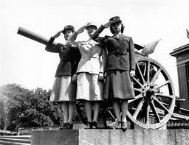
Americans Join the War Effort
Expanding the Military
Effort headed by General George Marshall
Included women: Women’s Auxiliary Army Corps (WAAC)
Nurses, ambulance drivers, noncombat

Slide 6
Americans Join the War Effort
Dramatic Contributions
Many people sacrificed everything to defend their country
Even with discrimination, many went
Asians, Mexicans, African-American’s
Not always treated fairly in military, but were extremely important to war effort.

Slide 7
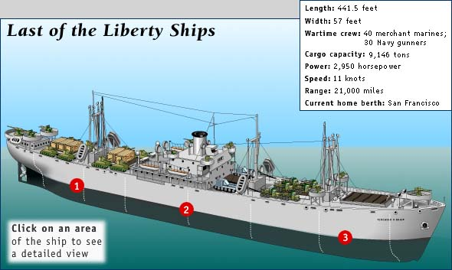
A Production Miracle
Production Miracle:
Everyone had a part to play in the war
1942-The last car was produced for private use
Didn’t even have chrome
Plants remodeled to make war goods
Soda pop companies, filled shells
Henry Kaiser: built navy ships
One every four days

Slide 8
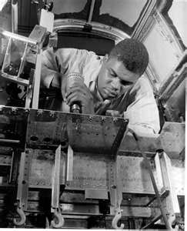
A Production Miracle
Labor’s Contribution:
18 million in factories
6 million women
Out preformed everyone's expectations
2 million minority workers
Factories at first wouldn't hire African Americans

Slide 9
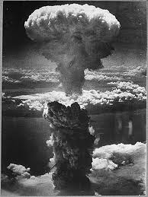
A Production Miracle
Mobilization of Science:
Office of Scientific Research and Development
Radar
Sonar
Health (lice)
Penicillin
Development of Atomic Bomb
Manhattan Project

Slide 10
The Federal Government Takes Control
Federal Government Takes Control:
Had to control economics
Office of Price Administration
Price freezes
Raise income tax
Workers don’t have a lot of $ to spend
If people had money, the gov. wanted them to buy war bonds

Slide 11
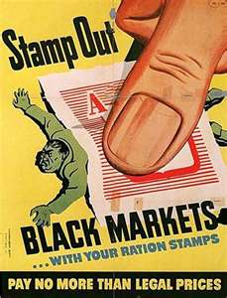
The Federal Government Takes Control
War Production Board
Helped to get factories ready for war
Organized drives to get metal
Rationing
Most saw it as a necessary sacrifice
Black market items increased
The idea was to tighten our belts and if possible give more

Slide 12
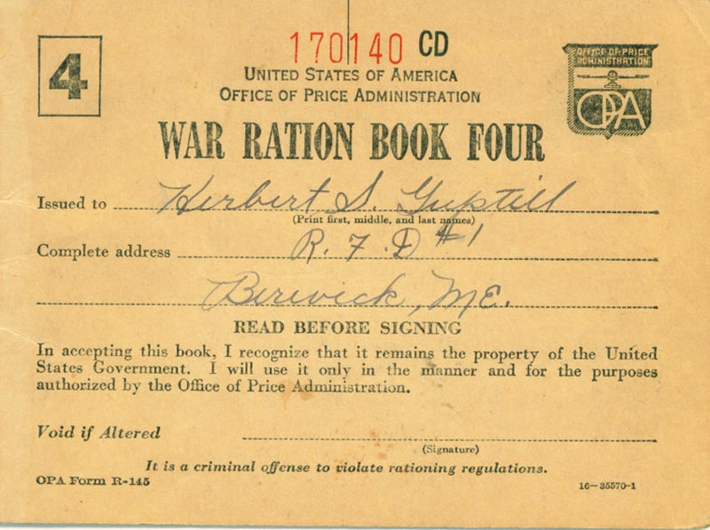

Slide 13
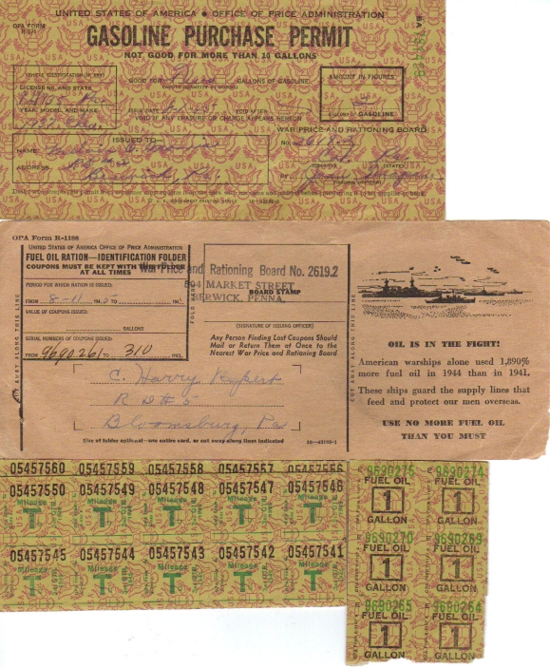

Slide 14
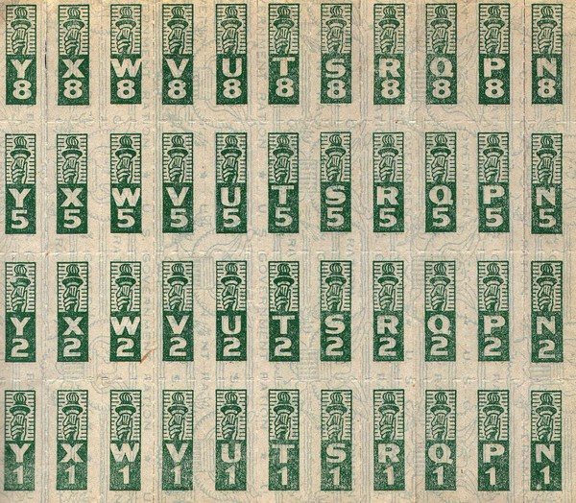

Slide 15
Items Rationed During WWII
Rationed Items Rationing Duration
Tires January 1942 to December 1945
Cars February 1942 to October 1945
Bicycles July 1942 to September 1945
Gasoline May 1942 to August 1945
Stoves December 1942 to August 1945
Sugar May 1942 to 1947
Coffee November 1942 to July 1943
Processed Foods March 1943 to November 1945
Meats, canned fish March 1943 to November 1945
Cheese, canned milk, fats May 1942 to 1947

