Slide 1
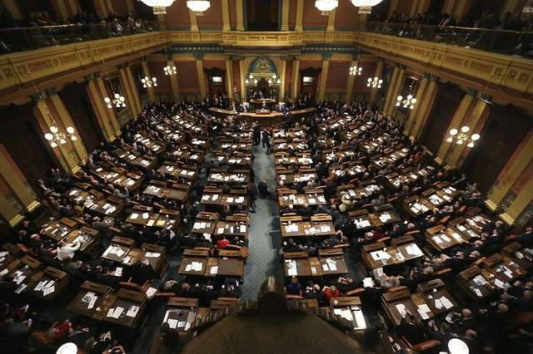
NATIONAL AND STATE POWERS
Chapter 4-Section 1

Slide 2
Federalism and Delegated Powers
Federalism-A system of government where through a constitution the powers of government are divided up on a territorial basis between the central government and the states.
Delegated Powers-A government who contains powers strictly delegated by its constitution.
Three types of delegated powers: expressed, implied and inherent

Slide 3
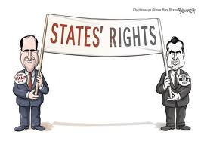
NATIONAL POWERS
10th Amendment establishes National Powers
The powers not delegated to the United States by the Constitution, nor prohibited to the States respectively, or to the people.

Slide 4
Expressed Powers
Expressed Powers-Powers that are expressly defined in the Constitution and delegated to the Federal Government.
Sometimes referred to as Enumerated Powers
Clearly expressed powers in the Constitution:
Coining Money, Regulating Interstate Commerce, Levying and Collecting Taxes, Declaring War, Establishing Post Offices, Making Treaties, Appointing Federal Office Holders, Granting Pardons

Slide 5
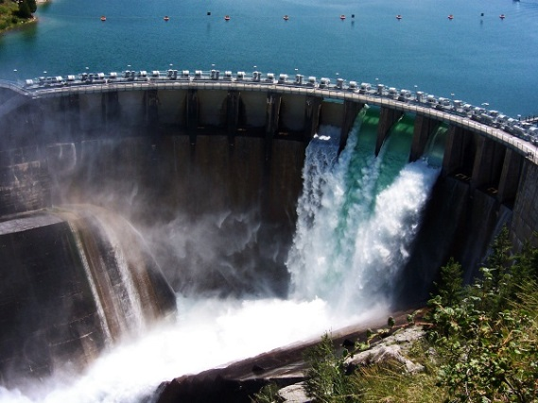
Implied Powers
Implied Powers-Powers not expressly stated in the Constitution but are reasonably suggested or implied.
Established under Article I Section 8 of the Constitution
Implied Powers based off the Constitution:
Examples: Regulating labor-management relations, building hydroelectric plants and interstate highways

Slide 6
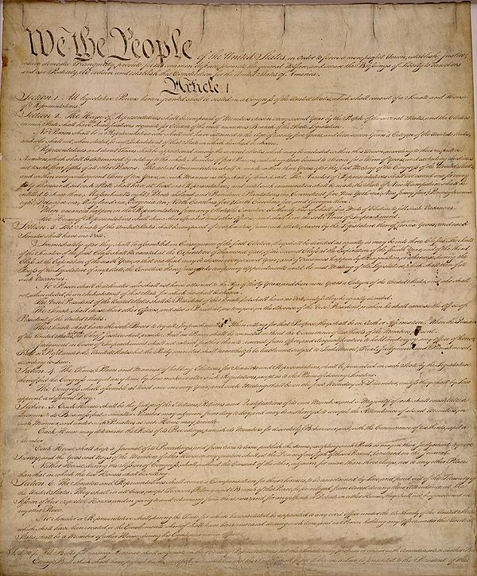
Necessary and Proper
The Necessary and Proper Clause is often called the elastic clause because it gives Congress all the powers that are not expressly stated in the Constitution
This makes the Constitution, flexible

Slide 7
Inherent Powers
Inherent Powers-Powers that are naturally assumed by the Federal Government because it serves as the national government of a sovereign state.
Inherent Powers allow the national government to:
Make treaties, regulate immigration, claim territory, wage war and create peace

Slide 8
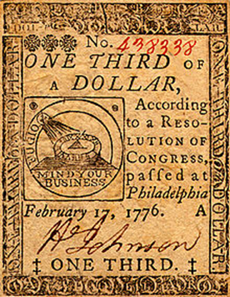
Powers Denied to the States
The Constitution denies many powers to the National Government as it does with the States.
Ex. No State can enter into a treaty, alliance or confederation, they also can’t coin/print their own money or deny any person on life, liberty or property without due process of law.

Slide 9
Reserved Powers
Reserved Powers-Powers the Constitution does not grant to the National Government and does not, at the same time, deny to the states.
Examples of reserved powers:
Forbidding persons under the age of 18 to marry, banning the sale of pornography, outlawing prostitution, permitting certain forms of gambling while restricting others

Slide 10
Concurrent Powers
Concurrent Powers-Powers both the Federal Government and the States possess that can be exercised independently from one another.
What powers do the Federal and State government share:
Levy and collect taxes, borrow money, make and enforce laws, establish courts, general welfare, regulate banks

Slide 11
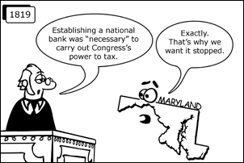
Denied Powers and the Supremacy Clause
Powers denied to both the Federal and State governments
Titles of Nobility, owning slaves and denying citizens the right to vote
Supremacy Clause-The Framers included in the Constitution a clause making the Constitution the “supreme law of the land” ranking higher than all other laws.
Established under the court case McCulloch v. Maryland

