Slide 1
Chapter 17-Test Materials

Slide 2
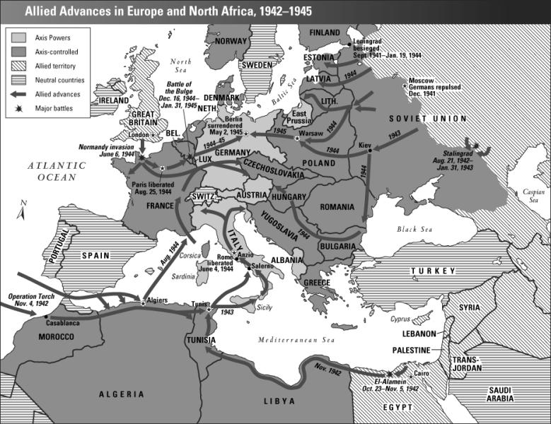

Slide 3
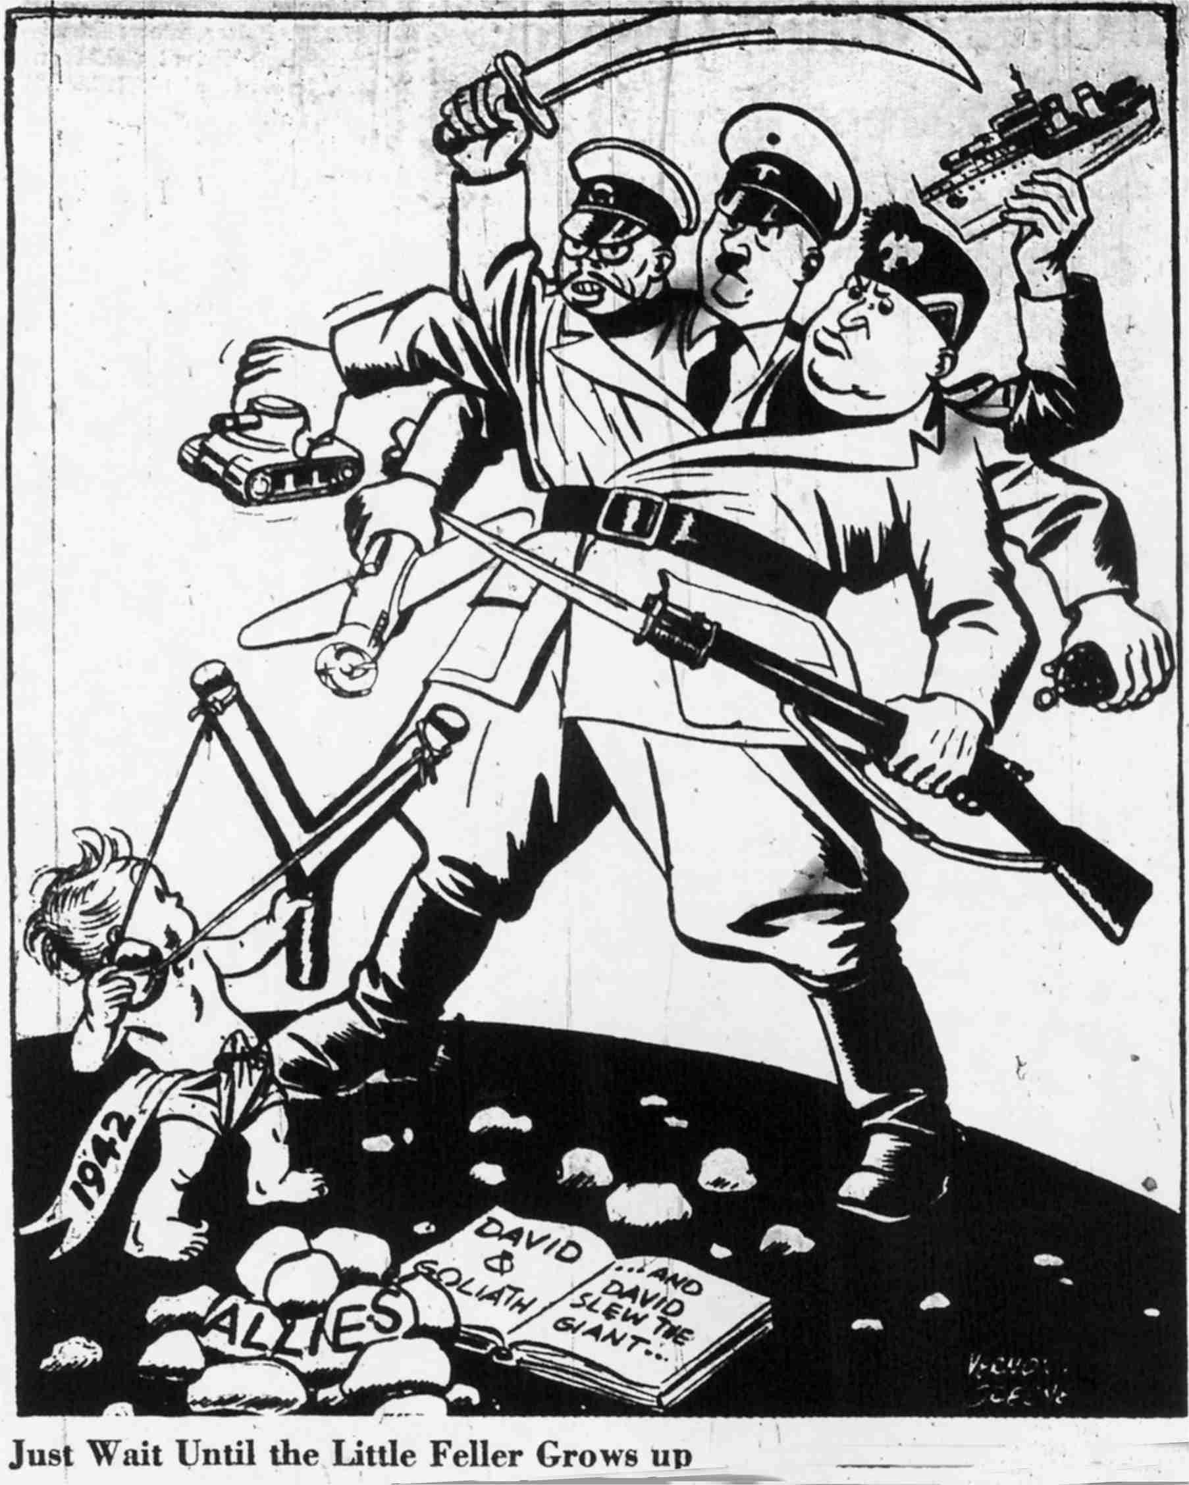
Political Cartoon #1

Slide 4
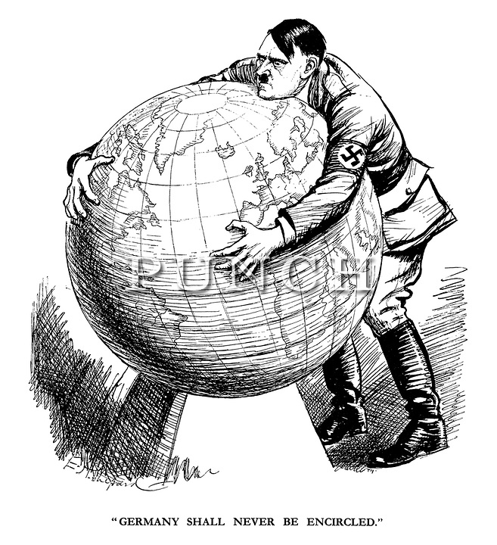
Political Cartoon #2

Slide 5
