Slide 1
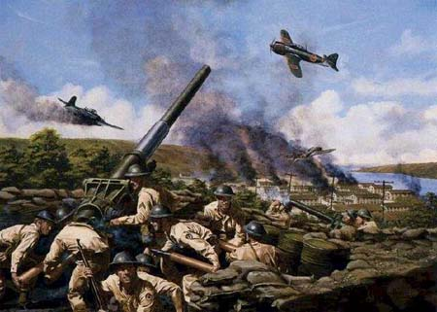
Section 3-The War in the Pacific

Slide 2
The Pacific Theater
Japan victorious at first
Took Hong Kong, Indochina, Asia and most of Pacific
Japan took the Philippines from America
Forced Macarthur to flee
Pledged to return
Those left forced into bloody camps
Bataan Death March

Slide 3
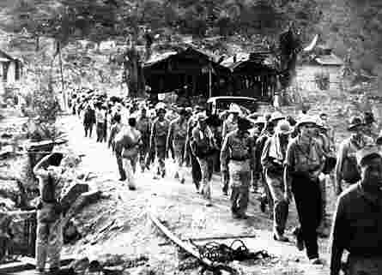

Slide 4
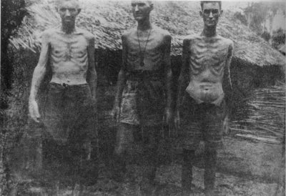

Slide 5
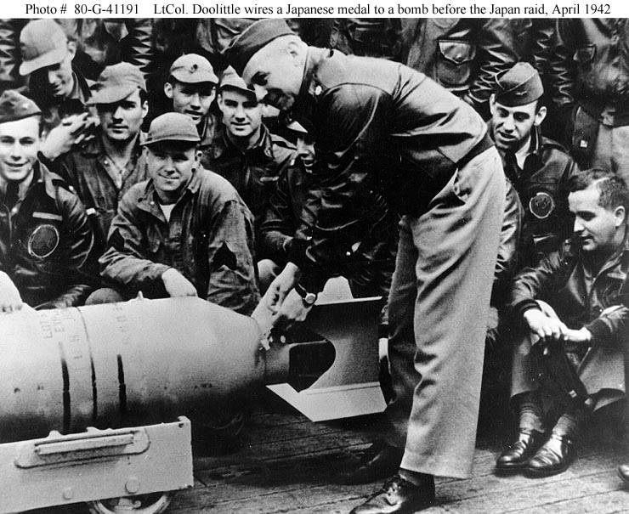
U.S. Needed a Victory
Doolittle’s Raid
1942 we hit Tokyo
Pointless strategically, but important for morale
“We hit Tokyo”

Slide 6
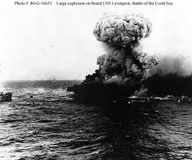
U.S. Needed a Victory
Coral Sea
1942 Americans and Australians stopped Japanese
5 day battle
No surface ships fired a shot, all done by aircraft
1st time the Japanese had been turned back

Slide 7
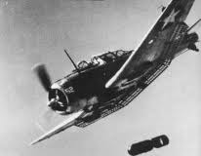
U.S. Needed a Victory
Battle of Midway
Turning point: Close to Hawaii
Nimitz in charge
We broke Japanese code
Finally found fleet with our scout planes
Japanese lost four aircraft carriers

Slide 8
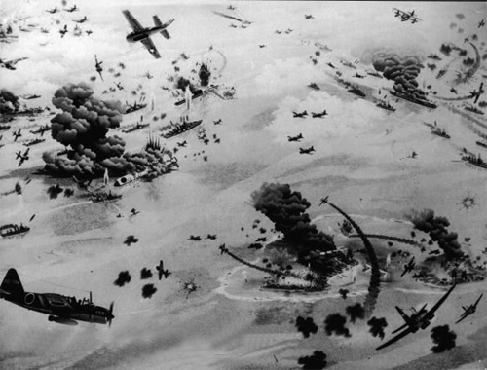

Slide 9
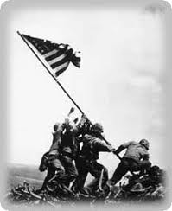
U.S. On the Offensive
After Midway turn to “Island Hopping”
Move us in position to take Japan
1944: Iwo Jima
Needed for bomber attacks on Japan
21,000 Japanese defended
200 survived
6,000 US Marines Died

Slide 10
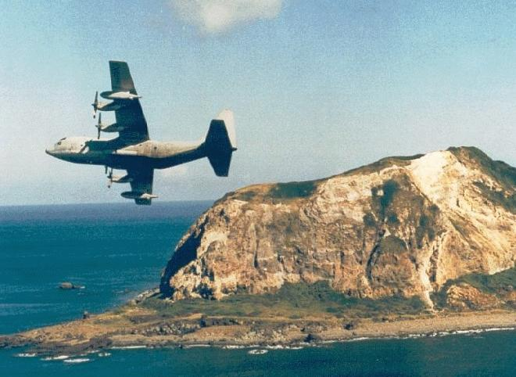

Slide 11
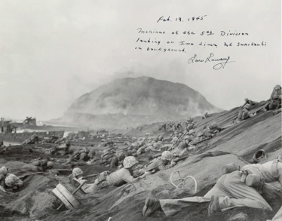

Slide 12
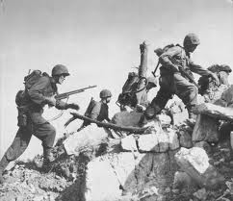
U.S. On the Offensive
1945-Okinawa Invasion
1,900 Kamikaze attacks
5,000 sailors dead
30 ships sunk
7,600 U.S. soldiers die
Japanese 110,000 die
Japanese Generals commit suicide rather then surrender

Slide 13
Manhattan Project
Development of Atomic Bomb
Led by Oppenheimer and Groves
600,000 workers involved
Truman didn’t know untill he was President
1945 first test in New Mexico: Worked, but no one realized the long term effects

Slide 14
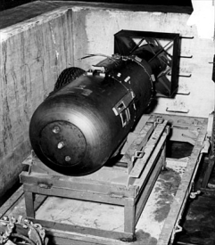
Manhattan Project
Truman had to decide to the A-Bomb
Gave Japan one last chance to surrender
Hiroshima: Military center
Little Boy (Bomb)
43 seconds: city was gone
Nagasaki
Fat Man (Bomb)
200,000 people died as a result

Slide 15
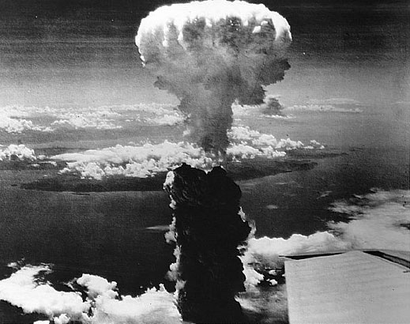

Slide 16
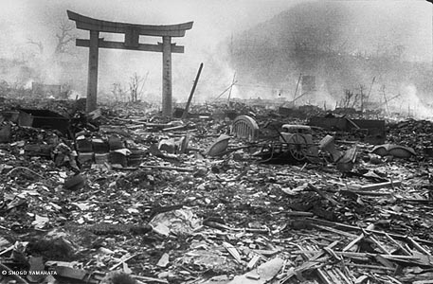

Slide 17
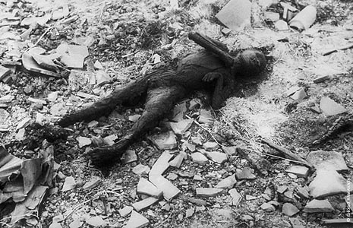

Slide 18
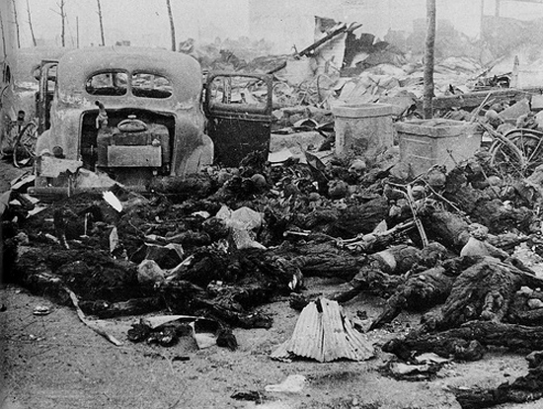

Slide 19
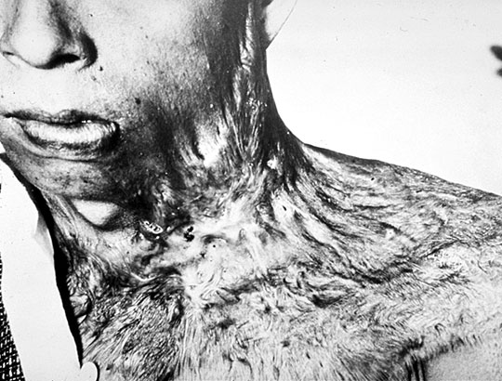

Slide 20
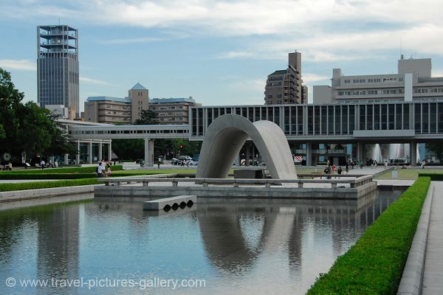
Rebuilding
Sept 2nd, 1945-Japan surrendered
Feb 1945 Yalta Conference
FDR/Churchill/Stalin
8 days
Russia wanted to Punish Germany but Britain wanted to bring them back in

Slide 21
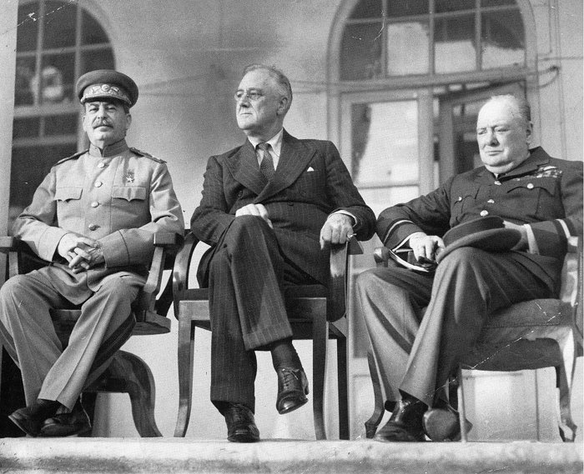

Slide 22
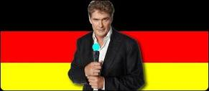
Rebuilding
Divide Germany 4 ways
With a goal to create a free Germany
Russia agreed to free elections in Poland and Eastern Europe
Stalin would join in war against Japan
Also agreed to hear plans for U.N.

Slide 23
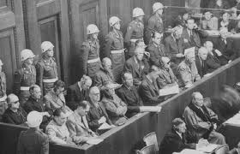
Nuremberg Trials
Someone had to be responsible for Death Camps
Leaders and Industrialists on trial
12 of 24 sentenced to death
200 found guilty of war crimes

Slide 24
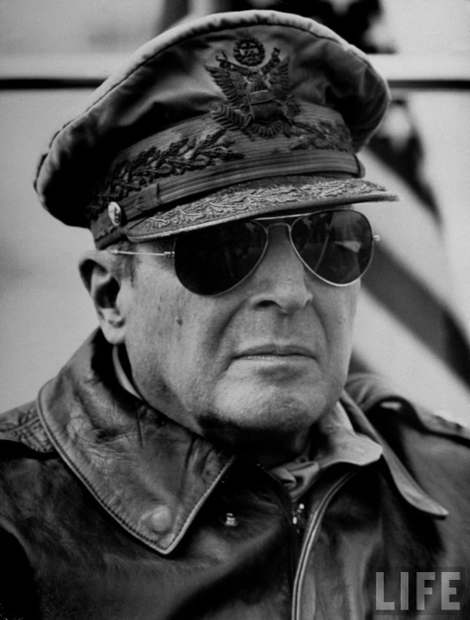
Japans Future
U.S. stayed in Japan
MacArthur led
War trials for their abusive leaders
Introduced capitalism and free market ideas
Constitution: Including women’s suffrage
“The MacArthur Constitution”

