Slide 1
Chapter 1-Section 2
Forms of Government

Slide 2
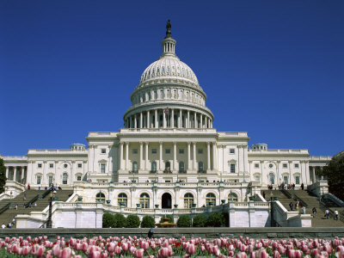
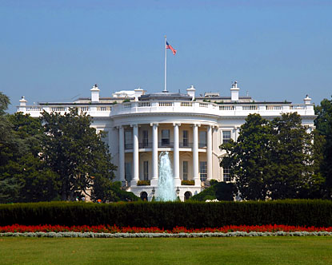
How Are Governments Classified?
Governments are classified based on the following concepts:
Who can participate in government
Where (geographically) the power to govern is located
The relationship between the lawmaking and the law-executing branches of government

Slide 3
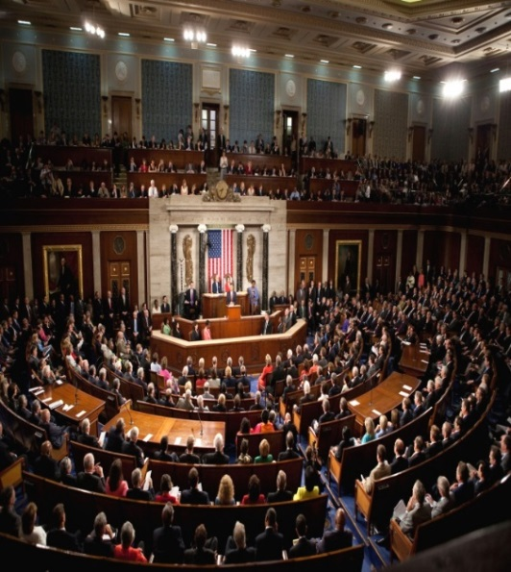
Who can participate in different types of government?
In a democracy, the people hold the supreme political authority.
In a direct democracy, they exercise it by getting together and making decisions in mass meetings.
We in the U.S. have what’s known as representative democracy, because we elect representatives who then govern for us.
The word republic can be thought of as meaning the same as democracy.

Slide 4
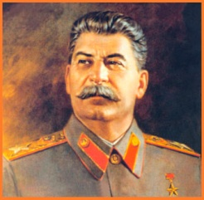
Who can participate in different types of government?
Dictatorship is the term used for any government not responsible to or answerable to the people. The government does what it wants. You should be familiar with two different types of dictatorship.
Autocracy is a government where one person has all the power
Oligarchy refers to a government where a small elite group rules.

Slide 5
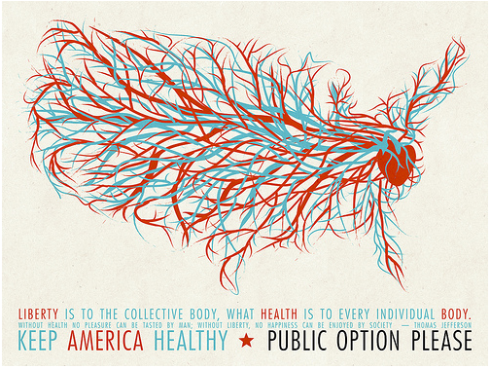
A Unitary Government
In a unitary government, political power is centralized in the sovereign state. This is because every state (nation) has a capital, and the government there makes all decisions.
Local governments are for administration purposes only. If the U.S. were considered unitary it would mean every decision has be made in Washington, DC.
In a unitary system, there is one capital where all decisions are made.

Slide 6
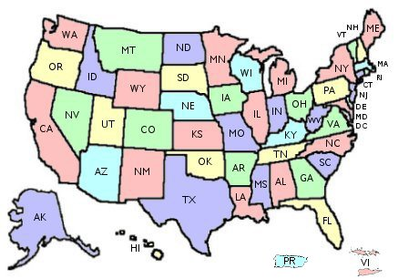
A Federal Government
A federal government has more than one “level”. Some of the power can only be exercised by the sovereign state (nation) while others can be incanted on the state or local level.
In our case there is the federal government is located in Washington, DC, while our State government for Michigan meets in Lansing, and a local government exists for the city of Dearborn

Slide 7
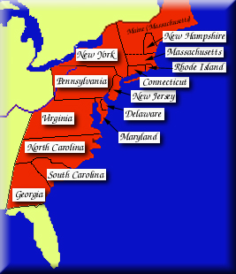
A Confederate Government
In a confederate government, a bunch of sovereign states get together and agree on some kind of additional government covering all of them.
Power is located in the capital of each sovereign state, and only a very limited amount is given to the federal government.

Slide 8
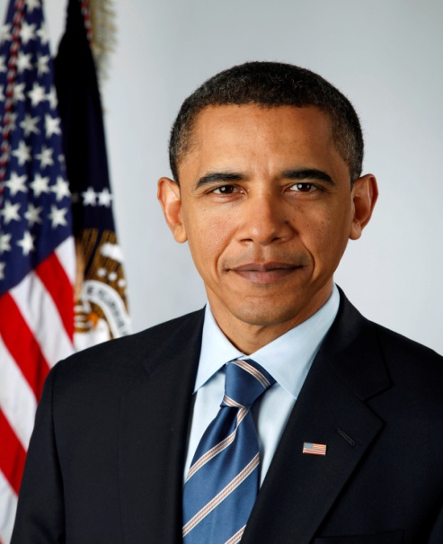
A Presidential Government
Presidential government features an elected president who serves as the head of state (the ceremonial “face” a state presents to the world )as well as its Chief Executive (head of the executive branch of government), with a separate and co-equal elected legislature (which actually makes the laws).
In America there is a separation of powers between the legislative branch (Congress), the executive branch (President), Judicial Branch (Supreme Court) all o fwhich is outlined in our constitution.

Slide 9
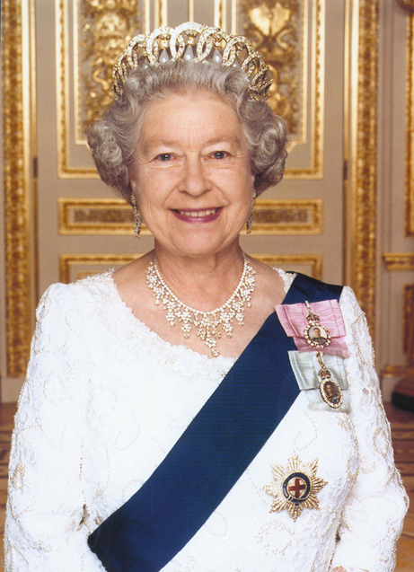
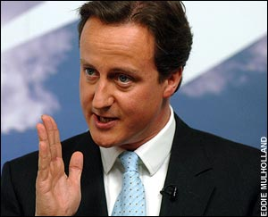
Parliamentary Government
In parliamentary states, the head of state is a king or queen, or someone called a president (but nothing like our kind). They are ceremonial or “figurehead” leaders.
The head of government is the prime minister (sometimes called a premier). The prime minister and his/her cabinet is the executive branch, and these executives also serve as members of parliament, which is the legislative branch.

