Slide 1
WWI-Political Cartoons
Chapter 11-The First World War (Exam)

Slide 2
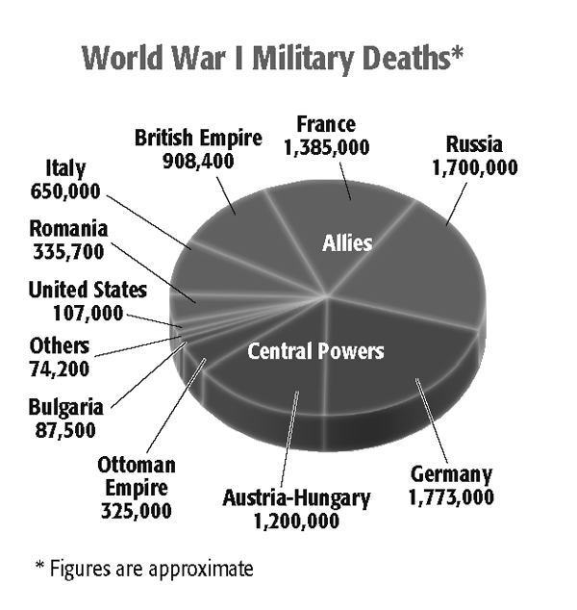
WWI Military Deaths-Pie Chart

Slide 3
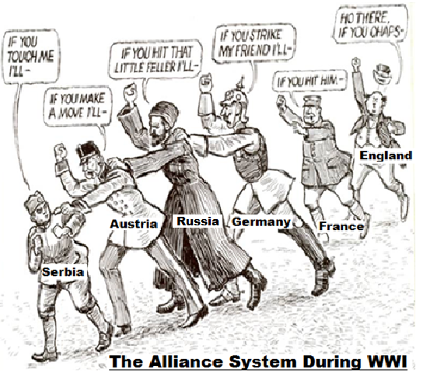
The Alliance System-Political Cartoon

Slide 4
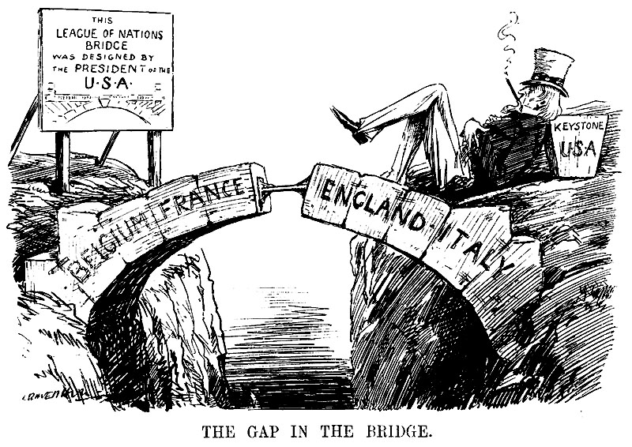
League of Nations-Political Cartoon

Slide 5
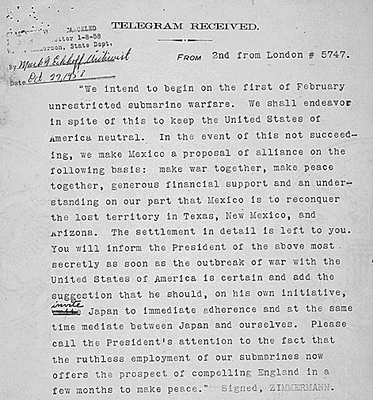
The Zimmerman Note

