Slide 1
Political Cartoon Analysis (10th Amendment)

Slide 2
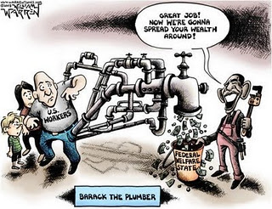
Political Cartoon #1-"Barack the Plumber"

Slide 3
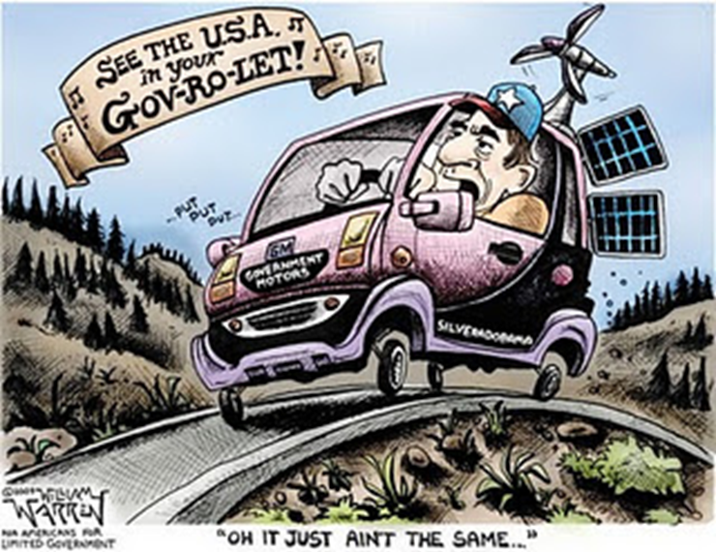
Political Cartoon #2-"GM Takeover"

