Slide 1
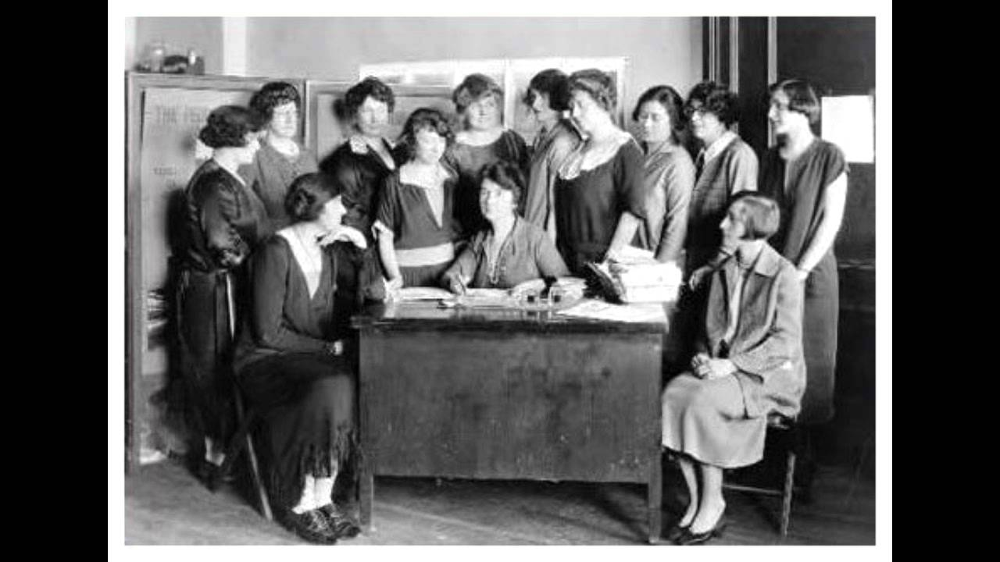
Chapter 9-Section 2
Women in Public Life

Slide 2
Where were women working at the turn of the century?
Please begin by reading pages 313-314
Create a Tree Map© that identifies the three important roles that women were most commonly found in.
On your map please explain least one of the problems they faced in each role

Slide 3
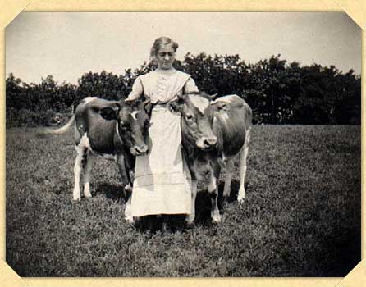
On the farm:
Mostly in South and Midwest
Lower middle class to lower class
Besides fields, had to care for family, laundry, and cook

Slide 4
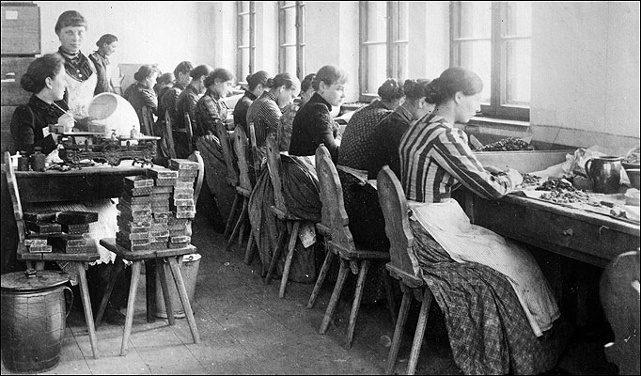
In the factories
Women had found their way into the factories to help make money
Often excluded from union membership
Often worked in garment industry
Paid about ½ as much as men
Some sought an education which would open more doors for them in the future

Slide 5
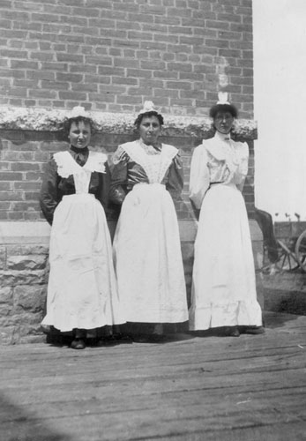
In The Home
A way for women who were not educated to help their family was by domestic work
For many African American women this was their only option because of racism

Slide 6
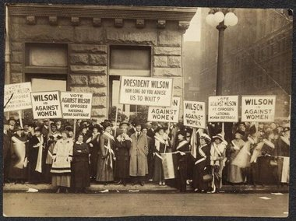
Working Conditions:
Bad pay, poor conditions made the workers feel trapped and made women realize they lacked fundamental rights

Slide 7
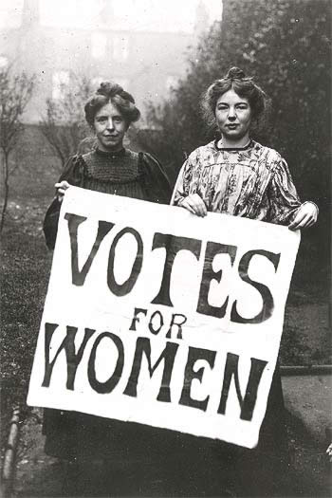
Women wanted education-
More education led to drive for college
Education led to reform
Push for reform, led women to push for equality and independence

Slide 8
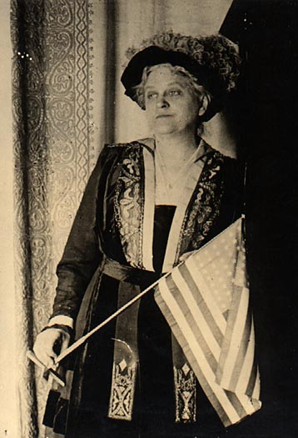
How did it all happen:
health and safety first thoughts
-Early leaders were Anthony and Stanton
-Laid foundation
-Led to NAWSA:-
Catt
3 ways to achieve suffrage
State legislatures
Courts
National amendment
-African American also fought for equality. Not always welcome in white women’s groups: NACW
Long hard battle to 1920 the 19th Amendment was passed giving them the right to vote

