Slide 1
SSR Inquiry Questions Monday 12/15
Please answer the following questions on a half-sheet of loose leaf paper
1.) Can you explain in your own words why Pope Francis feels there needs to be changes in the Catholic Church and what are some areas that need change?
2.) What two questions would you ask the Pope if you had the chance?
3.) As someone who is not Catholic is there anything about his ideas that you find appealing?

Slide 2
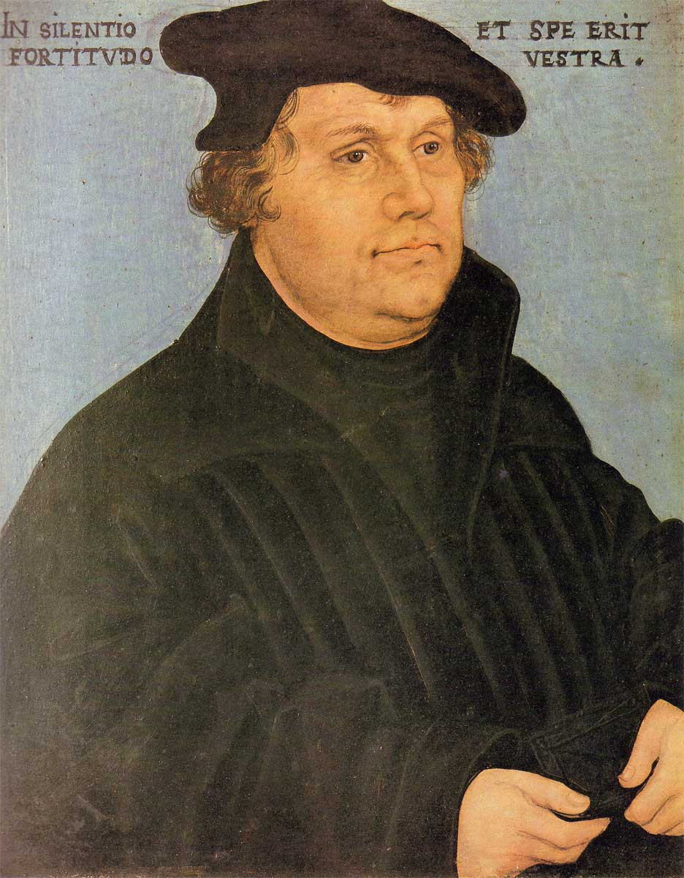
Section 3-Luther Leads the Reformation

Slide 3
Causes of the Reformation (pg. 488)
Causes of the Reformation
Social | Political | Economic | Religious
The Renaissance values of humanism and secularism led people to question the Church The printing press helped spread ideas that went against the Church | Powerful monarchs challenged the Church as the supreme power in Europe Many leaders viewed the pope as a foreign ruler and challenged his authority | European princes and kings were jealous of the Church’s wealth Merchants and others resented having to pay the Church taxes | Church leaders were becoming worldly and corrupt Many people found Church practices like the sale of indulgences unacceptable

Slide 4
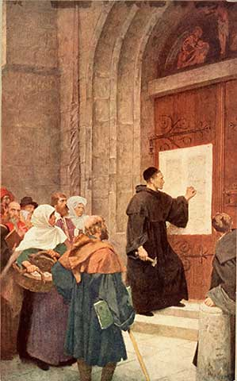
Luther Challenges the Church
Martin Luther-Monk and teacher from Germany
The 95 Theses-95 statements attacking the “pardon-merchants”
1517-Luther took a public stand against Johann Tetzel’s sale of indulgences
Indulgence-Selling releases from the punishment of their sins
Reformation-Religious reform and the formation of churches that did not follow the popes lead

Slide 5
Luther Challenges the Church
Luther’s Teaching-
Salvation through faith alone
Catholics believed faith and works = salvation
Church teaching should be based on the Bible alone
Pope and church traditions = false authority
All people with faith are equal
People could interpret the Bible for themselves

Slide 6
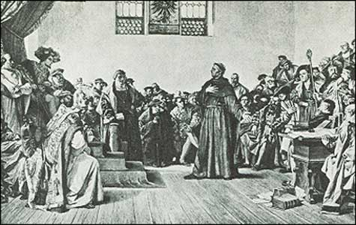
The Response to Luther
1520-Pope Leo X threatened to excommunicate Luther
He later did
1521-Emperor Charles V issued the Edict of Worms
No one could offer Luther food or shelter
Prince Frederick housed Luther during this time he translated the New Testament into German

Slide 7
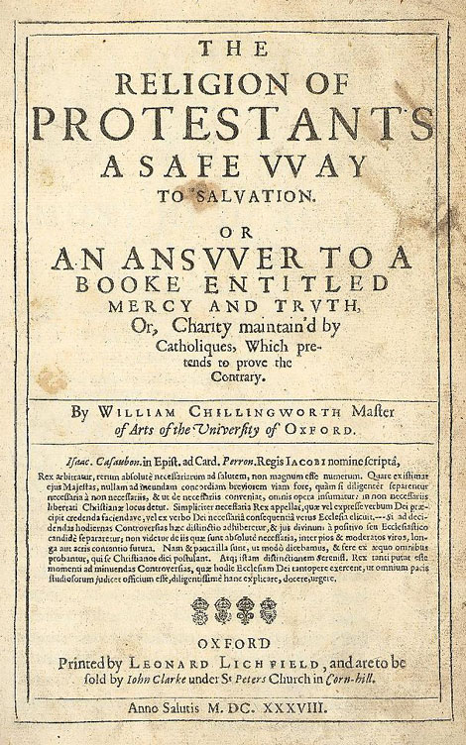
The Response to Luther
Protestant-Christian who belonged to non-Catholic churches
Peace of Augsburg-Compromise in which rulers would decide the religion on his state
Protestant or Catholic

Slide 8
England Becomes Protestant
Annul-Ending a marriage if proof is shown it was never legal (not a divorce)

Slide 9
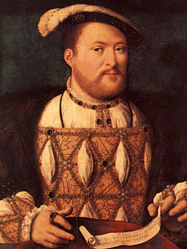
England Becomes Protestant
Henry VIII-King of England
Had one daughter (Mary) with wife Catherine and wanted a son
Asked the pope for an annulment so he could marry a younger wife
Act of Supremacy- Citizens had to take an oath recognizing Henry as the head of England’s Church and his divorce as legal

Slide 10
England Becomes Protestant
Elizabeth I-Wanted to restore Protestantism and with the help of Parliament set up the Church of England (Anglican Church)
Named the only legal church in England
Church of England- Designed to keep Protestants and Catholics happy
Priests could marry and give sermons in English
Kept rich robes and some Catholic traditions

