Slide 1
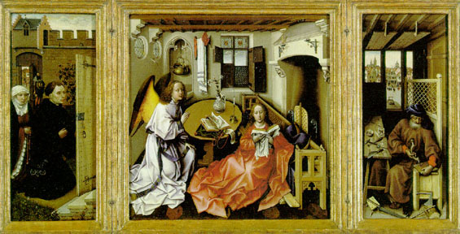
Chapter 17-Section 2- The Northern Renaissance

Slide 2
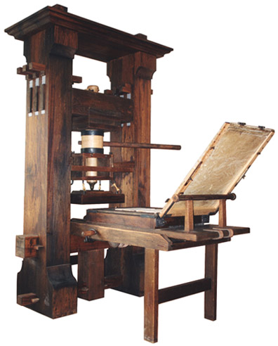
Important Stuff from Section 2
Utopia- An ideal place
Johann Gutenberg-German craftsman that developed a new printing press
Printed a full copy of the Bible
Allowed for books to produced cheaply

Slide 3
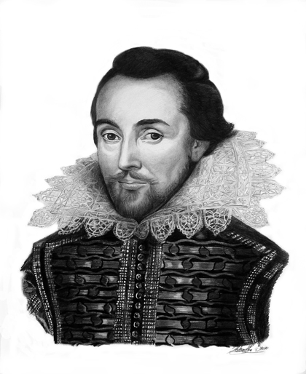
Important Stuff from Section 2
William Shakespeare-Most famous writer of the Elizabethan Age
Born 1592 in England
Emphasized the humanity through drama and tragedy
Shakespeare’s wrote Macbeth, Hamlet, Othello, Romeo and Juliet, King Lear, A Midsummer Night’s Dream

Slide 4
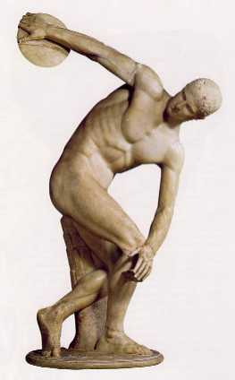
Important Stuff from Section 2
Changes in Art-
Based on classical Greek and Roman styles
Realistic style of art
Both secular and religious works were created
Writers used vernacular languages
Praised individual achievements

Slide 5
Important Stuff from Section 2
Changes in Society-
Information became inexpensive and available to the public
Cheap books = increased literacy
Clarified laws = more people understanding their rights
Christian humanists changed views on how life should be lived
People began to question political and religious practices

