Slide 1
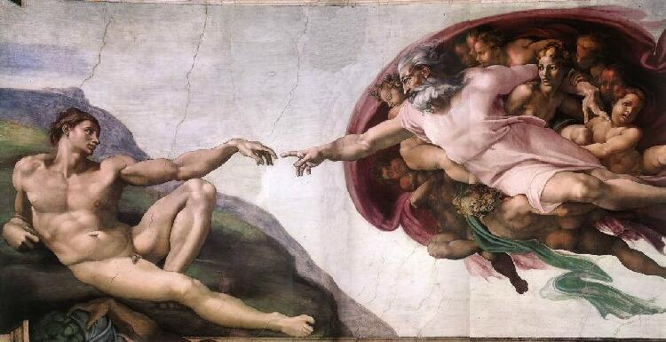
Chapter 14-Section 1-Italy:Birthplace of the Renaissance

Slide 2
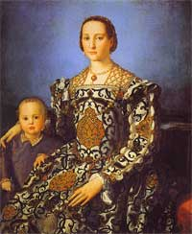
Italy’s Advantage
Renaissance-Meaning rebirth/revival of the arts and learning (1300 A.D. to 1600 A.D.)
Italians wanted to revive the culture of classical Greeks and Romans

Slide 3
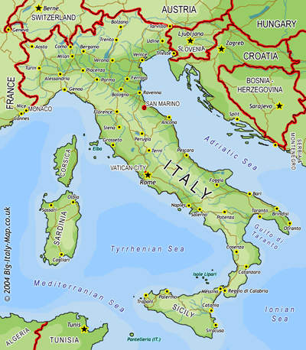
Italy’s Advantage
Three advantages that made Italy the birthplace of the Renaissance
Thriving cities
Wealthy merchant class
Classical heritage of Greece and Rome

Slide 4
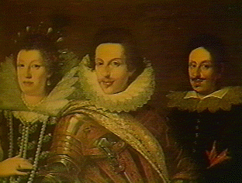
Italy’s Advantage
Medici Family-Powerful banking family who ruled Florence, Italy during the 1400’s.
Acting as patrons they encouraged the arts during the Renaissance

Slide 5
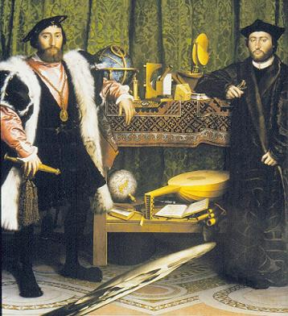
Classical and Worldly Values
Humanism- Movement that focused on human potential and achievement
Secular-Worldly outlook on life and art rather than spiritual
Patrons- People who financially supported the arts

Slide 6
Classical and Worldly Values
Renaissance Man- A man well versed in many areas of art and education
The Courtier-Book which taught young men how to become Renaissance men
Renaissance Woman-
Encouraged to be charming and know the classics, and inspire art
Not encouraged to seek fame, or create art

Slide 7
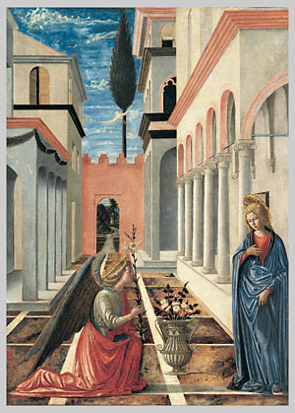
The Renaissance Revolutionizes Art
Perspective-Artistic technique that showed three dimensions on a flat surface

Slide 9
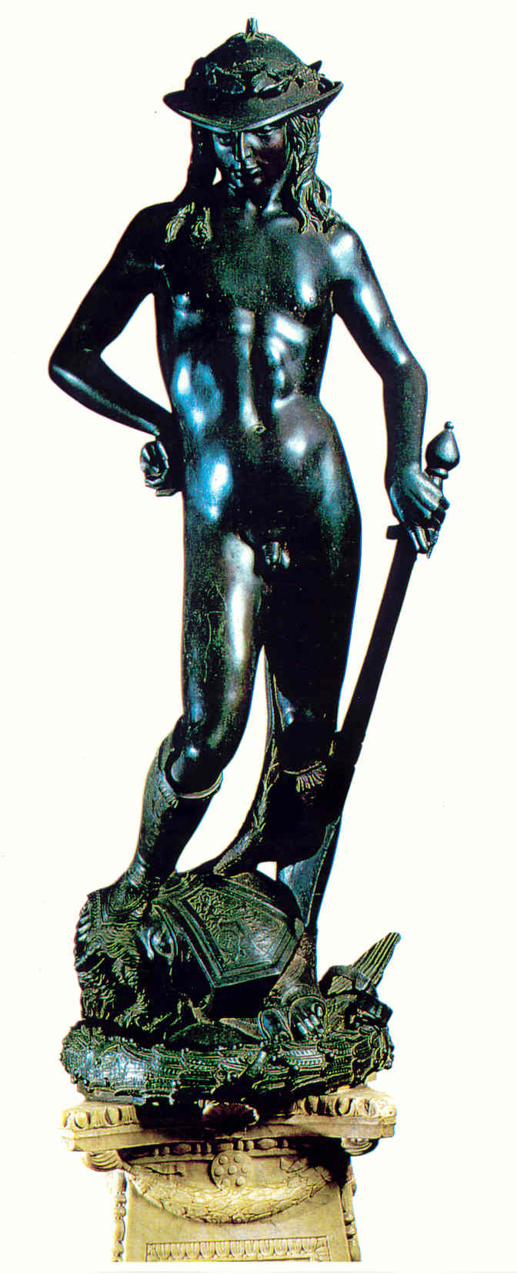
The Renaissance Revolutionizes Art
Donatello-Artist, poet, sculpture, architect, painter
Statue of David the boy
1st free standing nude male sculpture since ancient times
Leonardo da Vinci-Painter, sculpture, inventor, scientist
Best known for painting the Mona Lisa and The Last Supper
Raphael-Painted the School of Athens
Showed classical influence on the Renaissance

Slide 10
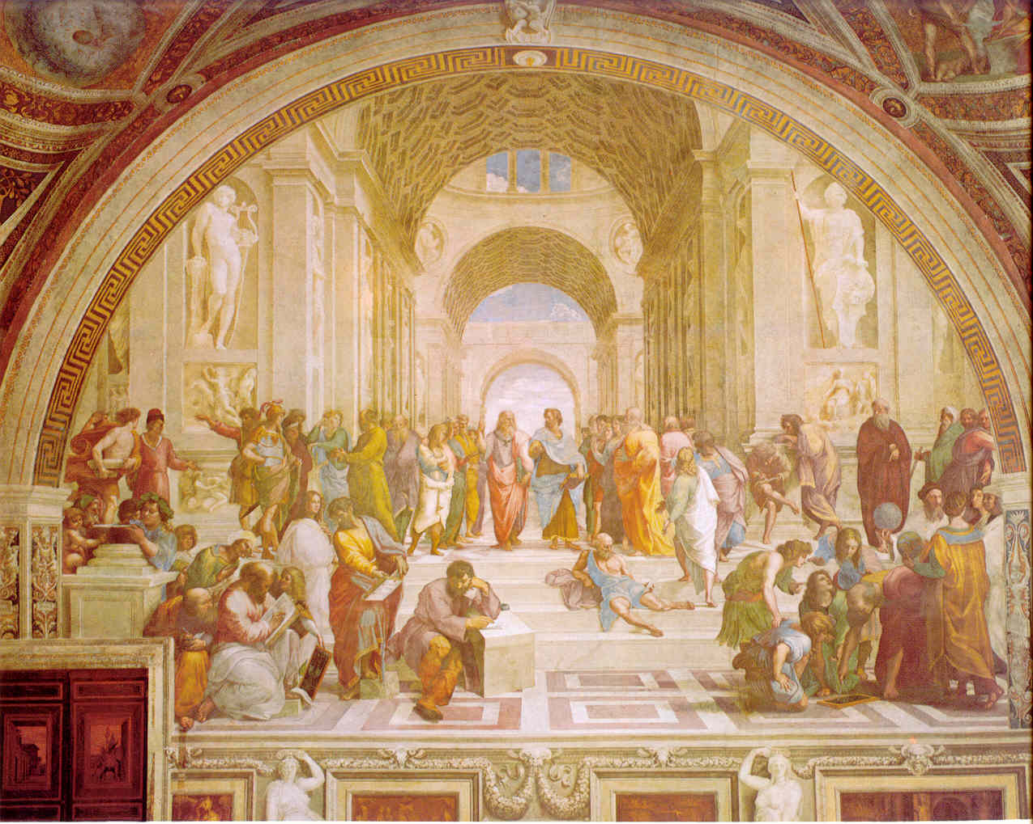
The School of Athens Raphael 1511

Slide 11
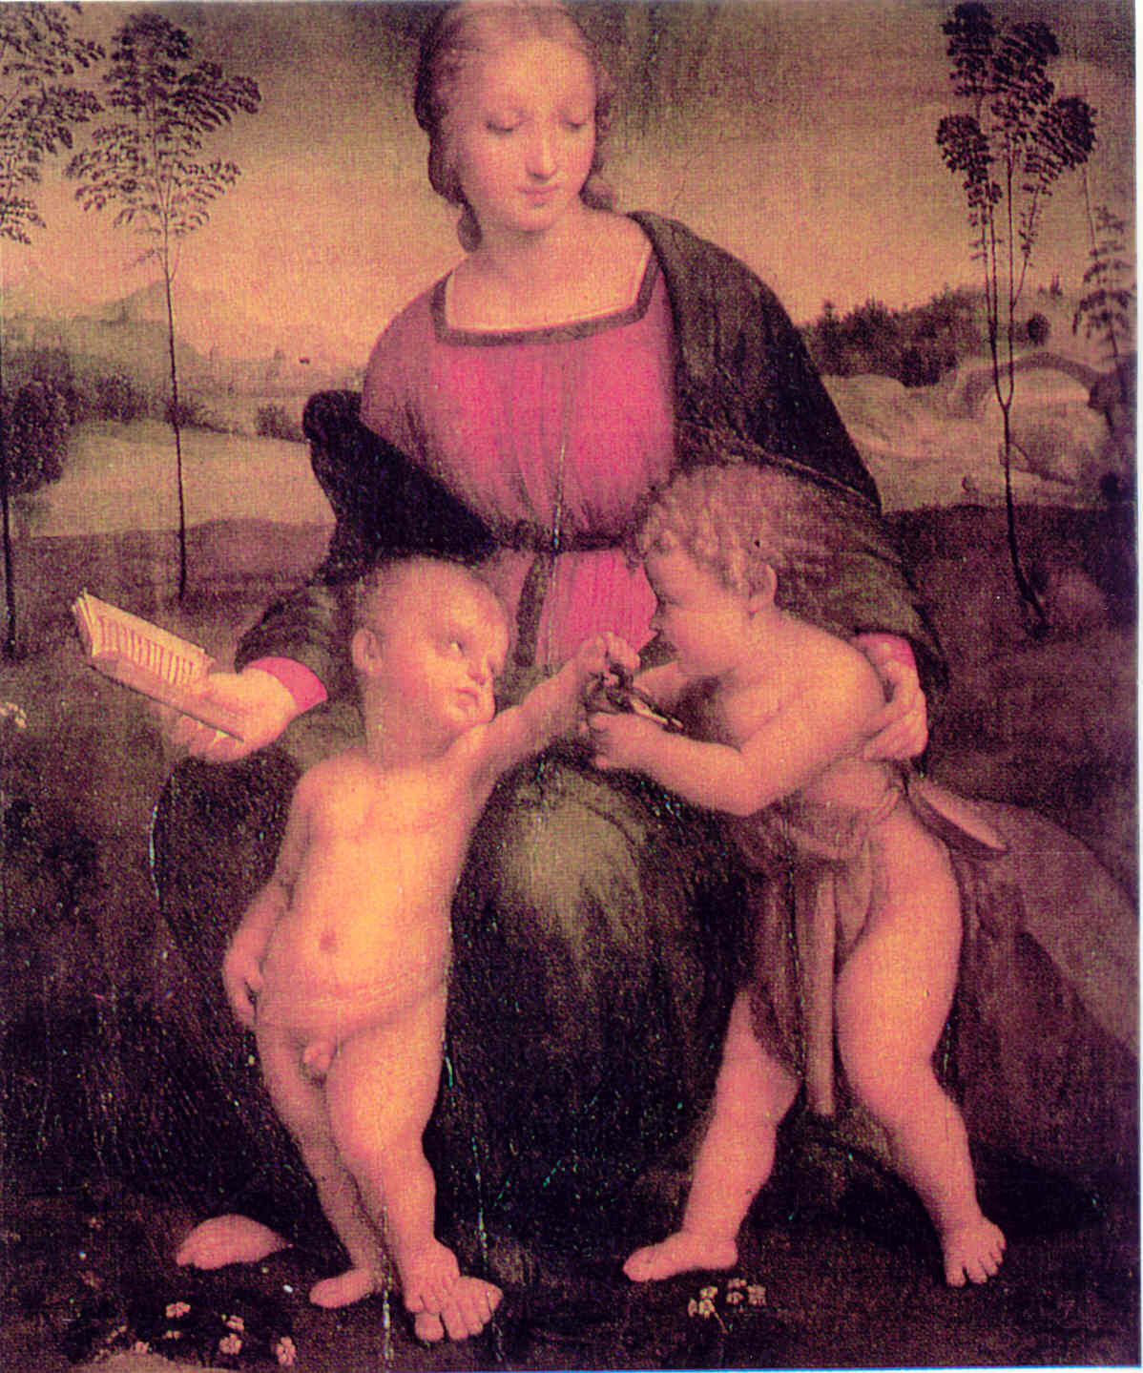
Madonna of the
Goldfinch
Raphael
1506

Slide 12
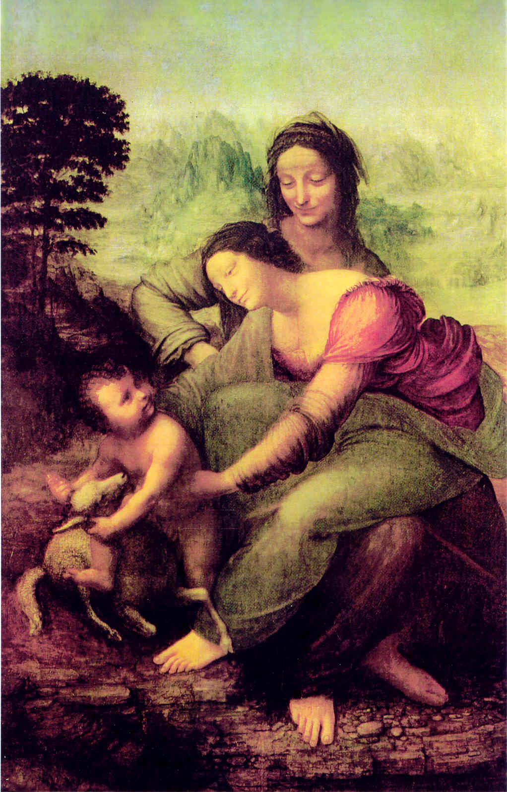
Madonna and Child with St. Anne
Leonardo da Vinci
1513

Slide 13
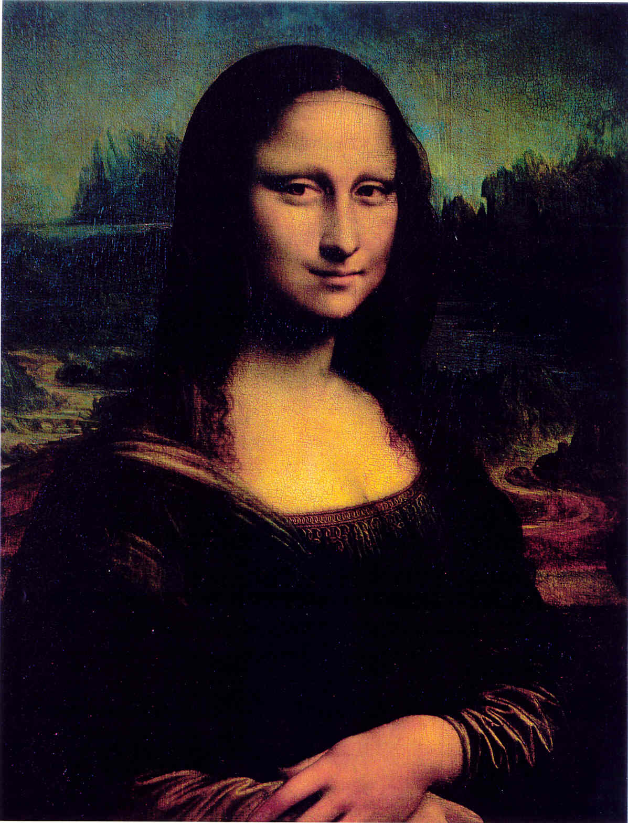
Mona Lisa
Leonardo da Vinci
1505

Slide 14
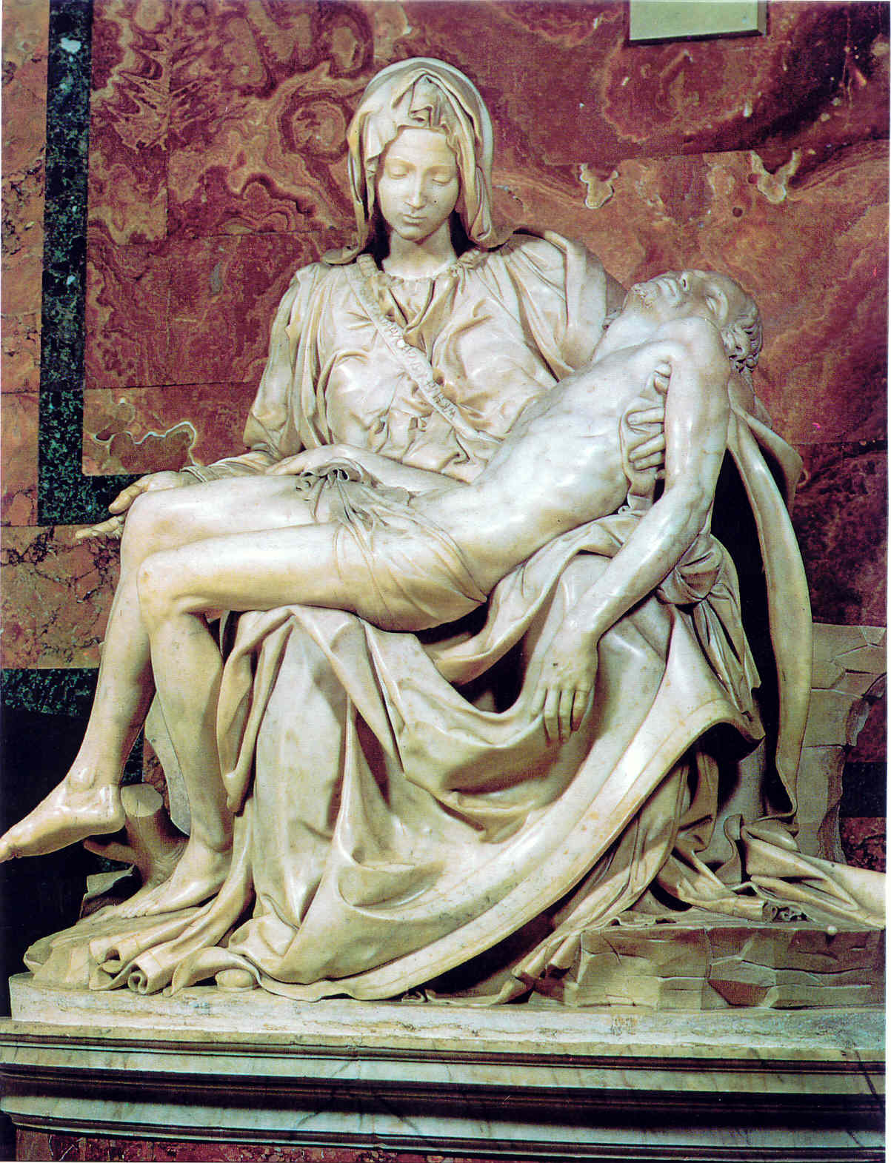
La Pieta
Michelangelo
1500

Slide 15
David
Michelangelo
1504
censored
Did you know that David was supposed to be placed on the top of a church in Florence?
It was commissioned by the de Medici family who were so impressed that they decided to leave it in the piazza in front of the church so that the public could see it up close.

Slide 16
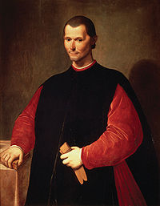
Renaissance Writers Change Literature
Vernacular-Writing in ones native language (instead of Latin)
Niccolo Machiavelli-
Wrote The Prince (1513)
Explains how a ruler can gain and keep power through misleading and deceive his opponents

