Slide 1
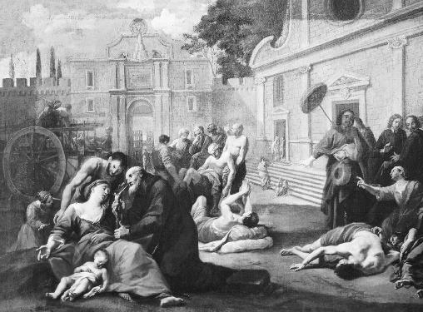
Chapter 14-Section 4-The Hundred Years’ War and the Plague

Slide 2
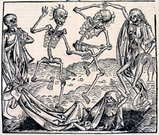
The Bubonic Plague Strikes
The Bubonic Plague- A deadly epidemic that killed about 1/3rd of Europe
Origins and Impact of the Plague-
Began in Asia and received its name the Black Death from the purplish black bumps on the skin
Took four years to cross Europe
Millions who caught it died

Slide 3
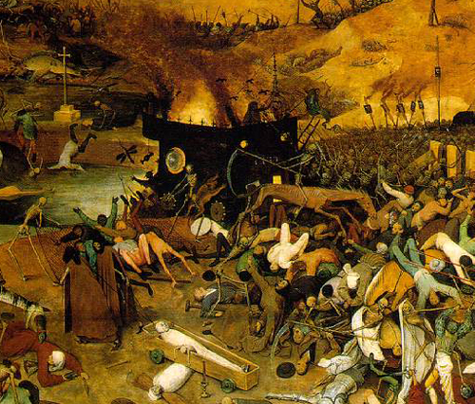
The Bubonic Plague Strikes
Effects of the Plague-
Population declined
Trade declined
Serfs left to find a better living
Jews were blamed for the plague
Church lost prestige when their prayers failed to stop the plague

Slide 4
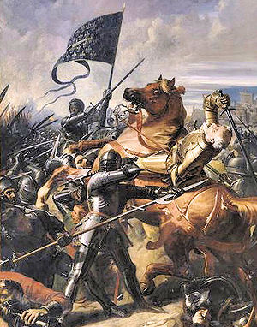
The Hundreds Year War
The Hundreds Years’ War-
Edward III launched a war for the French throne that was fought off and on from 1337 to 1453
French pushed the English out of France
The Hundred Years’ War changed European warfare
Longbow allowed for thousands of arrows to be rained down upon the French by archers

Slide 5
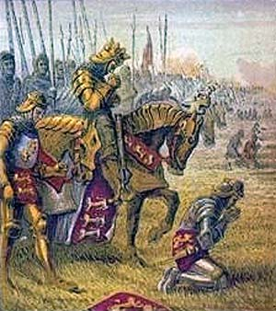
The Hundreds Year War
Impact of the Hundreds’ Year War-
Feeling of nationalism emerges in England and France
Power of the French Monarchy increases
End of the Hundreds’ Year War = the End of the Middle Ages
b/c religious devotion and code of chivalry crumbled

Slide 6
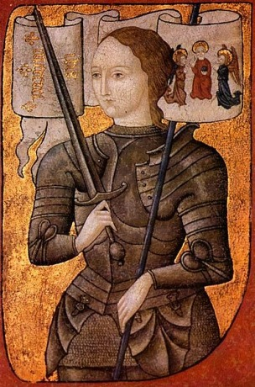
The Hundreds Year War
Joan of Arc-
1429- Joan a young peasant girl felt a call from God to rescue France from English conquerors
Led them to victory in the battle near Orleans
Charles VII was crowned king
Did nothing to save her
She was captured and burned as a witch

