Slide 1
Bell Work Thursday 11/20
Look in your book beginning on page 393 and begin reading to find the answers
1. What two legal practices date back to Henry II?
2. What rights are guaranteed by the Magna Carta?
3. Why did Philip II call the Estates-General together?

Slide 2
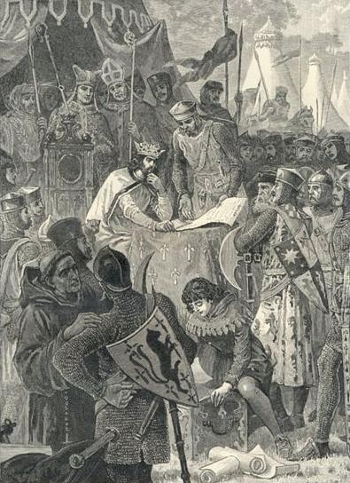
Section 3-England and France Develop

Slide 3
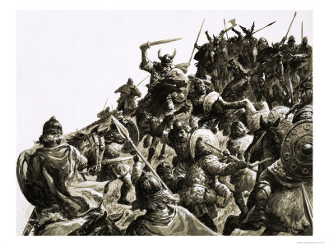
England Absorbs Waves of Invaders
Early Invasions-
During the 800’s England was invaded by Danish Vikings
United kingdom’s began to unite and started calling England “Land of the Angels”

Slide 4
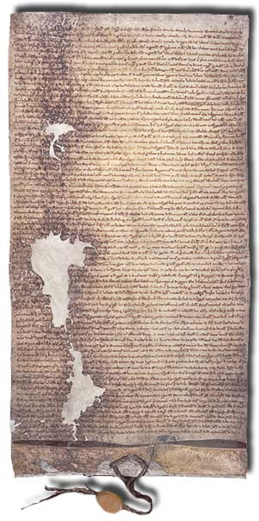
England’s Evolving Government
England’s New Goals
1st- Keep and gain more French land
2nd- Strengthen their power over Nobles and the Church
Magna Carta-
“Great Document” that granted certain political rights
No taxation without representation, trial by jury, protection of the law

Slide 5
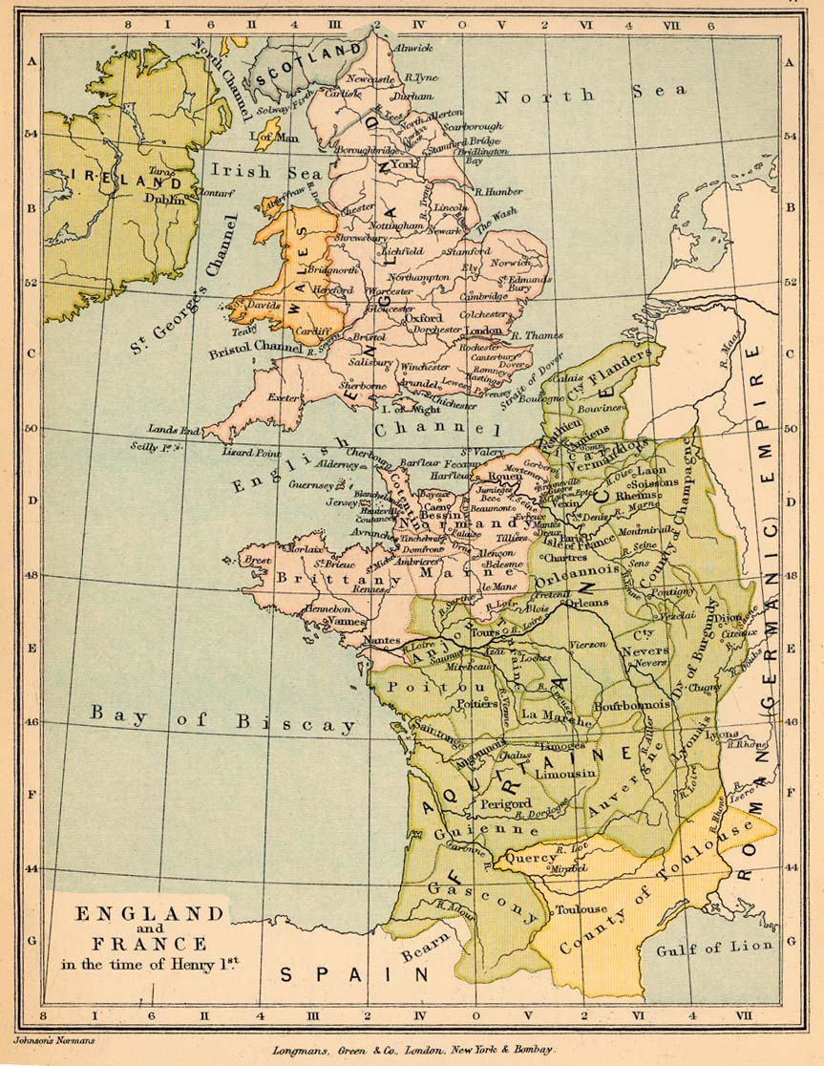
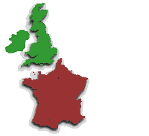
England and France
(Yes England is an island)
England
France

Slide 6
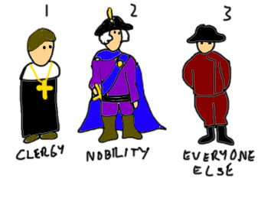
France Becomes a Separate Kingdom
Estates General-
The assembling of the Third Estate in which commoners, wealthy landholders and Philip assembled a council
Helped increase royal power over nobility
Failed to limit the power of the king
Beginnings of democracy in England and France

