Slide 1
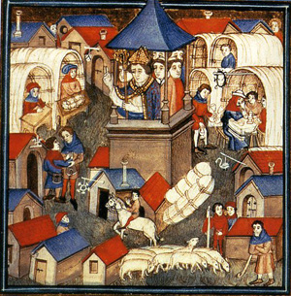
Section 2-Changes in Medieval Society

Slide 2
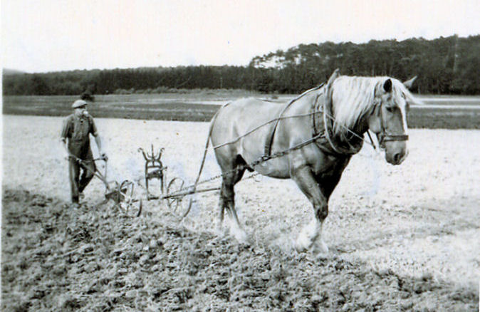
Growing Food Supply
Expanding civilization = need for more food
Switch to horse power
Horses required better food but could do three times the work
They began to use better harnesses that fit around the horses chest

Slide 3
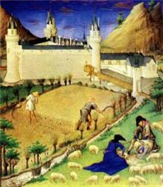
Growing Food Supply
The Three-Field System-
You divide your land into three parts
Farm two parts and let one rest for a year
Could now grow on 2/3 of the land instead of just ½
As food production increased population increased

Slide 4
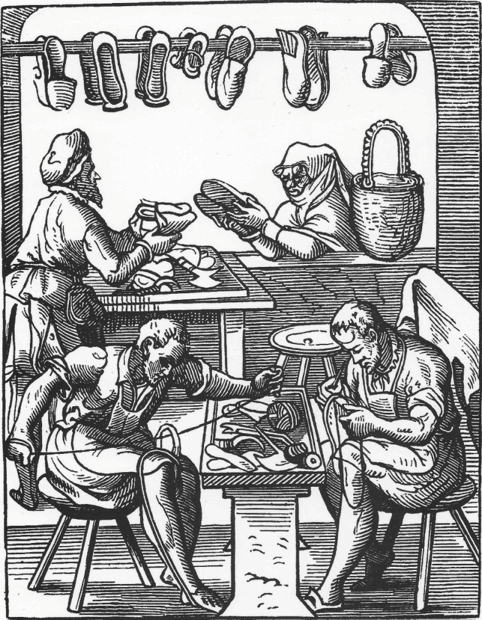
The Guilds
Guild- People striving to improve economic and social conditions for its members
Both men and women joined
Set standards for quality of work, wages, and working conditions, supervised training of new workers

Slide 5
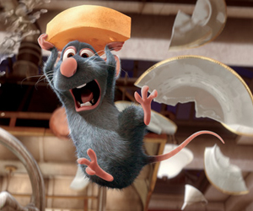
Commercial Revolution
Fairs and Trades-
Merchants traded cloth, bacon, salt, honey, cheese, wine, leather, knives
Things no longer limited to what was produced on the manor
Foreign goods now available

Slide 6
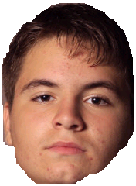
Commercial Revolution
Business and Banking-
Letters of credit eliminated the need for traders to carry large amounts of cash
Exchange rates established
Usury- Policy in which the Church banned lending money with interest

Slide 7
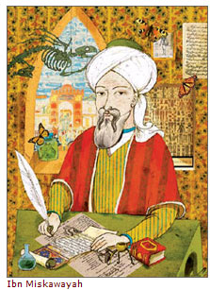
The Revival of Learning
The Muslim Connection-
Christian scholars began visiting the Muslim libraries in Spain
Learned about math, science, philosophy, and law
Crusaders brought back superior Muslim technology
Ships, navigation and weapons

Slide 8
The Revival of Learning
Scholars and Universities-
University- Higher institutions of learning
Most students were wealthy
Wanted a government or church job
Bachelors in theology – 5 to 7 years
Masters in theology- 12 years
Vernacular- Lively everyday language of one’s homeland
This brought literature to the people

Slide 9
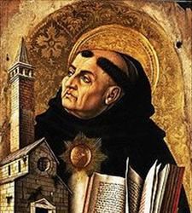
The Revival of Learning
Thomas Aquinas argued that religious truths could be proved by logic
Wrote the Summa Theologicate
Combined ancient Greek thought with modern Christian thought
Scholastics- Wise school men who used the knowledge of Aristotle to debate the issues of the day

