Slide 1
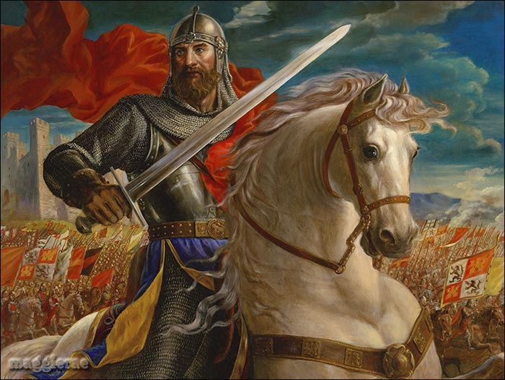
Section 3-The Age of Chivalry

Slide 2
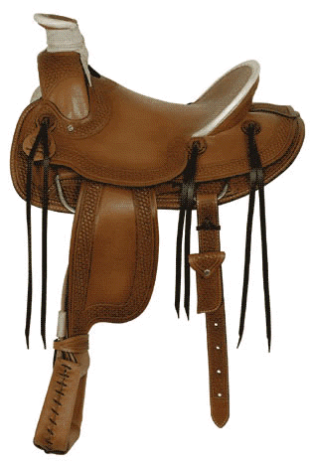
Knights: Warriors on Horseback
Technology of Warfare Changes-
  Leather saddles and stirrups allowed warriors to handle heavy weapons while fighting
  Mounted knights = most important part of the army

Slide 3
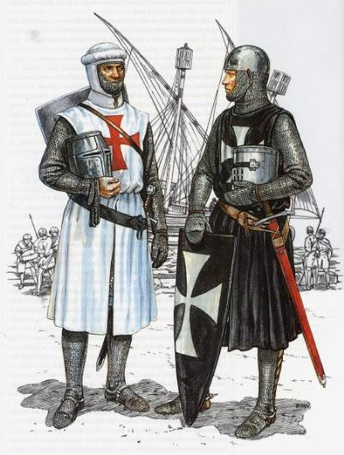
Knights: Warriors on Horseback
A Warriors Role-
  Feudal lords hired private armies of knights to protect their land
    40 days of service a year
  Traded protection for fiefs (land grants)
    Wealth allowed the knights to
      Devote their lives to war
      Buy weapons, armor, warhorses

Slide 4
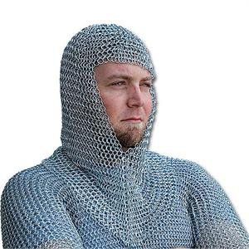
Knighthood and the Code of Chivalry
Chivalry-A complex set of ideals, in which a knight would fight bravely for three masters
  Earthly feudal lord
  Heavenly Lord
  His chosen lady
Qualities of an Ideal Knight-
  Loyal
  Brave
  Courteous

Slide 5
Chivalry
The Italian painter Paolo
Uccello captures the spirit of
the age of chivalry in this
painting, St. George and the
Dragon (c. 1455–1460).
According to myth, St. George rescues a captive princess by killing her captor, a dragon.
• The Knight St. George,
mounted on a horse and
dressed in armor, uses his
lance to attack the dragon.
• The Dragon The fierce looking dragon represents evil.
• The Princess The princess
remains out of the action as
her knight fights the dragon
on her behalf.
SKILLBUILDER:
Interpreting Visual Sources
In what way does this painting show the knights commitment to the code of chivalry ?

Slide 6
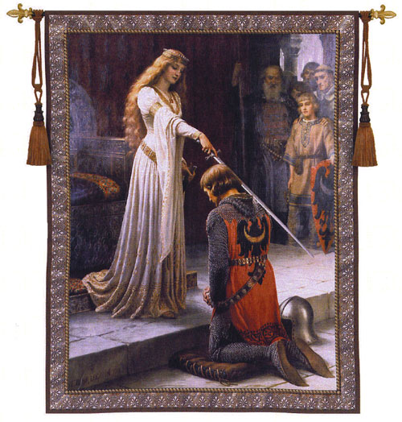
Knighthood and the Code of Chivalry
Knights Training-
  Age 7-Sent off to a castle became a page
  Age 14- Became a squire (knights servant)
  Age 21-Became a full-fledged knight
Tournaments-Staged battles for practice

Slide 7
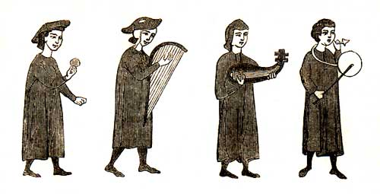
Literature of Chivalry
Epic Poems-
  They recounted a hero’s deeds and adventures
  Song of Roland-Earliest and most famous epic poem
Troubadours-Traveling Poet-Musicians
  Composed poems about the joys and sorrows of love

Slide 8
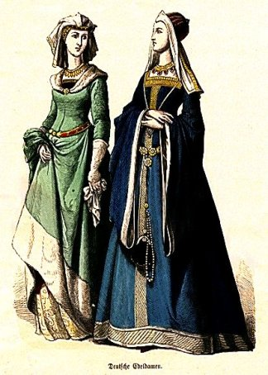
Women’s Role in Feudal Society
Women were seen as inferior to men
Noblewomen-
  Could inherit and estate from her husband
  Send knights to war
  Act as military commander when her husband was away
    Hurled rocks and shot arrows at attackers
  They were most often limited to activities around the home or convent

Slide 9
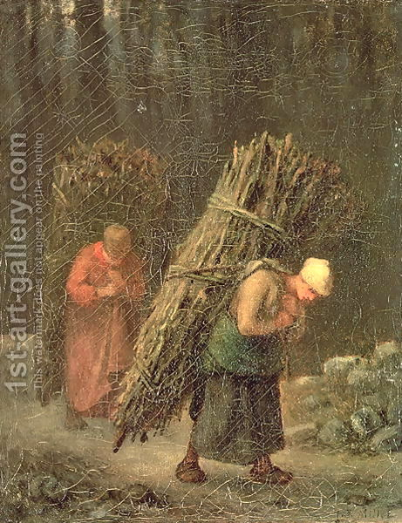
Women’s Role in Feudal Society
Peasant Women-
  Poor and powerless
  Performed endless labor
    In the home and fields
    Raised children
    Took care of families
  Poor girls learned house hold skills
  Rich girls were educated

Slide 10
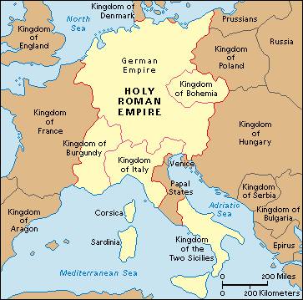
The Church and The Holy Roman Empire
Holy Roman Empire-
  German-Italian empire that became the strongest state in Europe

