Slide 1
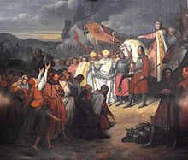
Section 1-Charlemagne Unites Germanic Kingdoms Pt. 1

Slide 2
Invasion of Western Europe
Middle Ages- Spanned 500-1500 A.D.
Disruption of Trade-
Merchants faced invasion from land and sea. Devastated Europe’s economy and left money scarce
Downfall of Cities-
Cities became abandoned as centers of administration

Slide 3
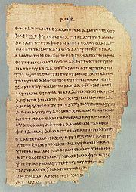
Invasion of Western Europe
Population Shifts-
Cities collapsed = nobles and other citizens retreating to rural areas.
Decline of Learning-
Germanic Invaders couldn’t read or write so education decreased.
No written language but strong oral tradition
Greek language was nearly lost

Slide 4
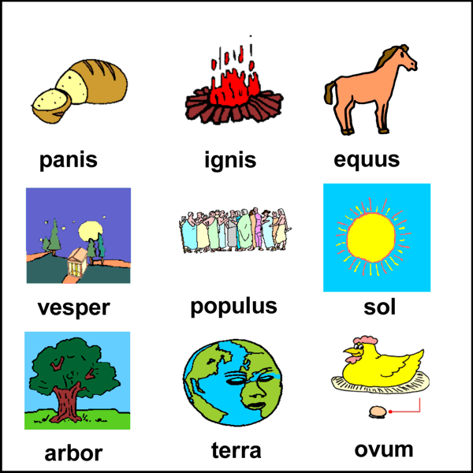
Invasion of Western Europe
Loss of Common Language-
Pure Latin (although still the official language) was lost.
By the 800’s the language spoken was a mix of Latin, French, Spanish, and other-Roman languages

Slide 5
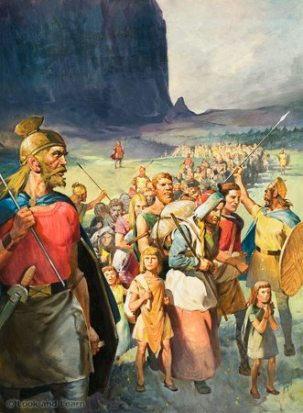
Germanic Kingdoms Emerge
Between 400-600 small Germanic kingdoms replaced Roman provinces
Changes in Government-
Personal loyalty and family ties held Germanic society together
Germanic people lived in small communities with unwritten rules and traditions

Slide 6
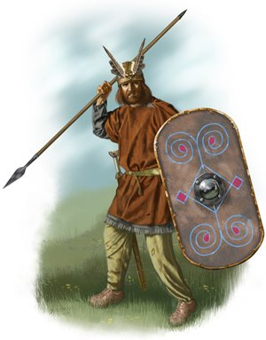
Germanic Kingdoms Emerge
Germanic Warriors-
Pledged their loyalty to the chief
Would fight to the death for their lord
Saw it as disgrace to outlive the lord
Felt no obligation to a king
Would not pay taxes or obey a emperor they never met

Slide 7
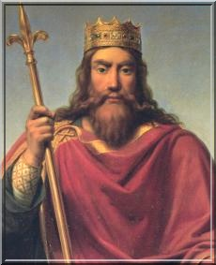
Germanic Kingdoms Emerge
Clovis Rules the Franks-
Clovis was the leader of the Franks
Brought Christianity to the region
Church of Rome supported him
By 511, Clovis had unified the Franks into one united kingdom

Slide 8
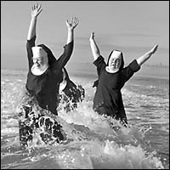
Germans Adopt Christianity
Politics played a key role in spreading Christianity.
By 600 The Church and Franks converted many Germanic people
Religious travelers often risked their lives bringing religious beliefs to other lands
Monasteries-
Religious communities built by the Church
Asked men to give up their possession and serve God
Nuns-Women who served God
Lived in convents

Slide 9
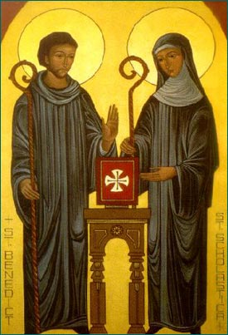
Germans Adopt Christianity
Benedict-
Italian monk who wrote rules for living in a monasteries
Scholastica-
Benedict’s sister
Adopted his rules for women living in convents

Slide 10
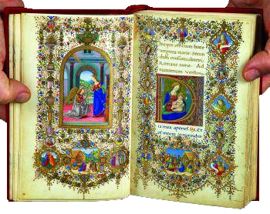
Germans Adopt Christianity
Monks and nuns-
Devoted their lives to prayer and good works
Opened schools
Maintained libraries
Copied books
Illuminated Manuscripts-
Beautiful religious writings decorated with ornate pictures

