Slide 1
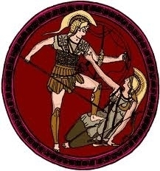
Section 2-Warring City-States-Part 2

Slide 2
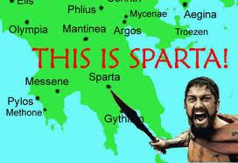
Sparta Builds a Military State-
Sparta Builds a Military- Sparta was located in the southern part of Greece.
In both cultural outlook and values Sparta sharply contrasted the other city- states. Instead of being a democracy Sparta was a military state.

Slide 3
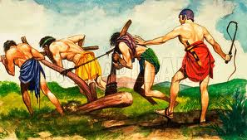
Sparta Builds a Military State-
Sparta Dominates the Messenia’s-
725 B.C. Sparta conquered the neighboring region of Messenia.
The Messenians became helots
Helots were forced to work the land and were required to give the Spartans half their crops.
Around 650 B.C. tired of Spartan rule the Messenians rose up and rebelled. The Spartans put down the rebellion even though they were out numbered 8 to 1.

Slide 4
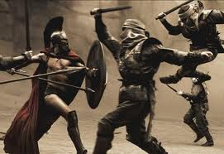
Sparta Builds a Military State-
Spartan Government and Society-
Government- Made up of several branches.
An Assembly- Which comprised of all Spartan citizens, elected officials and voted on major issues.
The Council of Elders- Made up of 30 older citizens which proposed the laws the assembly voted on.
Five Elected Officials- Carried out the laws passed by the assembly. They also controlled education and prosecuted court cases.
Two Kings-Who ruled over Sparta’s military forces.

Slide 5
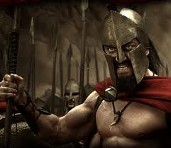
Sparta Builds a Military State-
Society- Made up of several groups
Citizens who descended from the original inhabits of the region.
Ruling families who owned the land.
Noncitizens who were free working in commerce and industry.
The helots were at the bottom of Spartan society, considered little better than slaves. They tended the fields or acted as house servants.

Slide 6
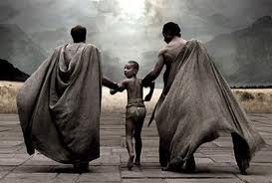
Sparta Builds a Military State-
Spartan Life- For the most part, men and women had completely different roles
Spartan Life- Boys
Daily activities consisted of military training
Marching and fighting in all weather with only a tight tunic with no shoes
Boys were removed from the house at 7 years old and trained until they turned 30 serving until age 60.
They ate black porridge.
Those who were still hungry were encouraged to steal food, this created resourceful soldiers.

Slide 7
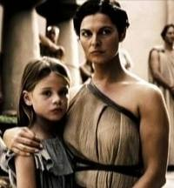
Sparta Builds a Military State-
The Girls-
Spartan women received some military training, while they also ran, wrestled and played sports.
Like men, women were taught to place duty to Sparta above everything including family.
Legend has it that Spartan women would tell their husbands “come back with your shield or on it”.
Women also ran the family while the husbands were away which differed from Athens where women were supposed to remain out of sight and quietly raise children.

Slide 8
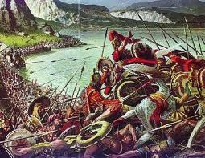
The Persian Wars
The danger of the helot revolt led Sparta to become a military state, and struggles between rich and poor lead Athens to become a democracy.
However, the greatest threat to Greece was the threat of Persian invasion.

Slide 9
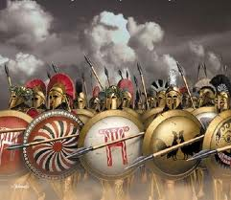
The Persian Wars
A New Kind of Army Emerges-
During the Dorian Age, only the rich could afford bronze spears, shields, breast plates, and chariots.
Iron later replaced Bronze which allowed ordinary citizens to purchase weapons and defend themselves.
A new type of army formed comprised of rich merchants, artisans, and small land owners.
Phalanx-Foot soldiers standing side by side holding spears and shields.

Slide 10
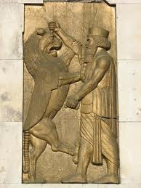
The Persian Wars
Battle at Marathon-
The Persian Wars (between Greece and Persia) began in Ionia around 546 B.C. when the Persians conquered the area.
The Ionians revolted and Athens sent soldiers and ships to their aid.
Darius the Great- the Persian king defeated the rebels and vowed to destroy Athens.
490 B.C.-25,000 Persians crossed the Aegean Sea and fought 10,000 Athenians arranged in phalanxes. Persians wore light armor and were poorly trained.
Death toll: Persians-6,000 Athenians- 200.

Slide 11
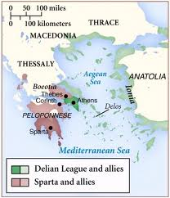
The Persian Wars
Consequences of the Persian War-
Defeating the Persians filled the Greeks with a sense of pride
Especially Athens who during the 470s had become the leader of the Delian League which contained 200 city-states
Athens used military force against anyone who challenged their authority.

