Slide 1
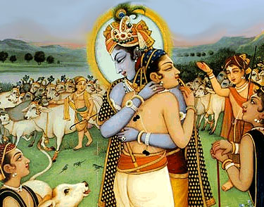
Hinduism and Buddhism Develop
Chapter 3-Section 2-Part 1

Slide 2
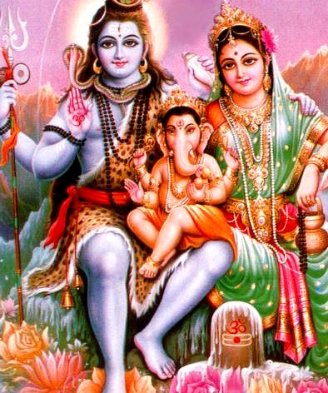
Hinduism Evolves Over Centuries
Origins-
Hinduism-no one founder or single set of ideas
See religion as a way of liberating the soul from illusions, disappointments, and everyday mistakes
Upanishads-Written explanations of the Vedic hymns
Moksha-Perfect understanding of all things

Slide 3
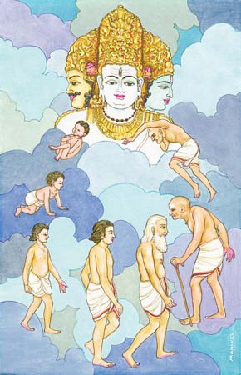
Hinduism Evolves Over Centuries
Beliefs-
Atman- The individual soul
Brahman-World soul (contain all Atmans)
When one understands this relationship they are released from life
Reincarnation- An individual’s soul is reborn until moksha is achieved

Slide 4
Hinduism Evolves Over Centuries
Karma-
Good or bad deeds
They follow you from one incarnation to the next

Slide 5
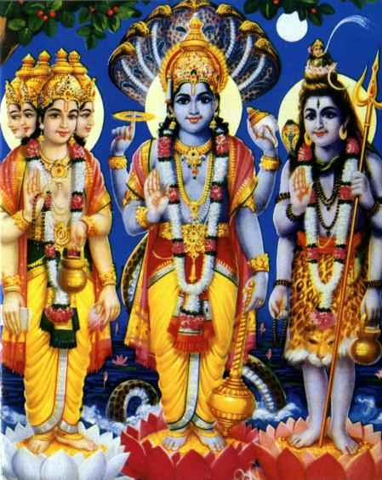
Hinduism Evolves Over Centuries
Brahma (world soul) has taken the personality of three gods over the last 2,500 years
Brahma-The Creator
Vishnu-The Protector
Shiva-The Destroyer
Hindus are free to worship any god or no god at all

Slide 6
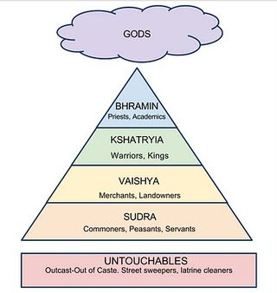
Hinduism Evolves Over Centuries
Hinduism and Society-
Caste System-
The better caste you were born into the better you were in a past life
Only those men in the top three castes can achieve moksha in their present life
Hindus turn to religion to help guide everyday decisions

Slide 7
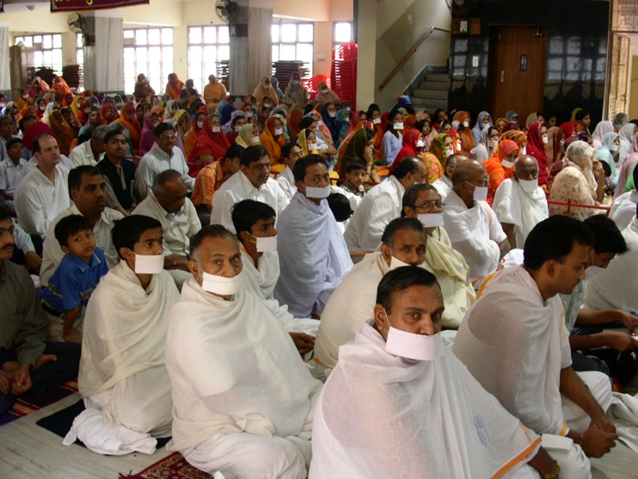
Hinduism Evolves Over Centuries
Jainism-
Mahavira- Jainism’s founder
Belief that everything in the universe has a soul
So you can’t harm or kill anything
About 5 million Jains in the world
Almost all live in India

