Slide 1
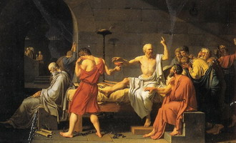
Section 3-Democracy and Greece’s Golden Age

Slide 2
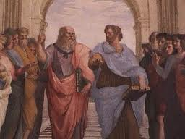
Pericles’ Plan for Athens
The Golden Age of Athens- A 50 year period (477 to 431 B.C.) where Athens experienced both intellectual and artistic growth.

Slide 3
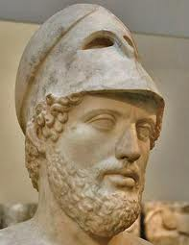
Pericles’ Plan for Athens
Pericles lead Athens for 32 years
He was described as honest, fair, an inspiring speaker, a skillful politician and a respected general.
461 to 429 called the Age of Pericles

Slide 4
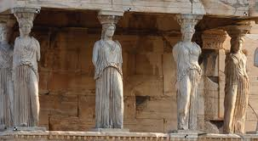
Pericles’ Plan for Athens
Pericles' Three Goals for Athens-
Strengthen Athens Democracy
Hold and strengthen the empire
Glorify Athens
Direct Democracy-A form of government in which citizens ruled directly and not through representatives.

Slide 5
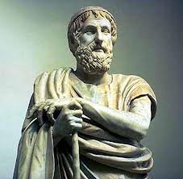
Pericles’ Plan for Athens
Stronger Democracy-
Political office became a paid position
Now any one rich or poor could serve if elected or chosen
Direct Democracy became one of Pericles’ lasting legacies

Slide 6
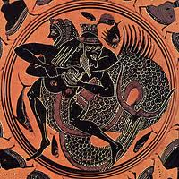
Pericles’ Plan for Athens
Glorifying Athens-
Pericles used treasury funds to beautify Athens
More money was spent on the artists than the actual materials

Slide 7
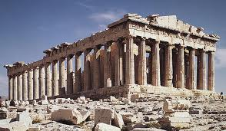
Glorious Art and Architecture
The Parthenon-
23,000 sq. ft. building created to honor Athena (Goddess of Wisdom)
Contained a 30 foot tall statue of Athena

Slide 8
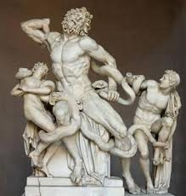
Glorious Art and Architecture
Greek Sculptures-
Designed to show the idealized human body in motion
Both graceful and strong
Classical Art-
Values harmony, order, balance and proportion

Slide 9
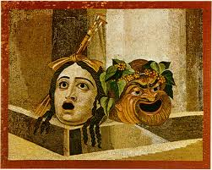
Drama and History
The Greeks invented drama
Source of civic pride and tribute to the gods
Wealthy citizens funded the plays
Actors used colorful masks and costumes
Plays were about leadership, justice, and duty towards the gods

Slide 10
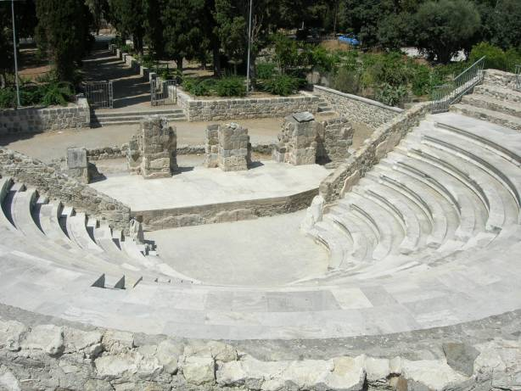

Slide 11
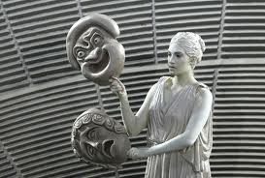
Drama and History
Two Types of Greek Drama-
Tragedy-A form of drama containing common themes such as love, hate, war and betrayal.
Often featured a tragic hero
Someone with an extraordinary ability but a tragic flaw

Slide 12
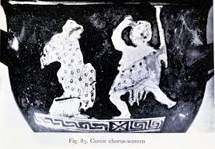
Drama and History
Comedy-A form of drama that contained scenes filled with slapstick situations and crude humor
Made fun of politics and respected people or ideas

Slide 13
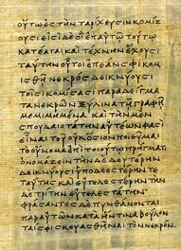
Drama and History
Historical Records-
400 year period with no written history known as the Dorian age
Herodotus’ book on the Persian war is considered the 1st historical work

Slide 14
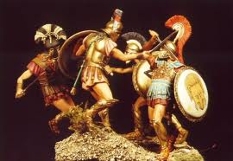
Athens and Sparta go to War
Athens wealth and prestige were the envy of other cities
Athens and Sparta quickly became enemies and began to build up their armies
Sparta declared war in 431 B.C.

Slide 15
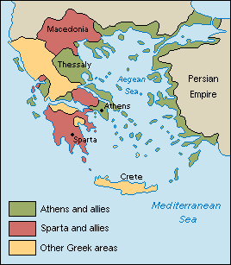
Athens and Sparta go to War
The Peloponnesian War-
Athens had a stronger navy
Spartans had a stronger army
They swept in and burned Athens food supply
430 B.C. a plague killed 1/3 of all Athenians
421 B.C. Both sides had became worn down and called a truce

Slide 16
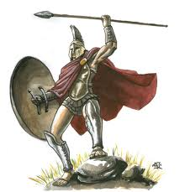
Athens and Sparta go to War
Spartans Gain Victory-
The truce was short lived
415 B.C. 20,000 Athenian soldiers attacked the city-state of Syracuse
The Spartans attacked the Athenians and they fought for 9 more years
404 B.C. Athens surrendered losing their empire, wealth and prestige

Slide 17
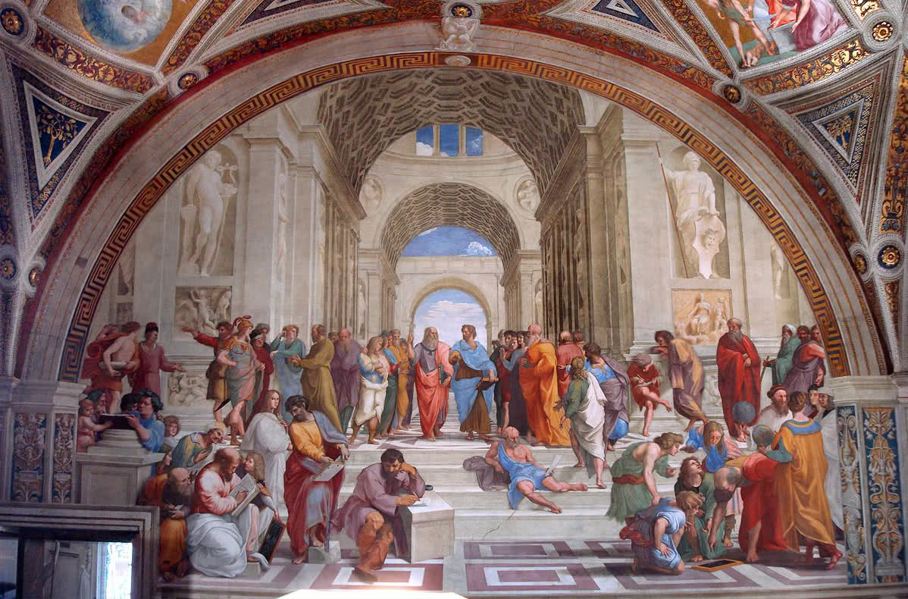
Philosophers Search for Truth
Philosophers-“Lovers of Wisdom” based their philosophy on two principals
The universe (land, sky, and sea) is put together in an orderly way, thus subject to absolute and unchanging laws
People can understand these laws through logic and reason

Slide 18
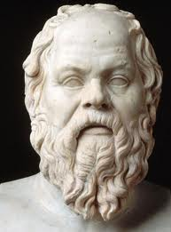
Philosophers Search for Truth
Socrates (470-399 B.C.)-
Encouraged his students to examine their beliefs
Believed absolute standards did exist for truth and justice
Sentenced to death for corrupting the youth
Instead he died by drinking hemlock, a slow acting poison

Slide 19
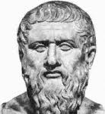
Philosophers Search for Truth
Plato (427-347 B.C)-
Studied under Socrates
Wrote “The Republic” in the 370’s B.C.
This focused on his vision of a perfectly governed society.
Felt people fell into three groups
Farmers and artisans
Warriors
The Ruling class
Philosopher king was the one with the greatest intellect

Slide 20
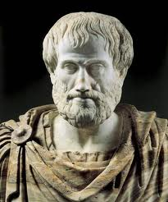
Philosophers Search for Truth
Aristotle (384-322 B.C.)-
Plato’s pupil
Questioned the nature of the world, human belief, knowledge and thought
Created guidelines for arguing according to rules and logic
His work is the framework for the scientific method
Alexander the Great served as his student for 3 years

Slide 21
Chapter 5-Review Terms

Slide 22
Chapter 5-Review Terms

Slide 23
Chapter 5-Review Terms

Slide 24
Chapter 5-Review Terms

