Slide 1
Bell Work Wednesday 9/10
Look in your book beginning on page 123 and begin reading to find the answers
1. Who was the most famous of all the Greek story tellers?
2. What are epics (a.k.a. Epic Poems)?
3. What did the Greeks attempt to understand through the use of myths?

Slide 2
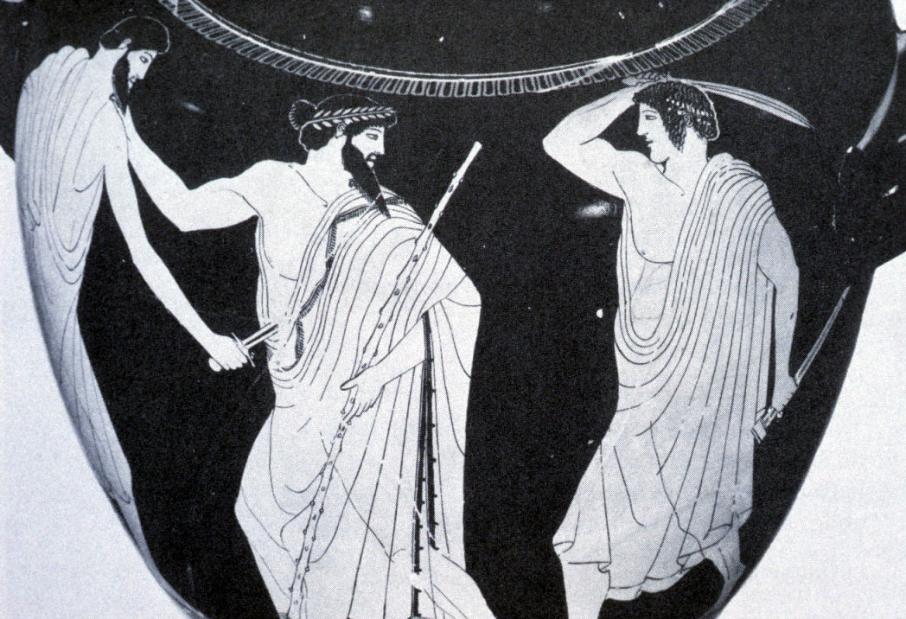
Classical Greece
Chapter 5

Slide 3
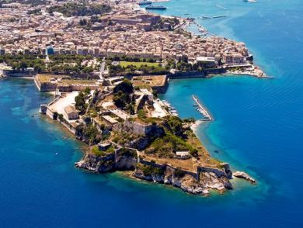
Section 1- Cultures of the Mountain and the Sea

Slide 4
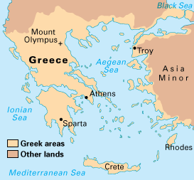
Geography Shapes Greek Life-
Ancient Greece was mainly a mountain peninsula jetting out into the Mediterranean Sea.
Containing roughly 2,000 islands in the Aegean and Ionian seas.

Slide 5
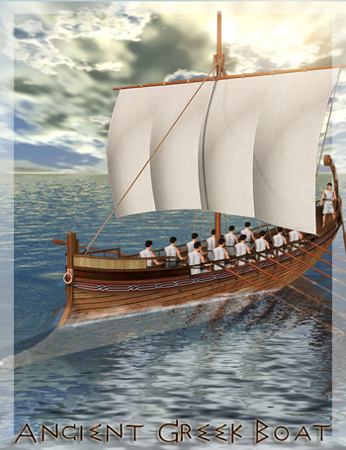
Geography Shapes Greek Life-
The Sea- The Greeks rarely had to travel more than 85 miles in order to reach the coastline.
As a result the Greeks became skilled sailors, and linked them with other societies.
Due to the fact that Greece lacked natural resources trade became a vital part of Greek life.

Slide 6
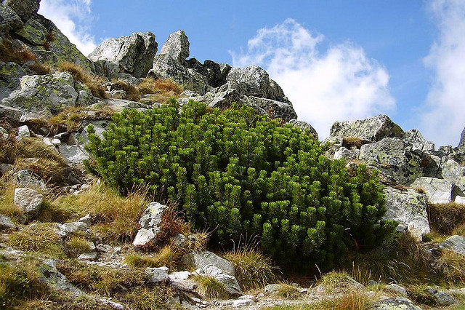
Geography Shapes Greek Life-
The Land- Rugged Mountains covered three-fourths of ancient Greece dividing it into several different regions.
These mountains caused Greece to developed small independent communities instead of a large central government.

Slide 7
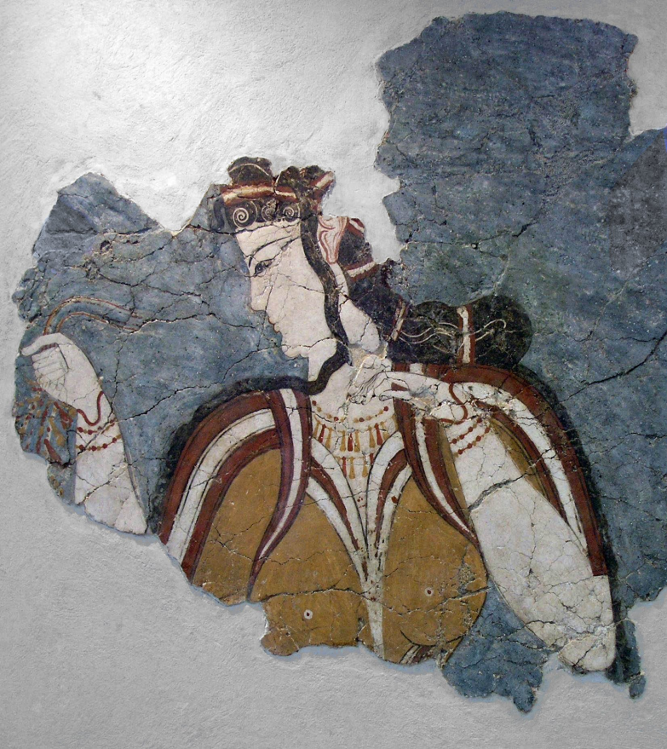
Mycenaean Civilization Develops-
Mycenaean’s were Indo-European immigrants who settled on the Greek mainland around 2000 B.C. Their leading city was named Mycenae.
Mycenae was located in Southern-Greece on a rocky ridge with a protective wall 20 feet thick.

Slide 8
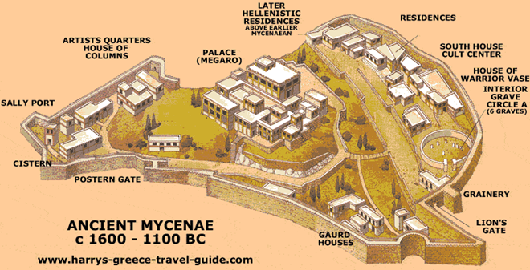
Ancient Mycenae 1600-1100 B.C.

Slide 9
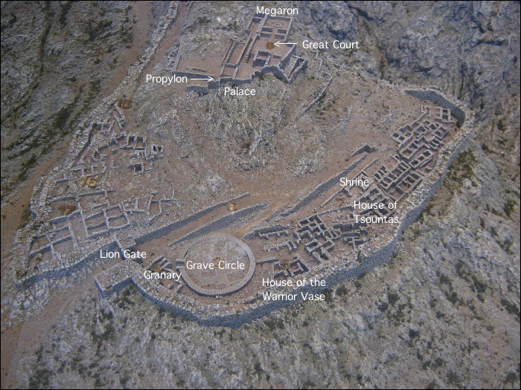
Ancient Mycenae 1600-1100 B.C.

Slide 10
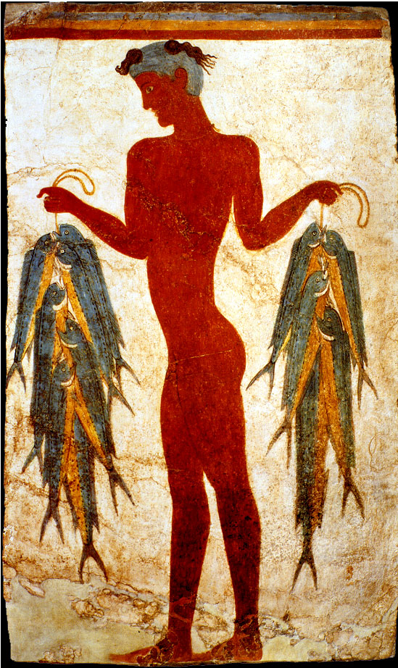
Mycenaean Civilization Develops-
Contact with the Minoans-
Either through trade or war the Mycenaean’s came into contact with the Minoans.
This showed the Mycenaean’s the value of seaborne trade.
They sailed through the eastern Mediterranean making stops at the Algerian islands, costal Anatolia and the ports of Syria, Egypt, Italy, and Crete.

Slide 11
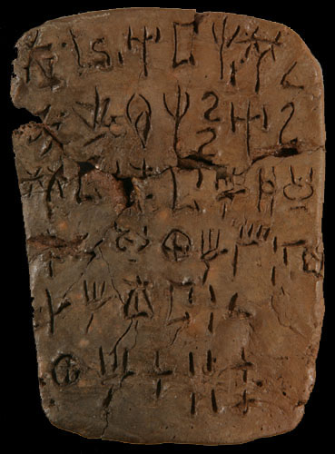
Mycenaean Civilization Develops-
The Mycenaean’s also adapted to the Minoan writing system to the Greek language.
The Minoan’s heavily influenced Greek religious practices, art, politics, and literature.

Slide 12
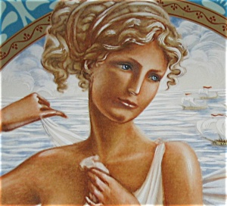
Mycenaean Civilization Develops-
The Trojan War- During the 1200’s B.C. the Mycenaean’s fought a ten-year war against the city of Troy.
The Greek army besieged and destroyed Troy because they believed a Trojan prince Paris had kidnapped Helen.
The Trojan warriors hid in a giant wooden horse and attacking the city while they were asleep.

Slide 13
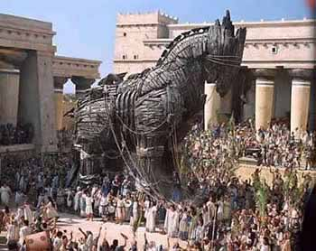

Slide 14
Greek Culture Declines Under the Dorian’s-
The Dorians were far less advanced than the Mycenaean’s. Their economy collapsed and trade eventually came to a standstill.
Most importantly historians believe that the Greeks appear to have temporarily lost the art of writing during the Dorian Age.
No written record exists for a 400-year period between 1150 and 750 B.C.
So little is known about this part of Greek history.

Slide 15
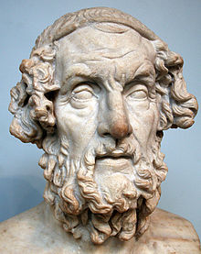
Greek Culture Declines Under the Dorian’s-
Epics of Homer-
According to Greek tradition the greatest story teller was a blind man named Homer.
The Trojan War serves as the backdrop to one of his greatest epic poems the Iliad.
The poem focuses on Hector’s pursuit of the Greek ideal of arête meaning virtue or excellence.

Slide 16
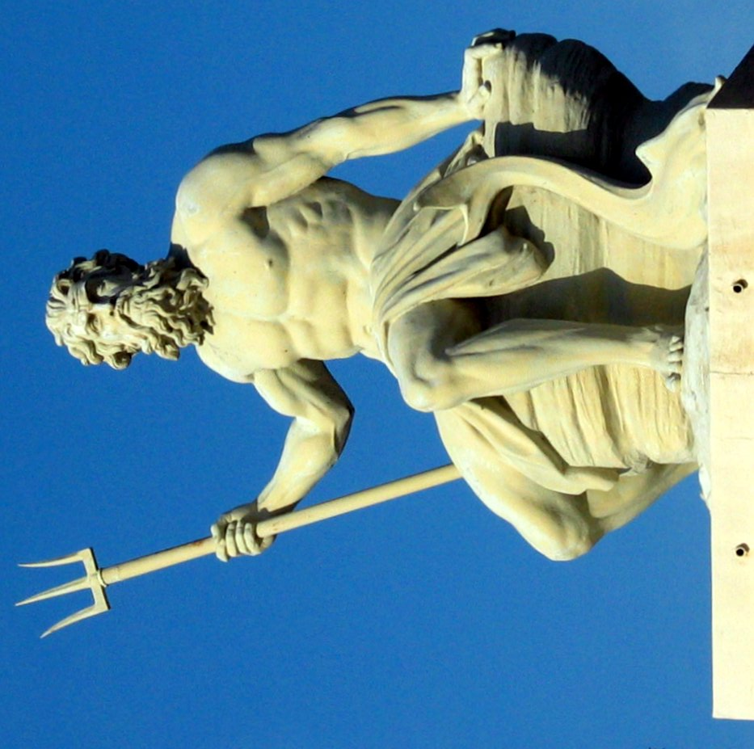
Greek Culture Declines Under the Dorian’s-
Greeks Create Myths- The Greeks developed a rich set of myths, about their gods.
Through these myths the Greeks sought to understand the mysteries of nature, the power of human passions, and even the changing seasons.

Slide 17
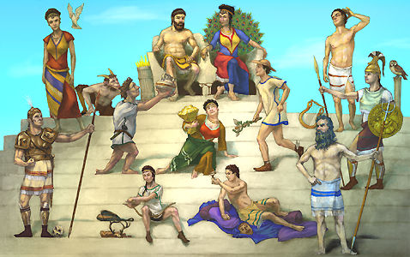
Greek Gods

Slide 18
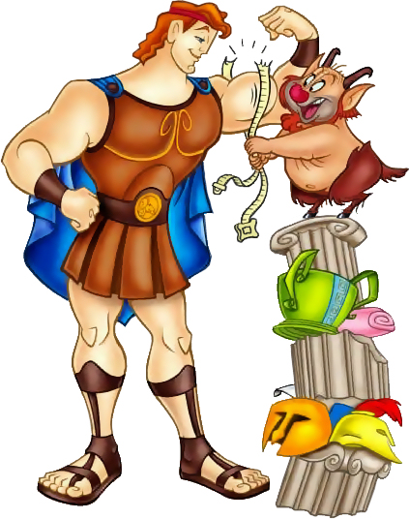
Greek Culture Declines Under the Dorian’s-
The Greeks attributed human characteristics such as greed, love hate and jealousy to their gods.
The gods quarreled like humans except they lived forever.
Zeus was the king of the gods, living on Mount Olympus with his wife Hera. Hera was jealous of Zeus’s affairs with human women (resulting in the birth of Hercules).
The city of Athens was named after Athena Zeus’s daughter the goddess of wisdom.

Slide 19
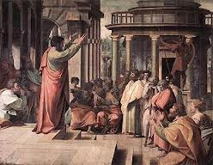
Rules and Order in Greek City-States-
Greek Political Structures- Greek city states had several different forms of government.
Monarchy- Single ruler (King)
Aristocracy- A government ruled by a small group of noble land owning families.
Oligarchy- A government ruled by a few powerful people.
(Direct) Democracy- State ruled by its people.

