Slide 1
Student /Parent Orientation
August 31-September 3
MS. Chamseddine Class
5th Grade Virtual Learning Class
2020-2021

Slide 2
Virtual Learning
Your child will be participating in the Dearborn Virtual Learning Program
All 2020-2021 school year
What does this mean?
Lessons taught by teacher stationed at River Oak Elementary
Live lessons and assignments provided by your teacher, Ms. Chamseddine
Dearborn Public Schools Reopening Plan

Slide 3
About Me!
My name is Mary Darwish-Chamseddine and I have been an educator for 27 years now. This is my 27th year teaching in Dearborn and my 10th year teaching 5th grade.
I grew up in Dearborn Michigan. I attended Wayne State Michigan University where I earned my undergrad and Wayne State University , Marygrove University and Madonna University where I earned my three masters degree.
I have two children Ahmad who is an attorney and Soraya who is a nurse. I enjoy reading and cooking.

Slide 4
Daily Schedule
8:55-10:25 - ELA
10:30-11:45 - Math
11:45-12:25 - Lunch
12:25-1:00 - Science/Social Studies
1:00-1:55 - SPECIALS
2:00-3:50 - Independent and Small Groups - By invitation

Slide 5
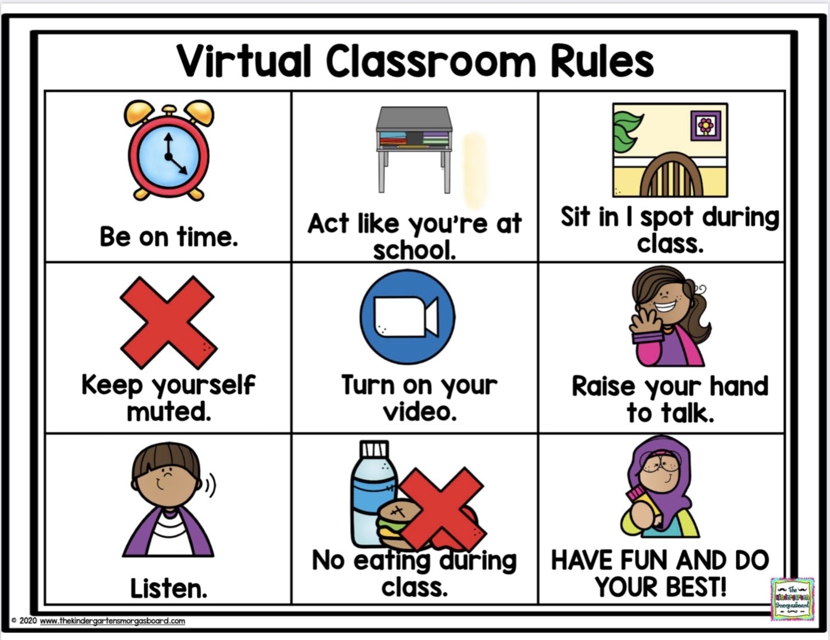
Class Rules

Slide 6
Morning learning (8:55 to 11:45)
Students will not be working online the entire school day. Teachers will post more detailed schedules for students on Schoology once class begins.
In broad terms, elementary students will spend the time before lunch (8:55 to 11:45) working on reading, math, and writing with their teacher. This will include a mix of lessons from the teacher, small group work with the teacher, and independent work at home.

Slide 7
Afternoon Learning (1:55 to 3:50)
The afternoons will vary by day. The last part of the day (1:55 to 3:50) will be used for asynchronous work for most students while teachers reach out for more one-on-one or small groups with students for interventions and monitoring.

Slide 8
Supplies
You are being provided with:
Math materials/Eureka
Reading Materials/Benchmark
Potentially other materials

Slide 9
Suggested Materials
In addition to what you have received from school, you might consider having these materials at home during the virtual learning.
Highly suggested items:
Pencils
Whiteboard
4 Notebooks
Pencils, highlighters. eraser, pens, dry erase markers {and dry erase eraser (I use an old sock)}
Multiplication flashcards
Dictionary

Slide 10
Student Expectations
Students are expected to log on everyday at 8:55am for attendance and their first live lesson of the day. ATTENDANCE MATTERS
Parents MUST CALL IN an absence to their homeschool like you normally would. You cannot simply “tell your teacher”.
Students will be expected to be available during the school day for live lessons as well as small group virtual lessons.
Students are expected to participate during the lessons.
Students are expected to be respectful of teacher and other students during lessons. Example, You must remain on mute unless instructed by the teacher.
Students are expected to be prepared with materials as directed by teacher. Example, your zearn lesson must be DONE before the day’s math lesson starts.
Students are expected to communicate with the teacher if they have any problems with technology, lessons or homework.

Slide 11
Parent Expectations
Parents are expected to make sure their child(ren) are available for virtual school each day.
Parents are expected to encourage students to participate during lessons respectfully.
Parents are encouraged to provide their child(ren) a quiet spot for the live lessons as well as a quiet spot to complete any assignments.
Parents are encouraged to contact the teacher with any problems or concerns.
Teachers will be available during the normal school day.
Teacher will be available for appointments during the normal school day.

Slide 12
Teacher Expectations
Teachers will be available during the school day.
8:55-3:50 (during virtual school)
See schedule in above slide for breakdown of student learning day
Teachers will provide live lessons during the day (synchronous)
Teachers will provide students with assignments to work on independently (asynchronous)
*Find our ZEARN class at www.zearn.org (sign in with school google account) and join with the Class Code: BY4A3F

Slide 13
Digital communication tools
Schoology - the new district method of providing online learning
Zoom - teachers will use Zoom for live lessons
Teacher Blog - https://iblog.dearbornschools.org/mchamseddine/
Teacher email - darwism1@dearbornschools.org

Slide 14
Schoology Login information
More information will be forthcoming!

Slide 15
Zoom Login information
Zoom link:
https://dearbornschools-org.zoom.us/meeting/register/tZAkc-ygrz0oHNWKkJOqtiE0ZzTEFJrJ2yty
Meeting ID 849 4581 6261
Security Passcode 158775
You MUST be logged into your school google account to have access to our meetings.

