Slide 1
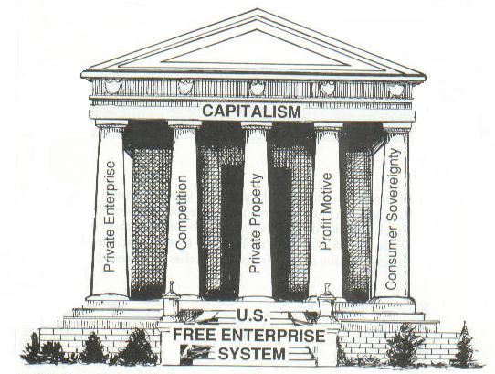
Section 3-Basic Concepts of Democracy

Slide 2
Foundations
The American concept of democracy rests on these five basic notions:
I. Individual Worth-A recognition of the fundamental worth and dignity of every person;
II. Equality-A respect for the equality of all persons;
III. Majority Rule and Minority Rights-A faith in majority rule and an insistence upon minority rights;
IV. Compromise-An acceptance of the necessity of compromise;
V. Individual Freedom-An insistence upon the widest possible degree of individual freedom.

Slide 3
Foundations of American Democracy
I. Individual Worth
Democracy is firmly based upon the importance of the individual.
At times, the welfare of one or a few individuals is subordinated to the interests of many.
Paying taxes, registering for the draft, stopping at a stop sign, etc.
II. Equality
Democracy stresses the equality of all individuals.
“All men are created equal.”
This means that all people are entitled to:
1. Equality of opportunity
2. Equality before the law

Slide 4
Foundations of American Democracy
III. Majority Rule, Minority Rights
Majority Rule-In a democracy, the majority of the people will be right more often than they will be wrong, and will be right more often than will any one person or small group.
Democracy requires majority rule restrained by minority rights.
Majority must recognize the right of any minority to become, if fair and lawful, the majority.
Majority must always be willing to listen to minority’s arguments.
IV. Compromise
Compromise-The process of blending and adjusting competing views and interests.
Essential to Democracy b/c:
Democracy insists that each individual is equal to all others.
Few public questions have only two sides; Most can be answered in several ways.

Slide 5
Foundations of American Democracy
V. Individual Freedom
Democracy can thrive only with individual freedom.
Only as far as the freedom of ALL will allow.
“The right to swing my fist ends where the other man’s nose begins.”
Democratic governments must work constantly to strike the proper balance between freedom and the law.
The authority of government must be adequate to the needs of society; Authority can’t be so great that it restricts the individual.

Slide 6
Democracy and the Free Enterprise System
The free enterprise system is an economic system characterized by private or corporate ownership of capital goods; investments that are determined by private decision rather than by state control; and determined in a free market.
Decisions in a free enterprise system are determined by the law of supply and demand.
An economy in which private enterprise exists in combination with a considerable amount of government regulation and promotion is called a mixed economy.

Slide 7
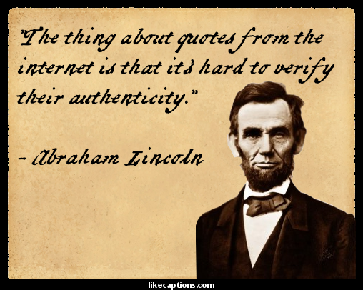
Democracy and the Internet
Democracy demands that the people be widely informed about their government.
Theoretically, the internet makes knowledgeable participation in the democratic process easier than ever before.
However, all data on the World Wide Web is not necessarily true, and the long-term effects of the Internet on democracy has yet to be determined.

