Slide 1

Start with the paper Long, not Tall
Fold the paper from the Right side to the Left side

Slide 2
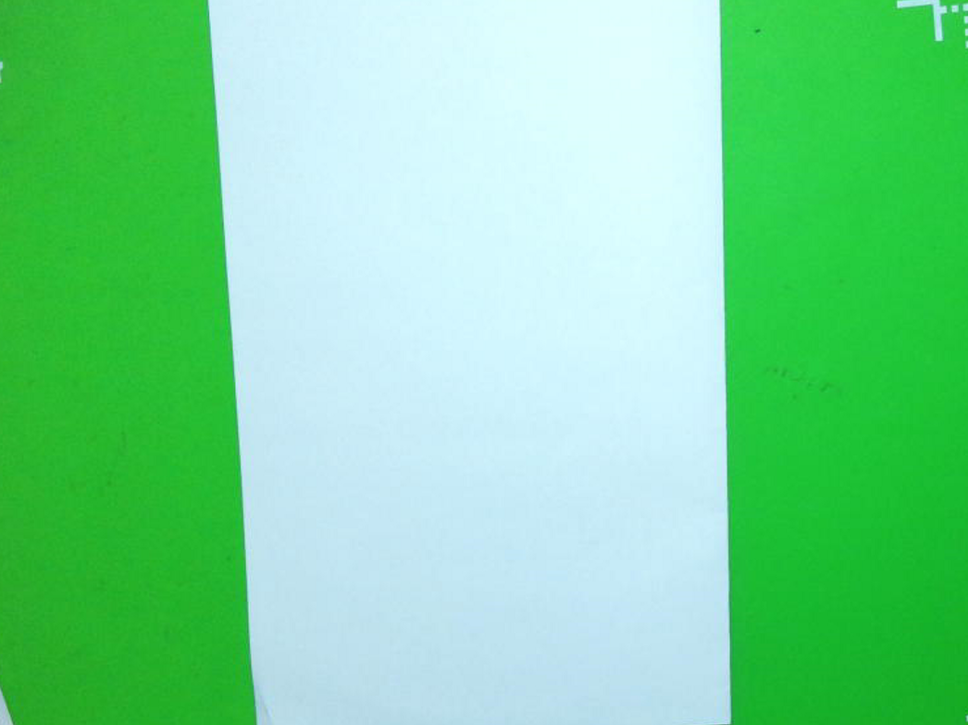
Fold the paper again from Right to Left

Slide 3

Now, fold the paper from the bottom to the top

Slide 4

Fold the paper top to bottom one more time!

Slide 5
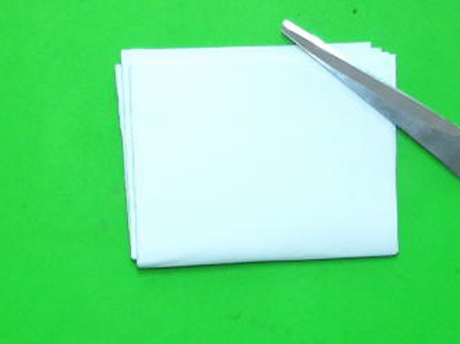
You should now have a small paper
Now that the folding is finished, unfold everything.

Slide 6

You should have a sheet of paper with 16 boxes.
Fold the left side to the middle, and the right side to the middle.

Slide 7
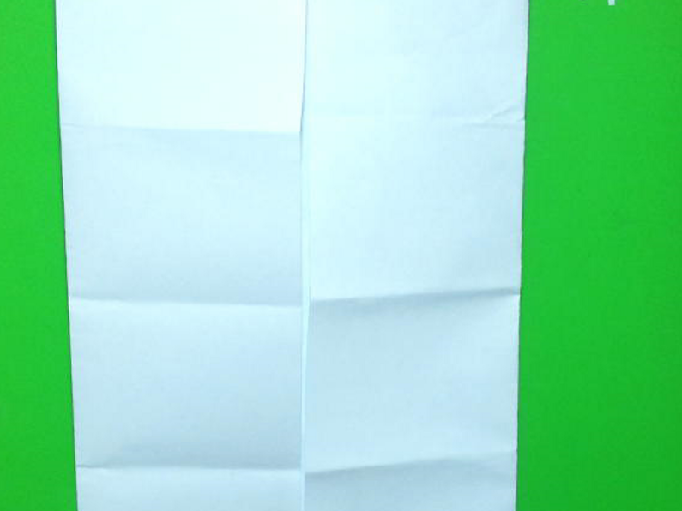
On Each of the boxes, write the following terms near the bottom of each box.
Homozygous 2) Heterozygous 3)Genotype
4) Phenotype 5)Dominant Trait 6)Recessive Trait
7)Gene 8)Allele

Slide 8
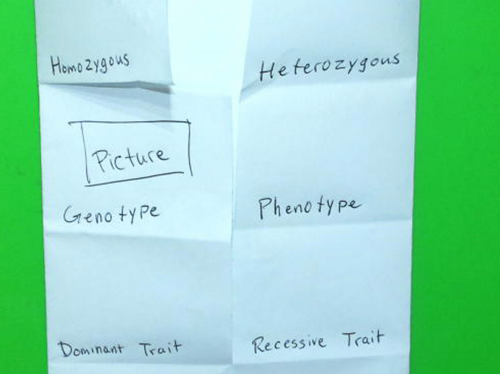
On the front of each box, you will draw a picture for that term.

Slide 9
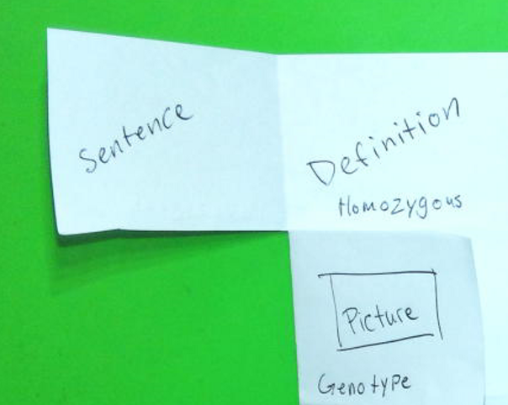
Inside you will write your own sentence, and the definition of each term.

