Slide 2
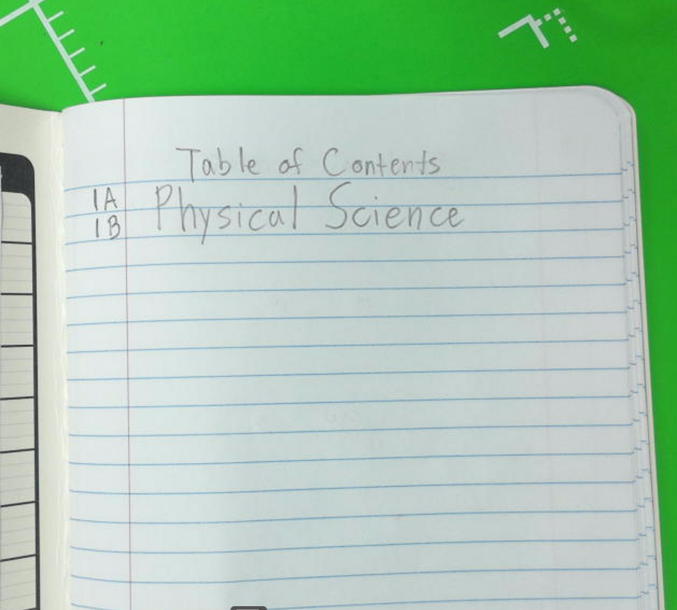

Slide 3
Turn the page

Slide 4
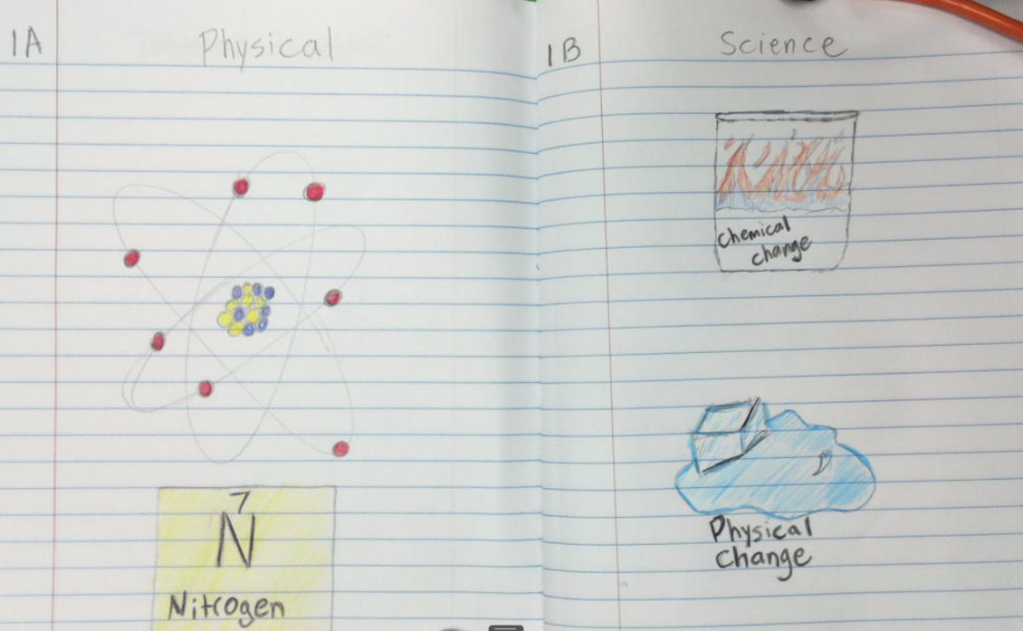
1A and 1B
Label pages 1A and 1B “Physical Science”
On these pages, draw pictures and decorate it to be related to physical science
(Use your text books)

Slide 5
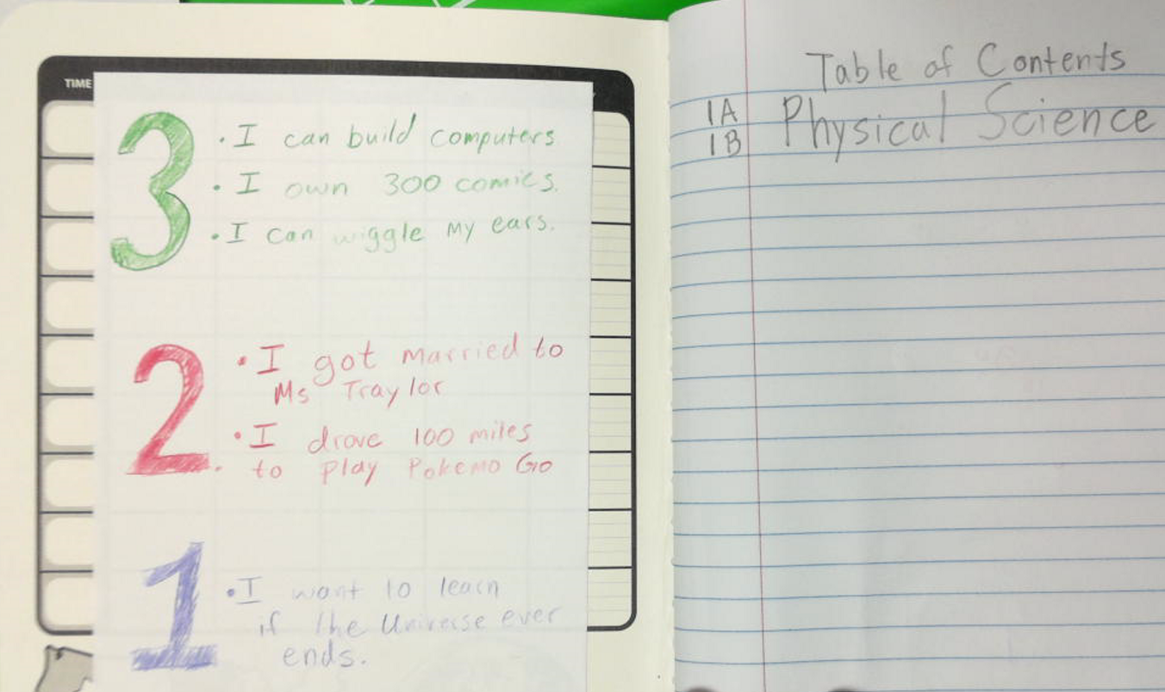
On the Back of the front cover
Glue your 3-2-1 to the back of the notebook cover.

