Slide 1
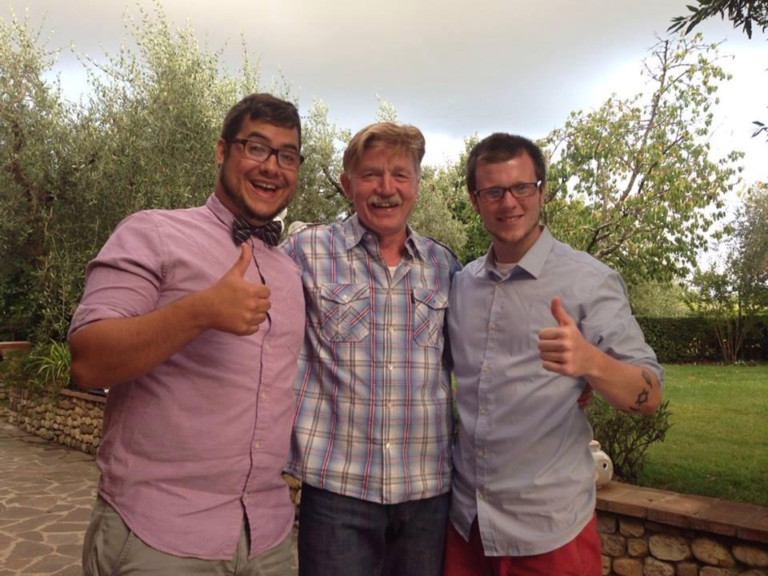
Seventh Grade Science
Starring: Mr. Bailey

Slide 2
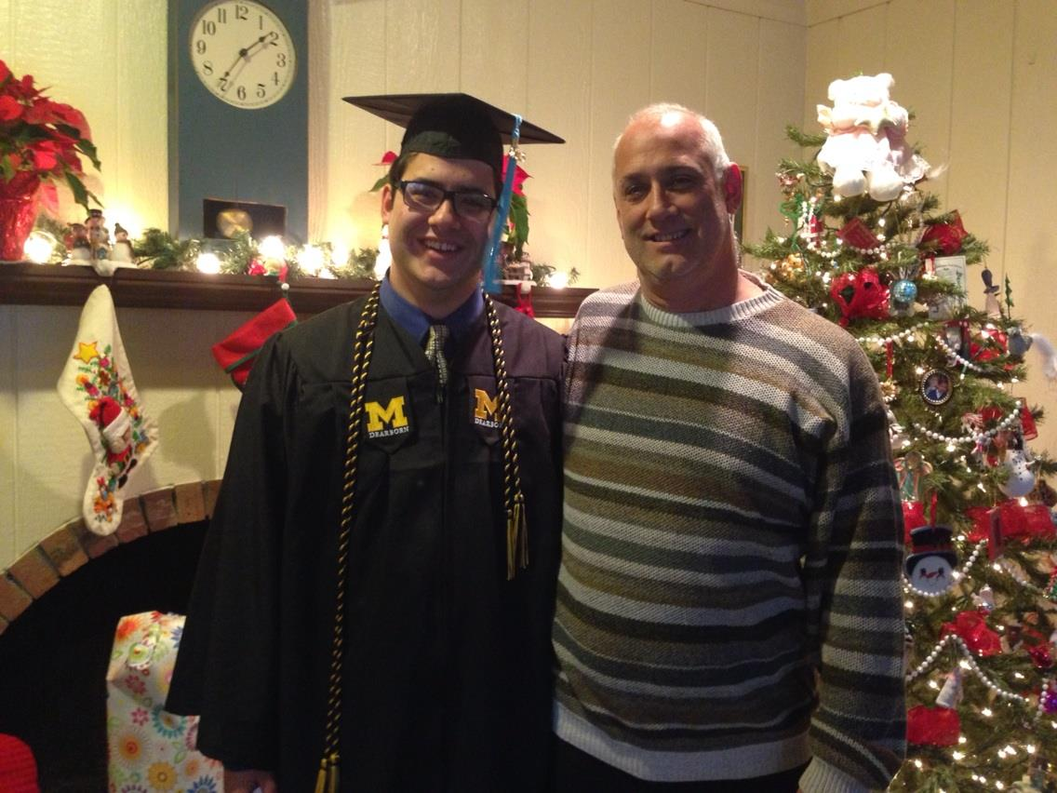
“Who is this guy talking to me?”
I went to school at, and graduated from, The university of Michigan

Slide 3
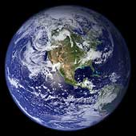
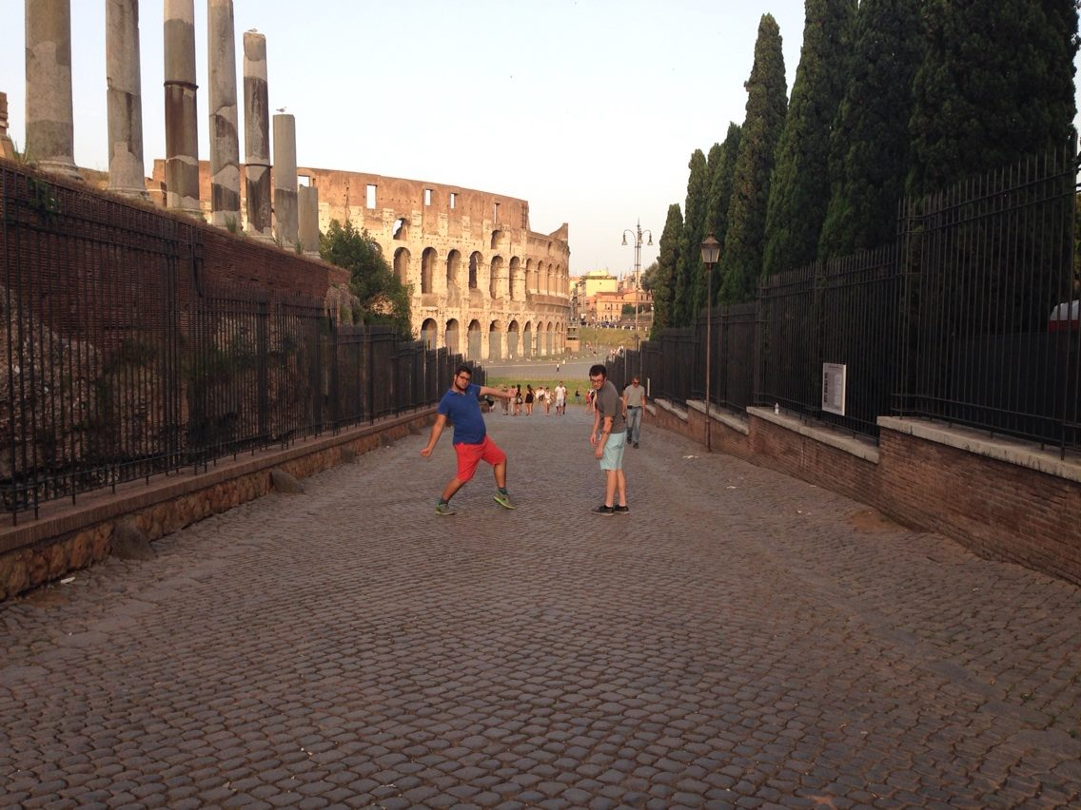
Traveling is one of my favorite things to do

Slide 4
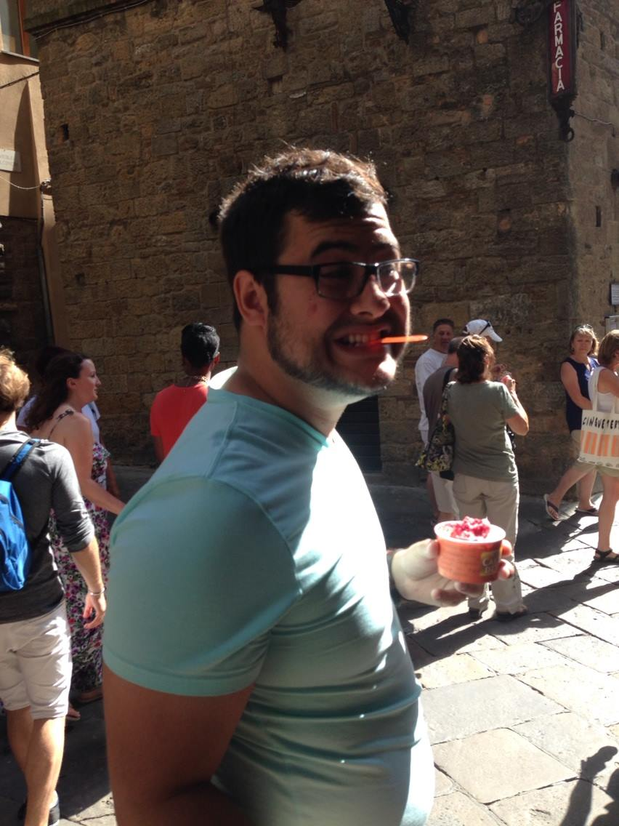
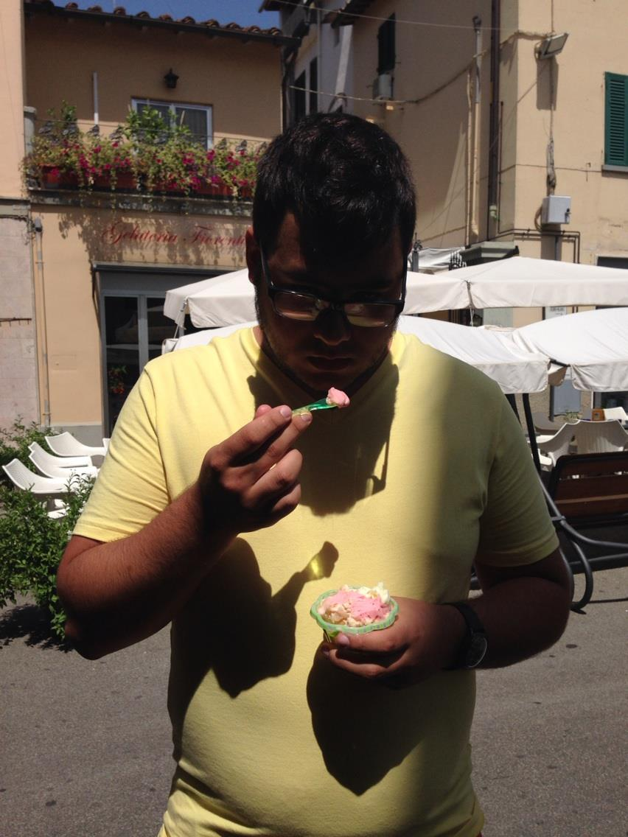
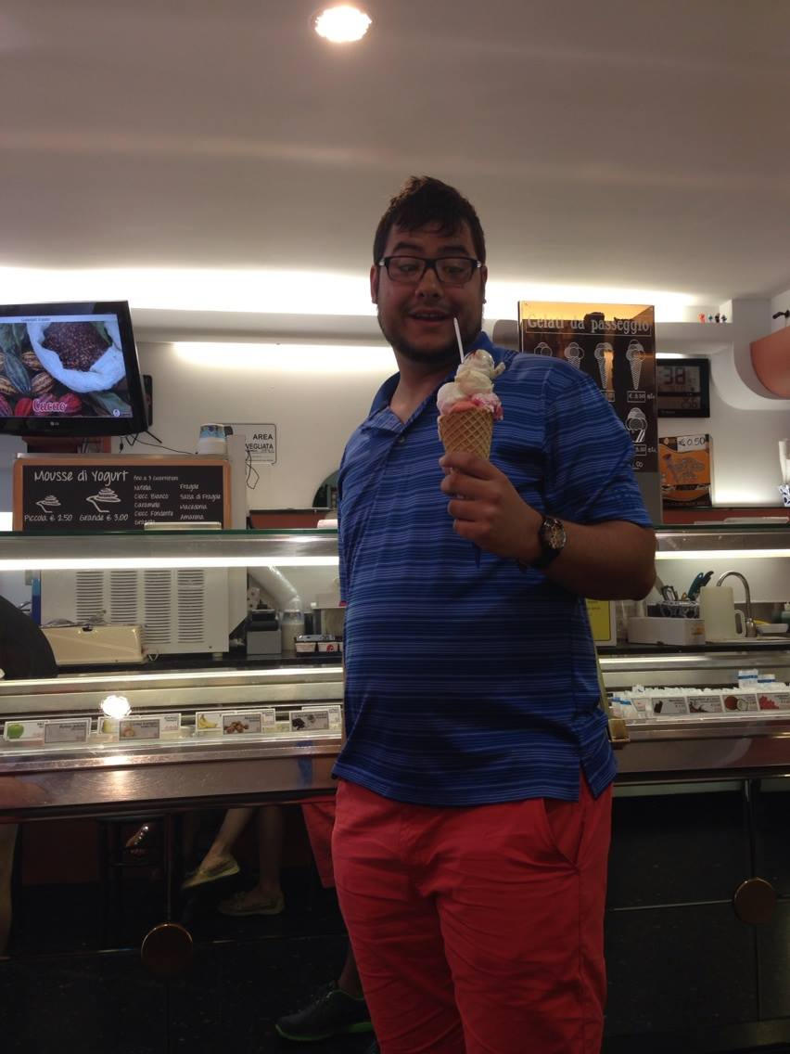
Last Summer I visited Italy
I ate a lot of gelato (Italian ice cream)

Slide 5
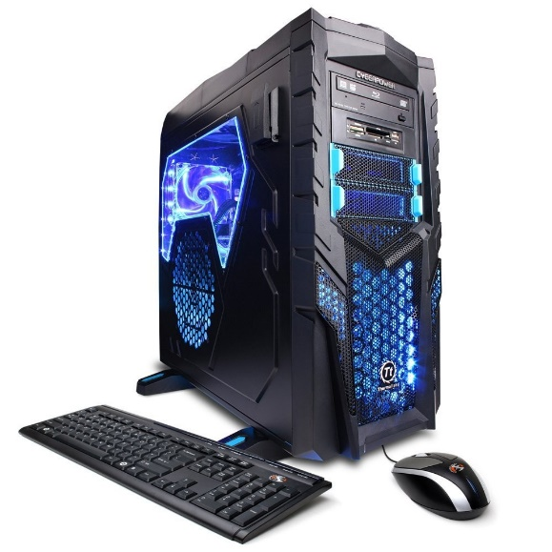
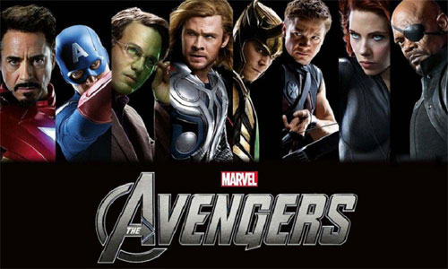
When I’m not teaching I love to…
Play computer games
Play Xbox with my friends
Watch movies; my favorites are Marvel movies!

Slide 6
Oh, speaking of Marvel
I have about 250
I also collect comic books

Slide 7
Now, about Science

Slide 8
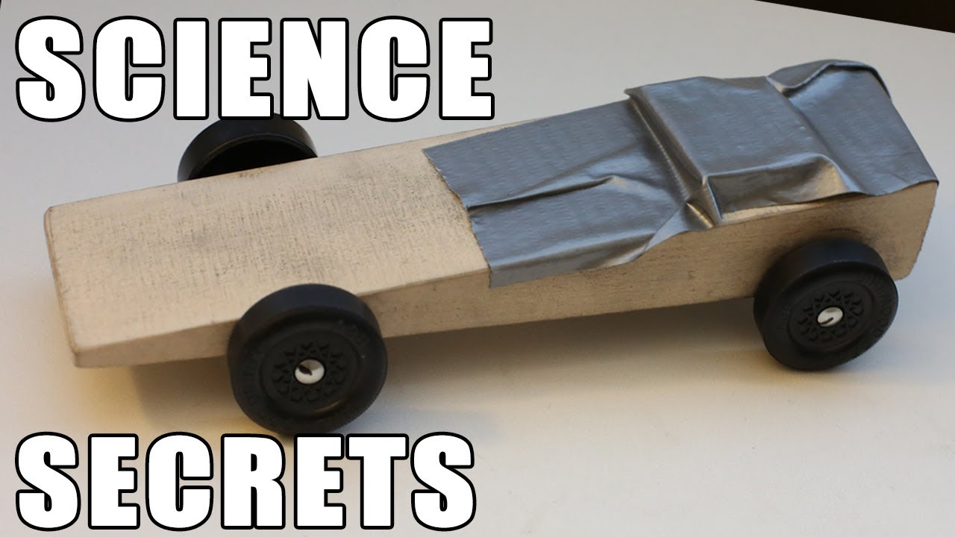
In this class, we are going to cover a lot of different topics
Like Motion

Slide 9
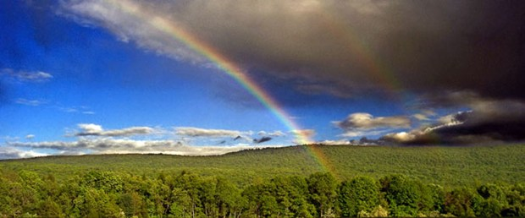
And Weather

Slide 10
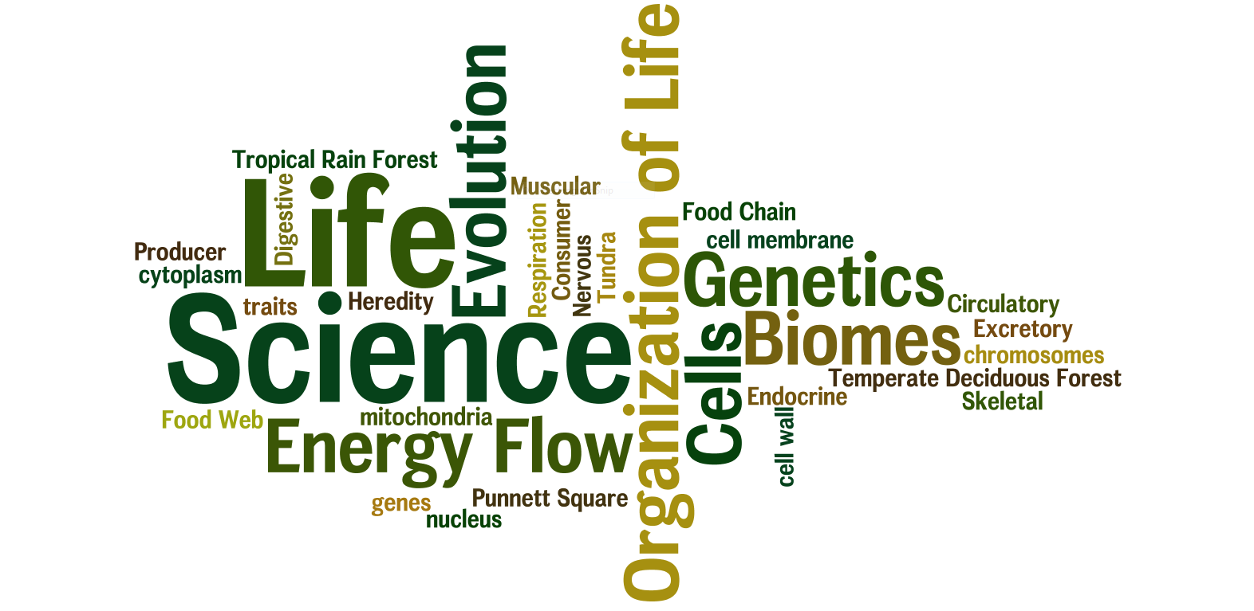
As well as Life Science
Cells
Genetics
DNA
Plants and Animals

Slide 11
It may seem like a lot, but I know you can do it!

Slide 12
If you are struggling, there is always something you can do!

Slide 13
AND ASK FOR HELP!!

Slide 14
If we work together, I’ll be sure to teach you a thing or two…

Slide 15
…About…

