Slide 1
Different Forms of Linear Functions Foldable
September 2, 2014
Pg. 9 in notes
Credit: http://mathequalslove.blogspot.com/2014/07/algebra-1-inb-pages-unit-6-linear.html

Slide 2
Warm-Up (pg 8…left side)
What is the slope-intercept form of a line?
What are the slope and y-intercept of the equation y = 2x – 1 ?
What does the slope mean on the graph?
What does the y-intercept mean on the graph?

Slide 3
Essential Question
What are some different ways that a linear function can be represented?

Slide 4
Fold your paper in half.

Slide 5
Cut along your fold so you have 2 pieces of equal size.

Slide 6
Lay one piece of paper on top of the other with about an inch of the bottom sticking out.

Slide 7

Fold over the top so you have 4 flaps. Then staple twice at the top.

Slide 8
Label your flaps.
Different Forms of
Linear Functions
Slope-Intercept Form: y = mx + b
Point-Slope Form: y - y₁ = m(x - x₁)
Standard Form: Ax + By = C

Slide 9
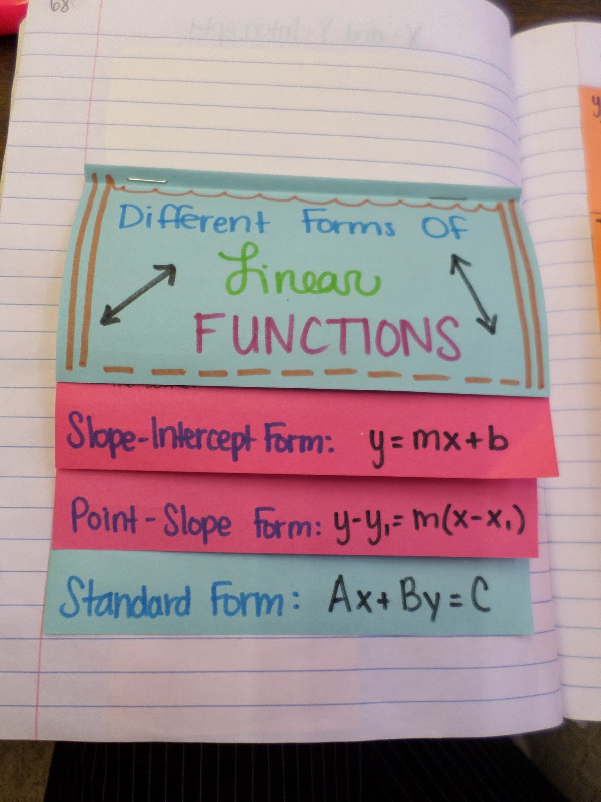
Credit: http://mathequalslove.blogspot.com/2014/07/algebra-1-inb-pages-unit-6-linear.html

Slide 10
Slope-Intercept Form Bottom Flap
Recognizing Slope-Intercept Form:
- y is by itself on one side of the equal sign.
- There are no parentheses.
Parts of the Equation:
- m (the coefficient of x) represents the slope of the line.
- b (the constant) represents the y-intercept of the line.

Slide 11
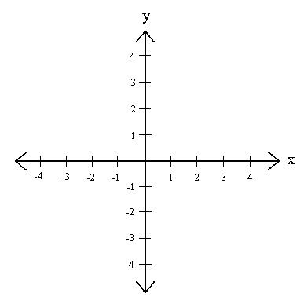
Slope-Intercept Form Top Flap
Steps to Graph:
- First, graph the y-intercept.
- Then, use the slope to find more points
Example:
y = 2x – 3
m = slope = 2
b = y-int. = -3

Slide 12
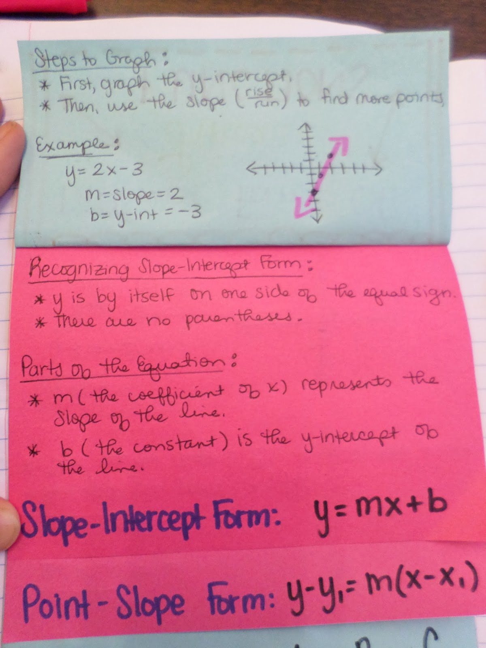
Credit: http://mathequalslove.blogspot.com/2014/07/algebra-1-inb-pages-unit-6-linear.html

Slide 13
Point-Slope Form Bottom Flap
Recognizing Point-Slope Form:
x and y are on opposite sides of the equal sign.
Either x is in parentheses or y is not by itself (or both!).
Parts of the Equation:
- m is the slope of the line.
- (x₁, y₁) is a point on the line.
Notice: x₁ and y₁ have opposite signs in the equation and the point.

Slide 14
Point-Slope Form Top Flap
Steps to Graph:
First, graph the point (x₁, y₁).
Then, use the slope to find more points.
Example:
y – 3 = -2(x + 1)
slope : -2
point: (-1, 3)

Slide 15
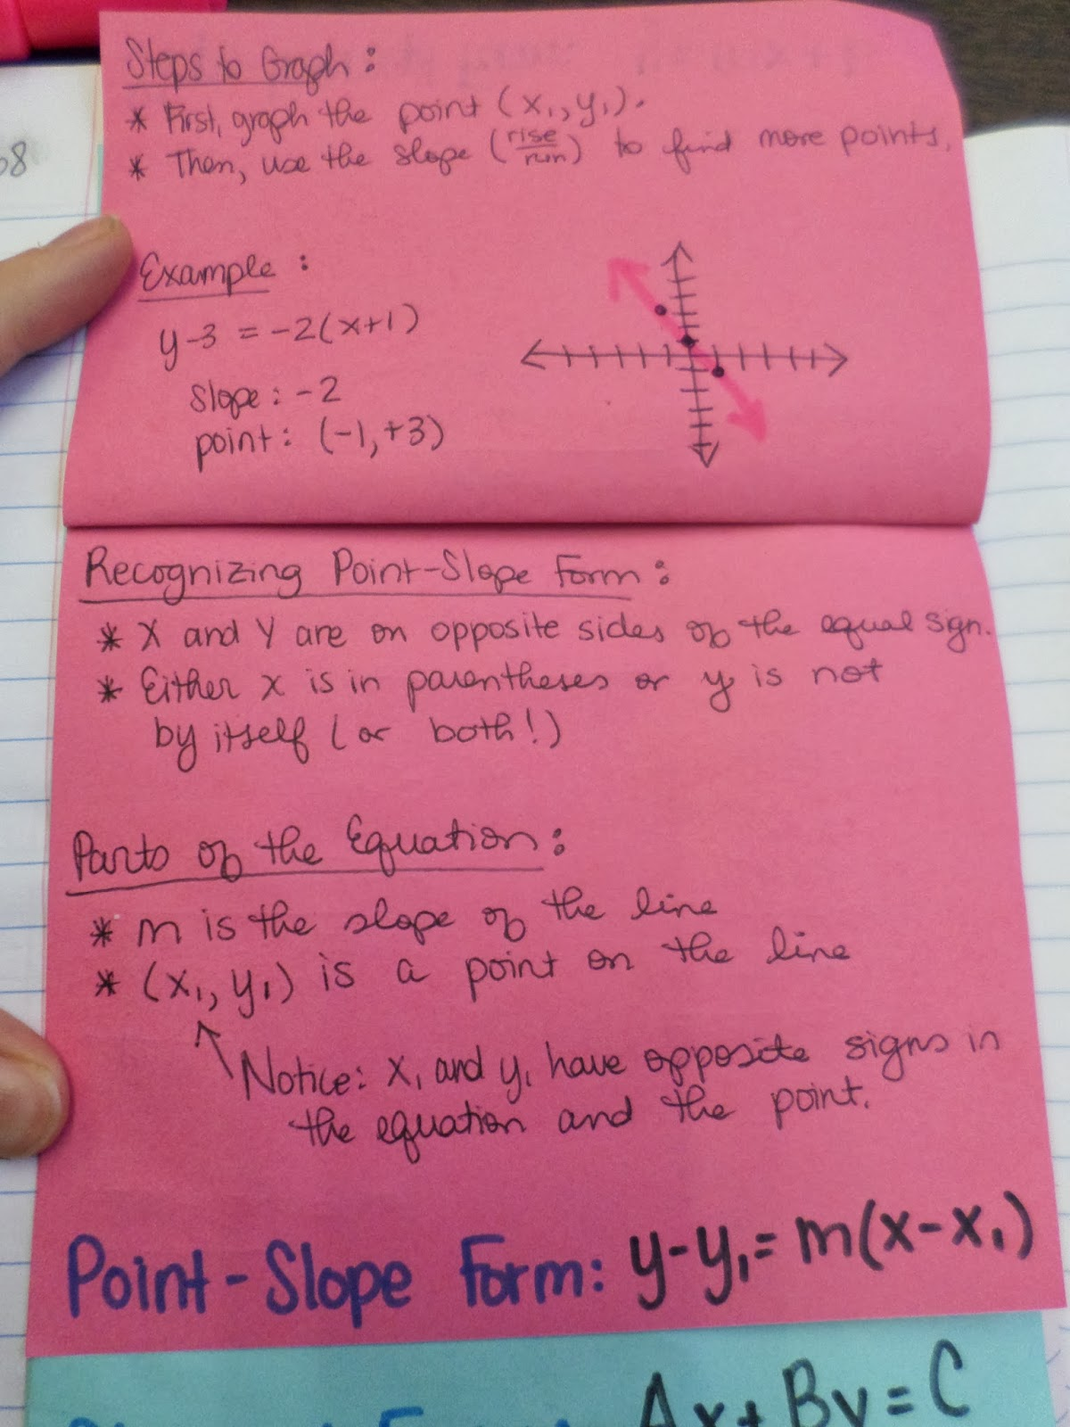
Credit: http://mathequalslove.blogspot.com/2014/07/algebra-1-inb-pages-unit-6-linear.html

Slide 16
Standard Form Bottom Flap
Recognizing Standard Form:
x and y are on the same side of the equal sign.
The coefficients of x and y are integers.
There is a constant on the other side of the equal sign.
Two Options to Graph:
Convert to Slope-Intercept Form.
Find and graph the x- and y-intercepts.
  x-intercept (Plug in 0 for y and solve)
  y-intercept (Plug in 0 for x and solve)

Slide 17
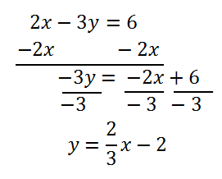
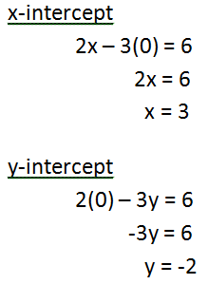
Standard Form Top Flap
Example: 2x – 3y = 6
Option 1 Option 2

Slide 18
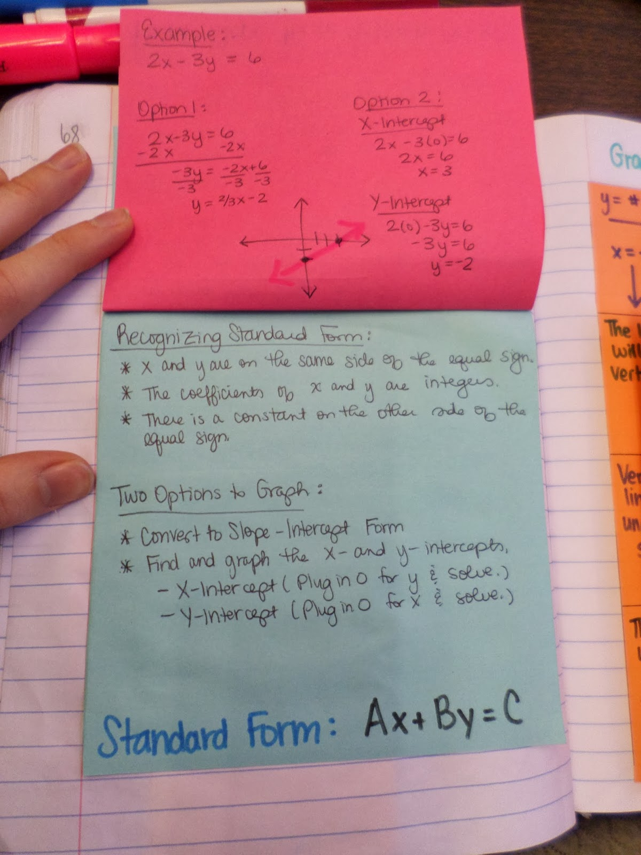
Credit: http://mathequalslove.blogspot.com/2014/07/algebra-1-inb-pages-unit-6-linear.html

Slide 19
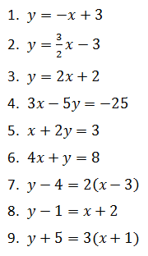
Glue on page 9.
Assignment: Graph the equations on your graph paper. Show your work on a piece of notebook paper and turn in both sheets.

Slide 20
Reflection
Exit Ticket
  Write down one thing you learned today and one thing you still have questions about.

