Slide 1
5th Grade Parent Meeting
September 13, 2018

Slide 2
Welcome to the 5th Grade Parent Meeting!
Mr. Bazzy
Ms. Michaels
Mrs. Fakhreddine
Ms. Mroczka
Mrs. Luckow

Slide 3
Our expectations for your child during the school day: المتوقع
Independence الاستقلال
Personal Responsibility المسؤلية الذاتية
Organizational Skills النظام
Respectful behavior (to self and others at all times) احترام الذات و الآخرين

Slide 4
Healthy Habits: bedtimes and diet
عادات جيدة عند النوم و تناول الطعام
It is very important that your child is going to bed on time every night. According to a study done by the National Sleep Foundation, the average 5th grade child needs 10 to 11 hours of sleep every night to be able to function well.
We are also noticing that the children are bringing a lot of junk food in their lunches or as a snack. No junk food should be brought to school. Examples of acceptable foods to bring for school snack are: fresh fruits and vegetables, dried fruits, crackers with cheese or peanut butter, yogurt, pita and lebna, pretzels, etc...

Slide 5
Reading

Slide 6
Why it is SO important that your child is reading at home every day!

Slide 7
Math

Slide 8
The importance of memorizing multiplication facts

Slide 9
Problem-solving skills
حل و شرح فرود الرياضيات

Slide 10
موارد Online resources that you can use at home to help your child be successful in 5th grade and prepared for 6th grade:

Slide 11
Exact Path (Edmentum)
Priority
https://ple.platoweb.com/Account/SignIn

Slide 12
XtraMath
Xtramath.org

Slide 13
BrainPop
Brainpop.com

Slide 14
Study Jams
Studyjams.com

Slide 15
Front Row
Frontrowed.com

Slide 16
MyOn
MyOn.com

Slide 17
Moby Max
Mobymax.com

Slide 18
Student Responsibility, Accountability, and Independence: Our hopes and expectations for your 5th grade child ☺

Slide 19
Homework
Homework is a wonderful opportunity for students to continue practicing the skills they are learning in school- at home.
Homework will be given daily (with the exception of Friday-at the teacher’s discretion)
All homework will be copied in the Student Planner.
Students are expected to complete their homework neatly and correctly.
Homework needs to be turned in on time.
Students can always be reviewing their notes and preparing for tests- even if they do not have assigned homework!

Slide 20
Major Assessments
M-Step will again begin in April 2019.
5th graders are tested in the subject areas of English Language Arts, Math, Social Studies, and Science
The NWEA/MAP Test
Reading, Math, Science, and ELA (grammar and writing)
The Social Studies common assessment will be taken throughout the year على مدار السنة الدراسية to assess your child in the area of Social Studies. This year’s focus is American History!

Slide 21
More About MAP Testing....
The MAP test will assess your child in the areas of Reading, English Language Arts, Math, and Science. It will be taken 3 times throughout the year: September, January, and May.
Grade Level Expectations: (according to Dearborn Public Schools)
A student entering 5th grade is expected to achieve a score of 213 in Reading and a 219 in Math on their first MAP test of the year (in September).
By the end of 5th grade (May), your child is expected to achieve a score of 218 in Reading and a 225 in Math.

Slide 22
MAP Testing continued...
The MAP test is “adaptive” which means that as your child answers questions correctly, the questions become more difficult. As they answer questions incorrectly, the questions become less difficult.
We use this assessment to measure a student’s growth over the course of a year.

Slide 23
Field Trips and Camp Information
Please, if you would like to be a chaperone on any of our field trips this year:
You MUST have a background check completed. This is just a matter of taking your state ID to the William Ford office. It takes about 2 to 3 weeks for the background check to be completed, so please don’t wait until the last minute.
Background checks DO expire, so if you have not had one done in the last couple of years, you may want to stop by the office and make sure that yours is up-to-date.
We encourage and welcome all parents to help chaperone this year’s field trips!

Slide 24
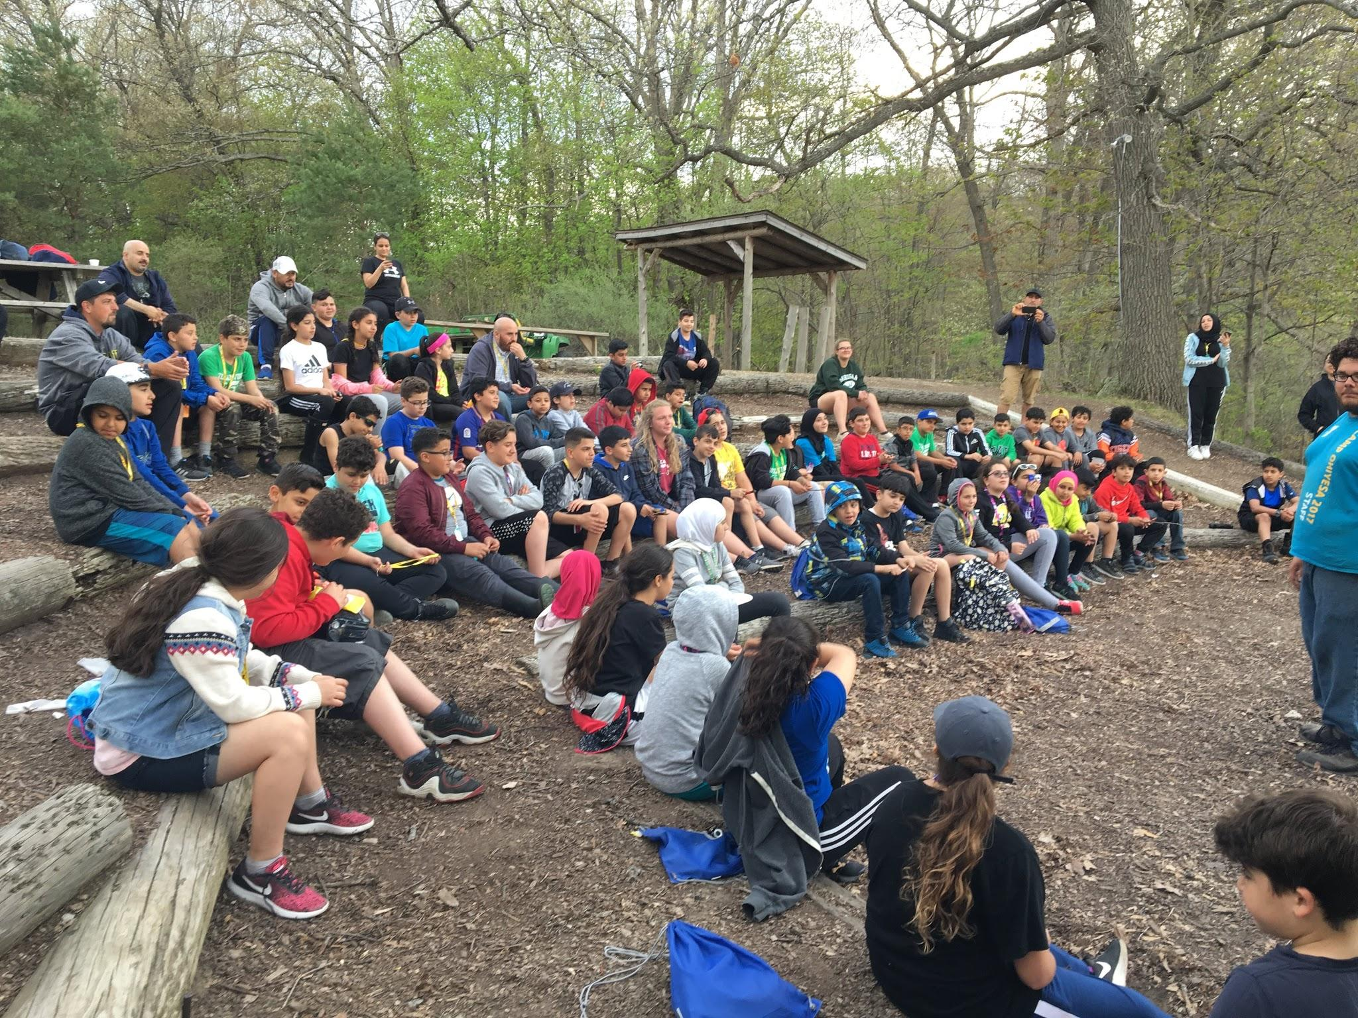
Camp Info
April 22, 23, 24, 2019 (2 nights, 3 days)
Fundraising (chocolate boxes)
Cost: $120 per student
Parent Chaperone: $60
Camp Ohiyesa
7300 Hickory Ridge Dr.
Holly, MI 48442

Slide 25
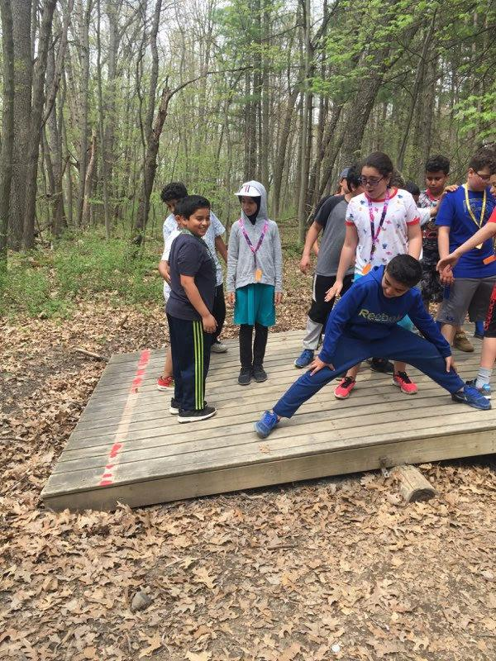
Why Camp?
Independence
Problem Solving Skills
Team Building
Celebrate the END of Elementary School!

Slide 26
A Summary of the Skills Woodworth Expects for your Child to Have Coming Into the 6th Grade:
Automatic Math computation (addition, subtraction, multiplication, and division)
Problem-solving skills (and the ability to explain HOW they solved a problem)
Writing across all content areas
Knowledge of academic vocabulary in Math, Science, and Social Studies
How to write a good paragraph
The ability to read and understand grade-level informational texts

Slide 27
What this means for us…
As 5th grade teachers, our main priority is to help your child master the 5th grade expectations set forth by the State of Michigan.
In addition to helping them be successful in the 5th grade, we are always thinking ahead about how to effectively prepare them for 6th grade and beyond. This means that we have high expectations of each and every child in our classrooms!

Slide 28
Thank you so much for coming!
We can’t do this without you!

