Slide 2
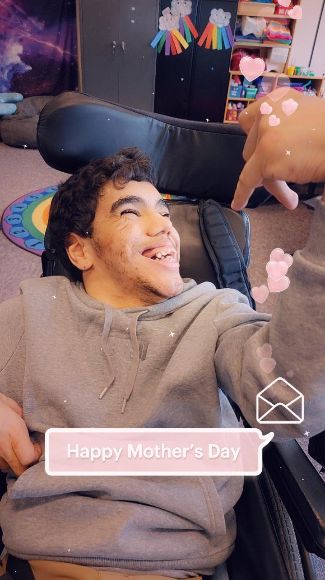
Mom, Thanks for loving me unconditionally!

Slide 3
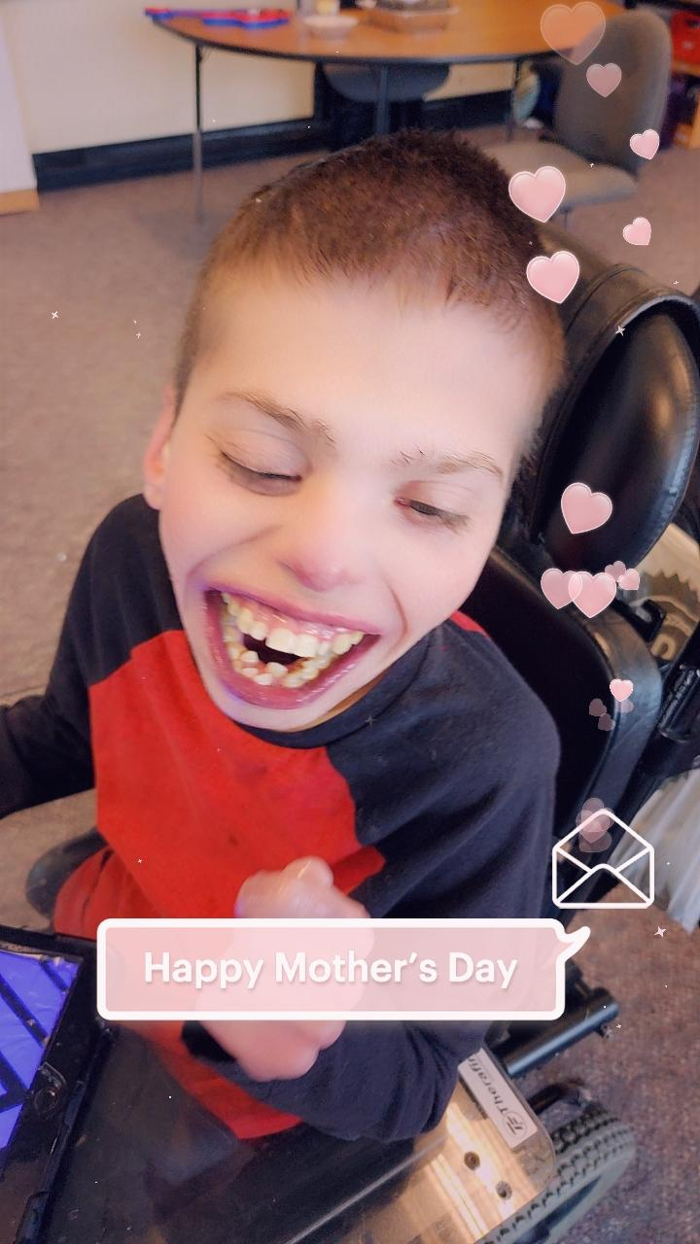
I believe in myself because you never stop believing in me!

Slide 4
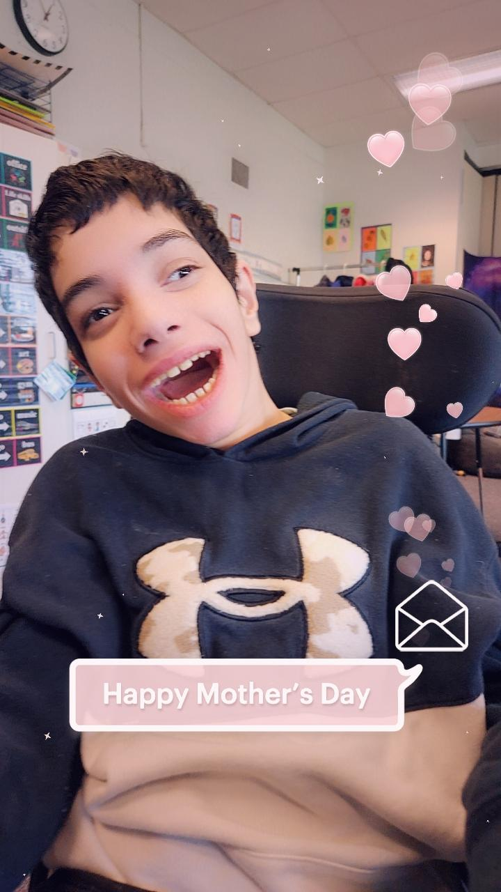
Thanks for standing by me daily fighting, caring, encouraging and challenging me to be the best me I can be

Slide 5
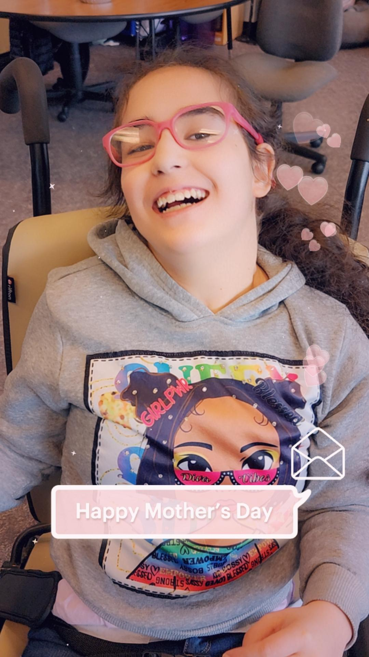
Encouraging me to move two steps forward when I move one step back

Slide 6
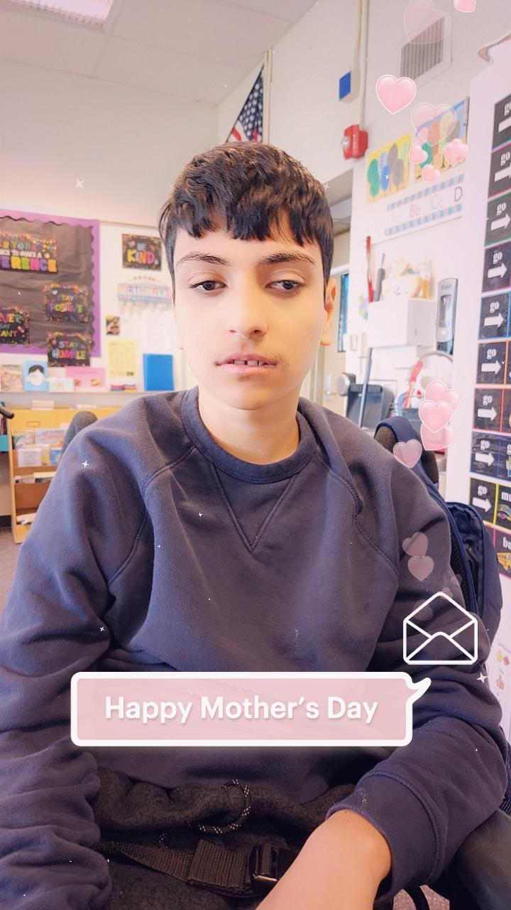
Even without my words, you always know what I need.

Slide 7
You know what makes me smile and fills my heart with joy.

Slide 8
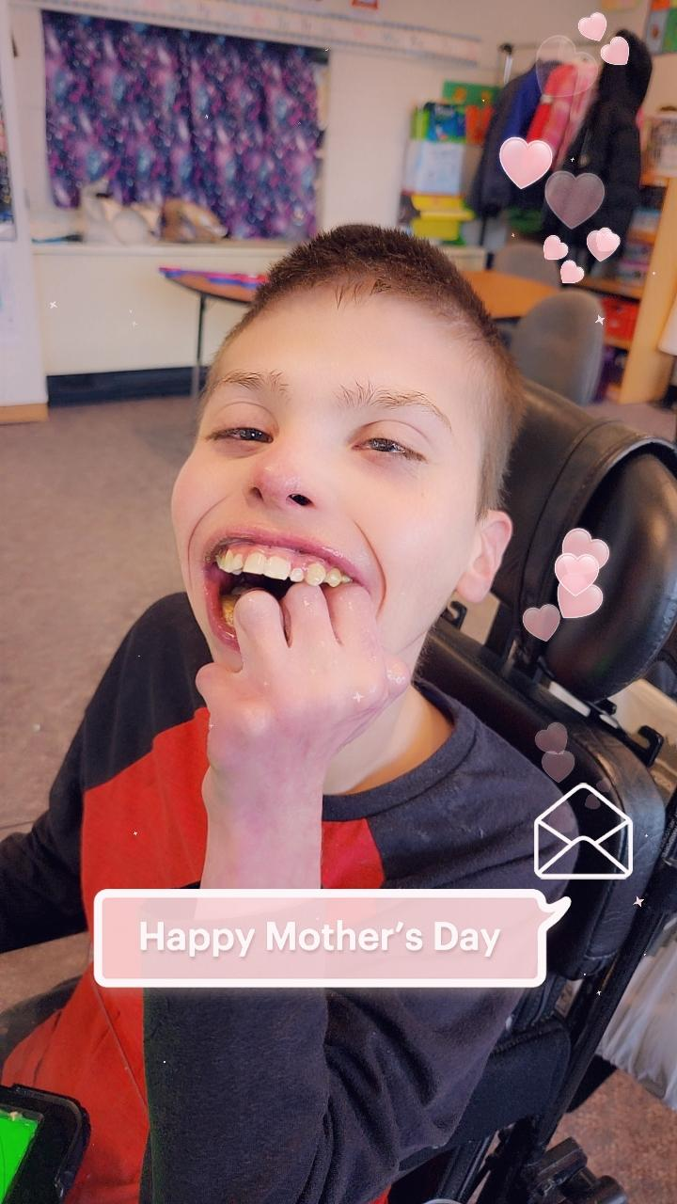
You ignore the words of others telling you what I cannot do, and then fill the hours of every day telling me what I can.

Slide 9
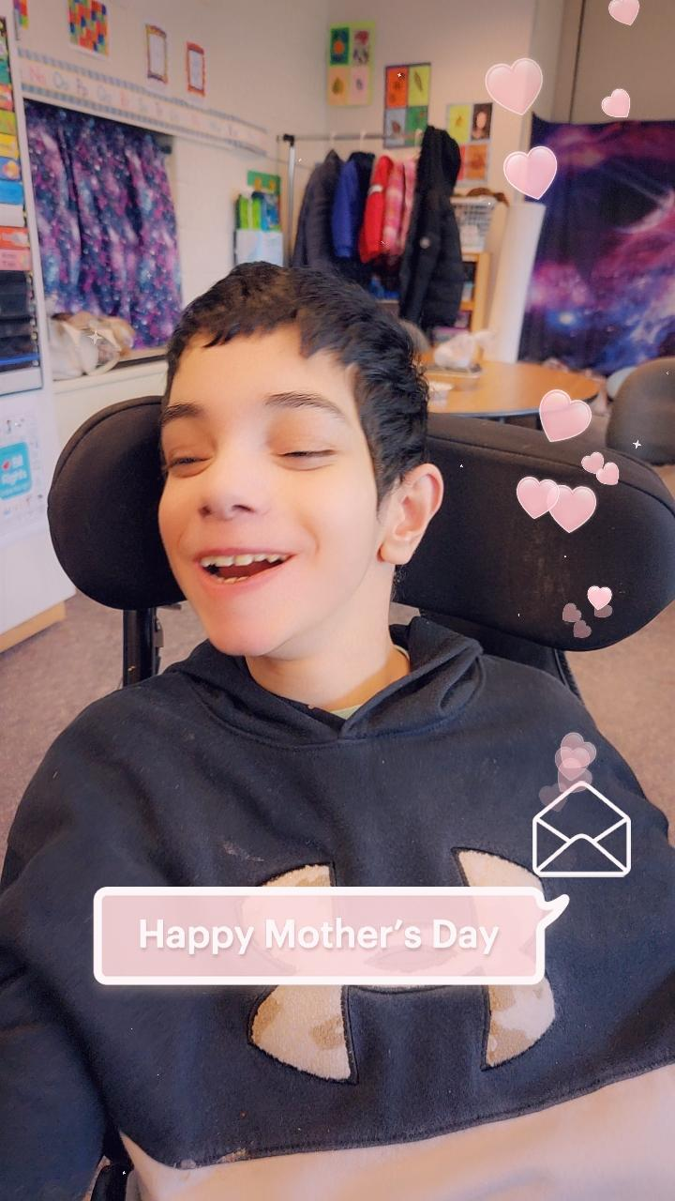
Pushing away sadness, you focus on the hope of my future.

Slide 10
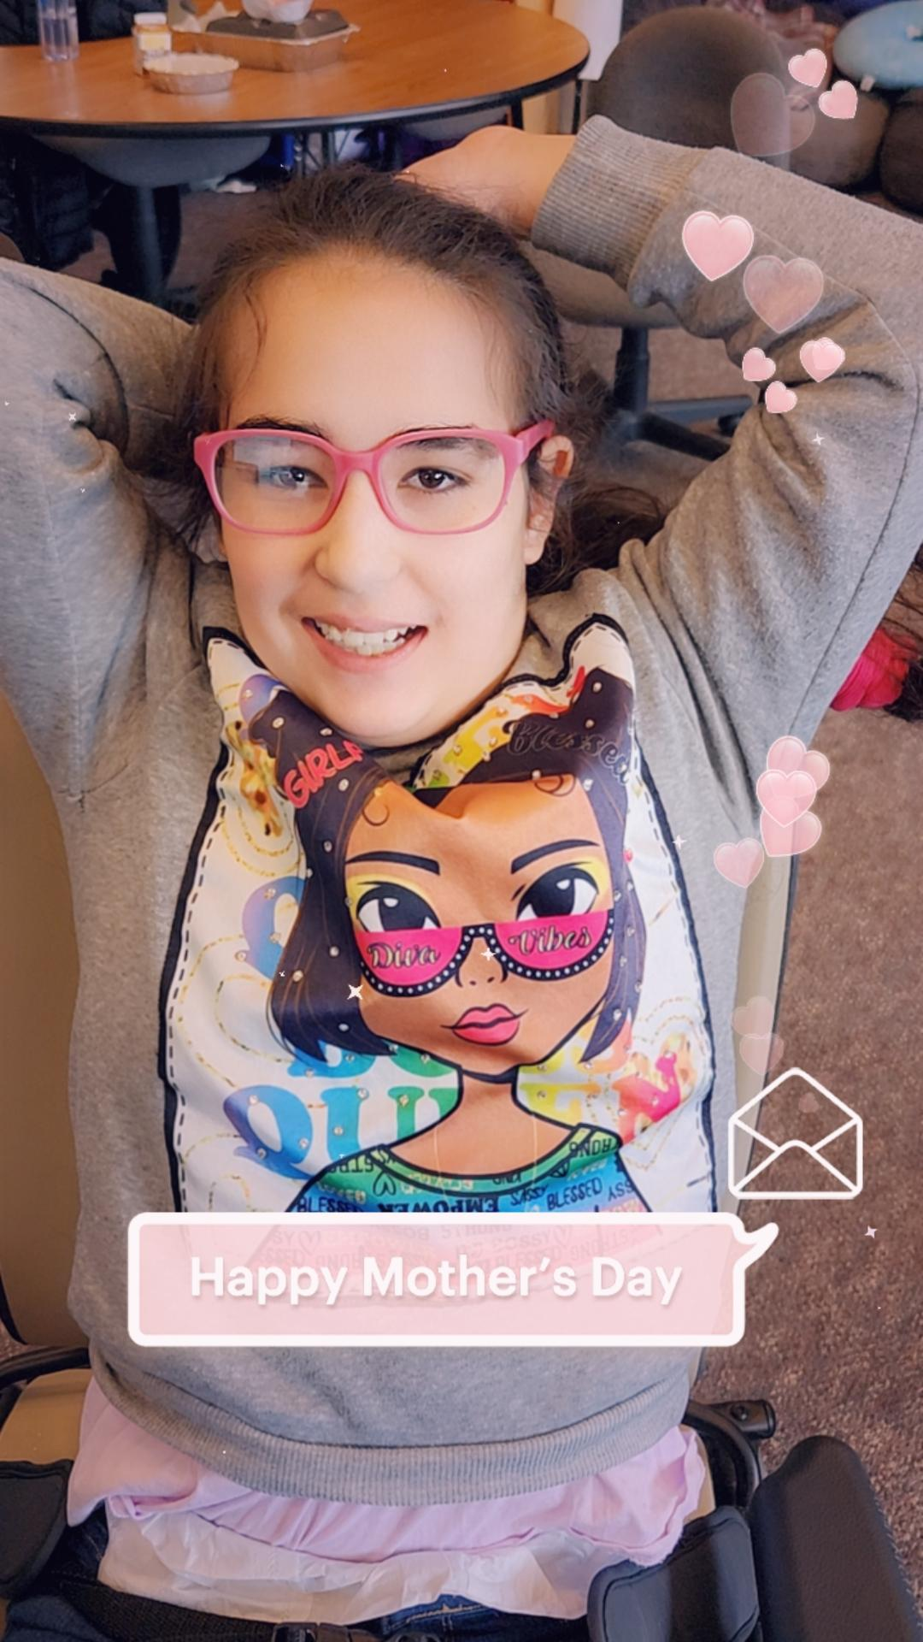
You let my simple, small steps lead us forward.

Slide 11
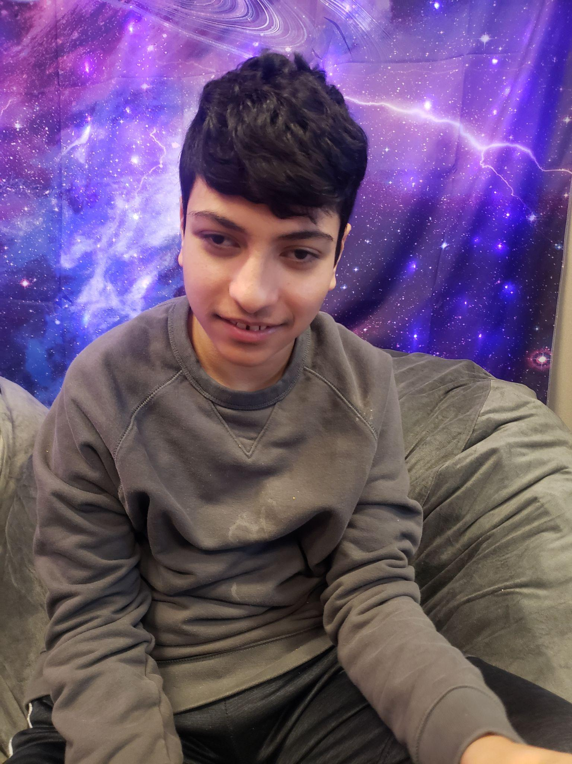
and Mom, in case you don’t know…..

Slide 12
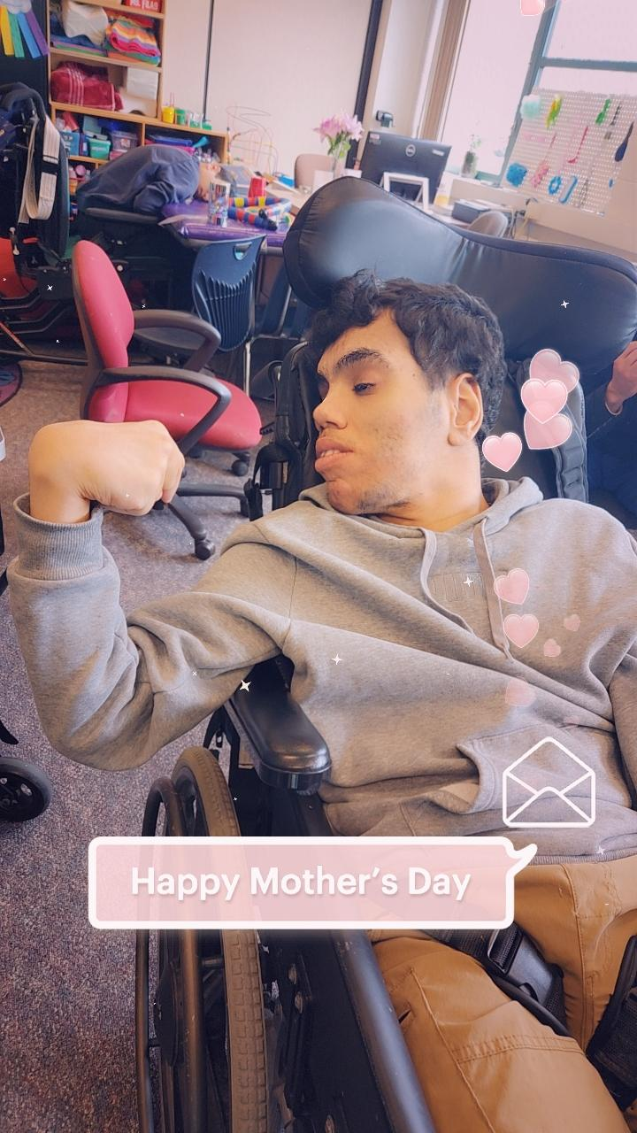
I live the fullest life…

Slide 13
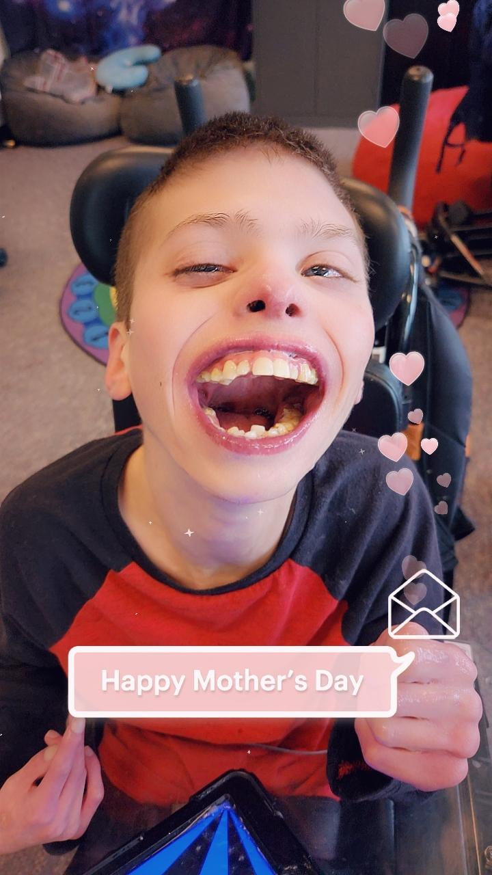
I see the world through your understanding eyes.

Slide 14
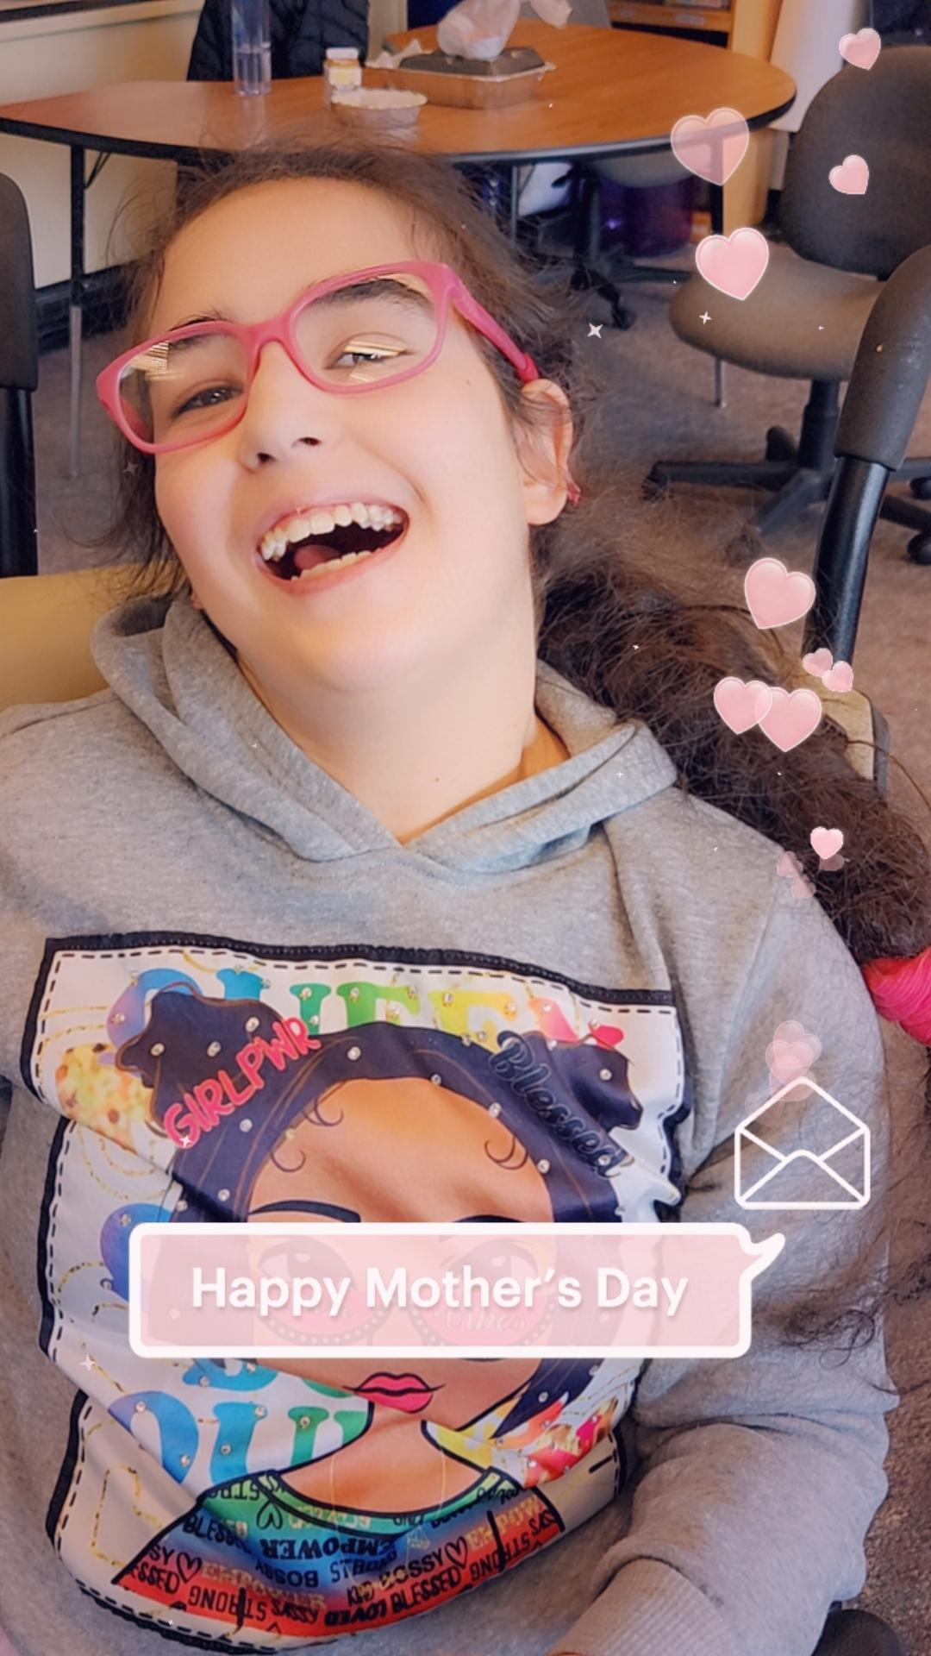
With your gentle touch, you fill my life with the greatest kind of love.

Slide 15
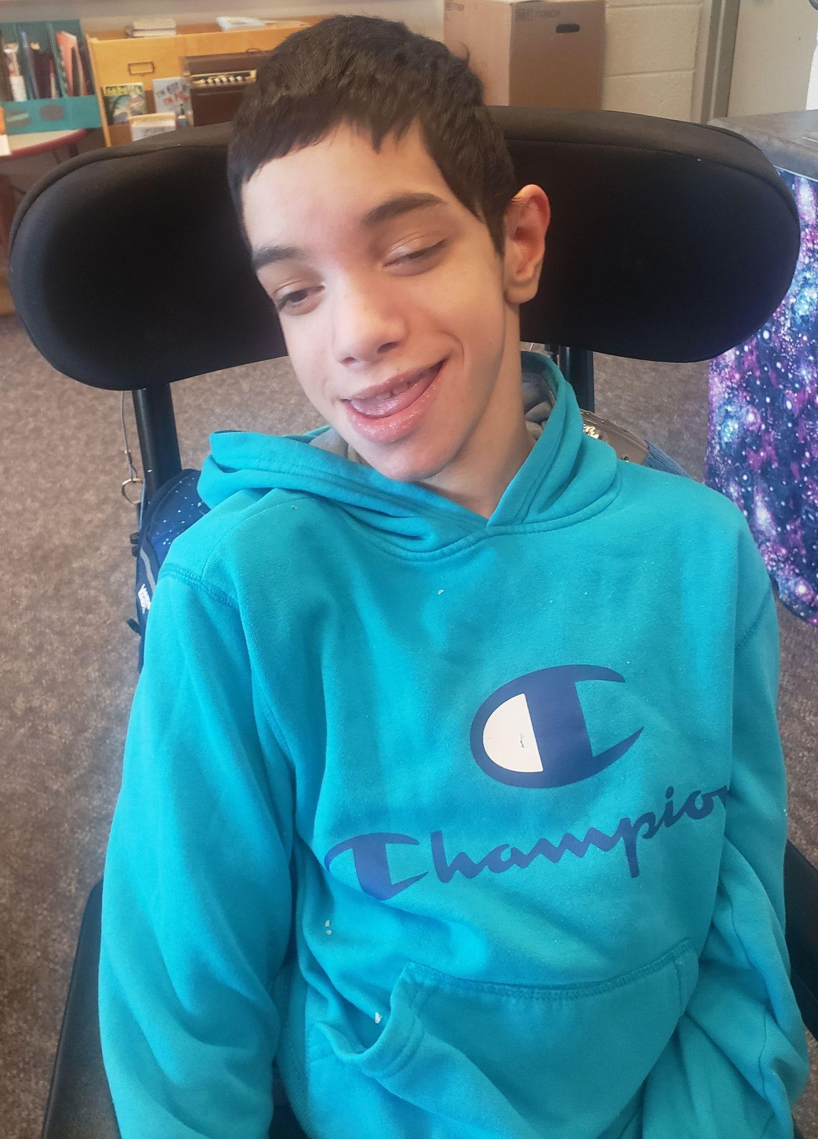
You keep on fighting the good fight out of nothing but sheer love for me.

Slide 16
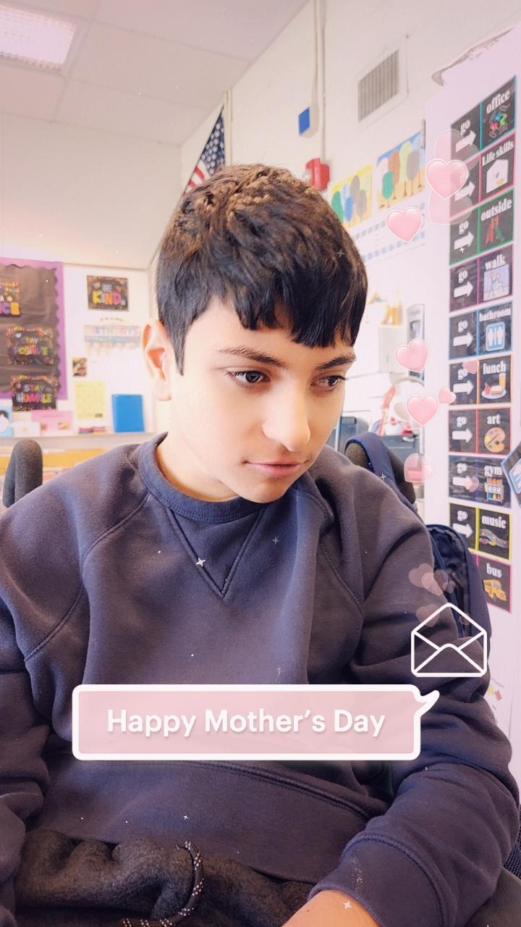
Thank you for all you do for me!
I love you to the moon and back Mom!

