Slide 1
March 13,2018 Bellwork
Briefly explain what nature vs. nurture means.
Which position do you take? Does nature or nurture determine personality?

Slide 2
If you have not turned in your project by now and you have not talked to me about it, it is a zero.
If you missed the test last Wednesday, come after school to take it.

Slide 3
Ch. 4, Section 1: Personality Development

Slide 4
Content Objective: Students will be able to list and define the key factors that go in to personality development: Heredity, Birth Order, Parental Characteristics, The Cultural Environment.
Language Objective: Students will listen to information and write notes on Personality development. They will be able to define what nature vs. nurture means and how social environment heavily influences personality development.

Slide 5
Nature Vs. Nurture
Personality: The sum total of behaviors, attitudes, beliefs and values that are characteristic of an individual
Personality helps to determine how we adjust to our environment and how we react in specific situations
No two people have the exact same personality
It has been debated for a long time what determines personality.

Slide 6
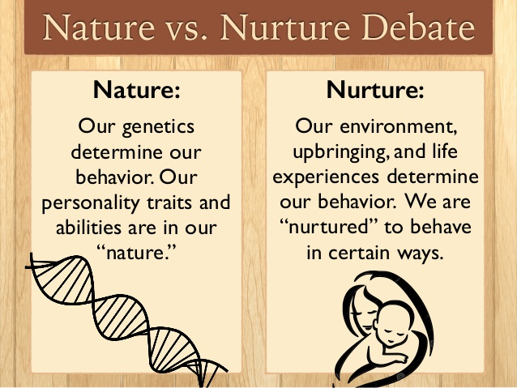

Slide 7
For a much of the 1800’s, the belief was that human behavior is instinctual.
Instinct: an unchanging, biologically inherited behavior pattern. Typically it is applied to animal behavior
Those who support the nature portion of nature vs. nurture use this to relate animal behavior to human behavior
The belief is that instinct drives everything humans do. This includes things like motherhood and warfare

Slide 8
In the early 1900’s, social scientists said that they had determined over 10,000 human instincts
The nurture point of view believes that a person’s behavior is the result of their social environment and learning
Pavlov, a Russian scientist, demonstrated this and helped this viewpoint gain popularity
An American psychologist, John B. Watson, suggested Pavlov’s experiment could be applied to humans

Slide 9
Sociobiology: The systematic study of the biological basis of all social behavior
Sociobiologists argue that varied traits (religion, cooperation, competition, envy) are all things that are within human’s genetic code
Biological factors determine most of human social life

Slide 10
Factors in Personality Development
Personality and social behavior stems from a blend of genetics and environment
Heredity
Characteristics that are present at birth include hair type, eye color, skin pigmentation
Hereditary characteristics also have aptitudes
Aptitudes: a capacity to learn a particular skill or acquire a specific body of knowledge
Example: natural born musicians or athletes
Some aptitudes can be learned or inherited
Inherited aptitudes develop due to environmental factors

Slide 11
A parent’s response can encourage or discourage a certain aptitude
  Think of parent’s reading and talking to a child. They praise the child when he or she babbles as an infant and this encourages the child to do it more until they develop speech
Parental reinforcement also affects how things such as sociability, shyness and aggression development.
  Example: A parent who constantly shushes their child and shoos them away may cause the child to become extremely shy
Humans also inherit basic needs. Like animals, we all have biological drives
Drives make you want things, but do not determine behavior

Slide 12
Heredity also sets limits on things people can and cannot do
  A 5 foot person will never play in the NBA
Inherited characteristics limit what is possible but do not determine what a person will do
No one factor decides what kind of personality a person will have

Slide 13
Birth Order
Personalities are often influenced by whether or not we have siblings.
Those without siblings will view the world differently than those with siblings
The order in which you are born into your family affects personalities as well
Later born children tend to be better in social relationships and are more affectionate than earlier born children
Earlier born children are more conservative in what they say and do and want to keep the status quo

Slide 14
Parental Characteristics
Characteristics of parents influences personality development in their children
Children born to older parents relate to their parents differently than those born to younger parents
Things such as level of education, religion, economic status, cultural heritage and occupational background are influential to a child’s personality

Slide 15
The Cultural Environment
Culture strongly influences personality development
Cultural environment determines the basic types of personalities that will be found in a society
Each culture gives rise to a series of personality traits that are typical of members of a society
  In the U.S., competitiveness, assertiveness, individualism are common traits
How we experience culture affects our personalities
Subcultural differences exist and affect our personalities as well
  Italian American families are different than Russian American families

Slide 16
Influence of Social Environment
Feral children are children raised without any influence of a social environment
These children did not develop things like manners, no ability to reason, no ability to control bodily functions or move like other humans
These children lead sociologists to believe that personality comes from our social environment
Sociologists also study children who lived in institutions, since these children show similar characteristics to feral children
The cases of the feral children and institutionalized children leads to the conclusion that human interaction is needed for development
Children who do not have a caring environment to be raised in will develop much slower than those who do.

Slide 17
Exit Ticket
Given the notes, which do you believe now influences personality more: nature or nurture? What evidence from the notes lead you to this conclusion?

