Slide 1
Name
McCombe
Hour
Date
1.
Tuesday 3-13
Using the thinking map and page 603,
Write 3
things
About Truman and 3 things about Stalin
Key Players
Harry S, Truman
Joseph Stalin

Slide 2
Objectives
Content Objective: Students will be able to list and define key events from Ch. 18, Section 1. This will include things like the Potsdam Conference and the formation of the United Nations.
Language Objective: Students will listen to and take notes on the beginnings of the Cold War. They will listen to what events lead up to it and will write these down.

Slide 3
Classwork
Notes
You will be responsible for taking your own notes today. Pull out a few pieces of loose-leaf, around 3 or 4.

Slide 4
Ch. 18, Section 1: Origins of the Cold War
Former Allies Clash
The U.S. and the Soviet Union had different ideas about what the future held.
These differences caused some tension between the two that would lead to a rivalry
Within the Soviet Union, the state controlled all property and all economic activity.
The U.S. was different in that private citizens controlled all activity

Slide 5
Former Allies Clash
The United States enabled people to elect a president and members of Congress from different political parties
The Soviet Union had no political parties and was a totalitarian government
Throughout the war, the U.S. was aware that Stalin was once an ally of Hitler.
The only reason that alliance ended was after Hitler invaded.
This lead through both the United States and the Soviet Union becoming suspicious of each other.

Slide 6
Stalin believed that the Allies should have attacked Germany sooner
If they had done that, he believed that the German army would have stayed out of the Soviet Union
Stalin was also not happy that the United States kept the development of the atomic bomb secret from him.

Slide 7
The United Nations
With the war ending, most people were hopeful that world peace was imminent
The most visible symbol for world peace was The United Nations.
On April 25, 1945, representatives from 50 nations met in San Francisco to establish this new peacekeeping organization

Slide 8
Two months later, all representatives signed a charter establishing the UN
Despite the reason for the UN being to keep peace, it soon became a place for the U.S. and the Soviet Union to compete and influence over the other nations.

Slide 9
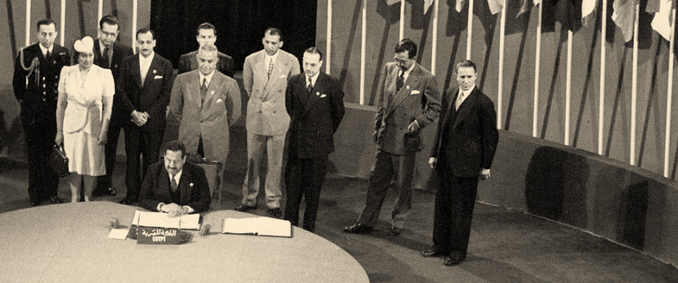

Slide 10
Truman Becomes President
Harry S. Truman was a key figure in the early years of conflict with the Soviets
He had suddenly become president when Roosevelt died after only being his vice president for a few months
As VP, he had not been given any say in decision making
He was not even aware of the development of the atomic bomb

Slide 11
The Potsdam Conference
July 1945
The Big Three: The United States, Britain and the Soviet Union met at Potsdam, near Berlin
The reason for the meeting was a final wartime conference
Stalin represented the Soviets, Clement Atlee represented Britain and Truman represented the United States
Stalin had previously promised he would allow free elections in Poland and other Soviet occupied countries but soon backtracked on this promise

Slide 12
The Potsdam Conference
Truman soon realized that the aims of the Soviet Union and the aims of the United States were quite different
Truman believed that spreading democracy to nations that had been under Nazi rule was a good thing
He wanted a new world order where all nations had the right of self-determination

Slide 13
The Potsdam Conference
At the Yalta conference, soviets had wanted to take from Germany in order to repay for their wartime losses.
Truman objected then and still objected at this conference
After much bargaining, it was decided that the Soviets, British, American and French would take reparations from their own occupied zones.

Slide 14
Soviets Tighten their Grip on Eastern Europe
After the war, Soviets made it clear that they were a nation of enormous economic and military strength
They, unlike the U.S. however, had suffered much devastation on their own land.
20 million Soviets had died, half of them being civilians
Because of these deaths, they felt as though they were owed Eastern Europe
If they had this land, they felt they could better prevent future attacks from the west.

