Slide 1
Bell Work Week of 2-05 to 2-09
Name
McCombe
Hour
Date
2.)
Wednesday 2-07
Use the thinking map below to organize what you already
Know about the Holocaust
The Holocaust

Slide 2
Section 3: The Holocaust
The Persecution Begins
April 7, 1933: Hitler ordered all non-Aryan people to be removed from government jobs
One of the first moves in a campaign for racial purity
Aryans: Blonde haired, blue eyed
One of the moves that would eventually lead to the Holocaust
Holocaust: Genocide of over 11 million people throughout Europe
Thought to be only Jewish people, but more than the Jewish were killed

Slide 3
Jews Targeted
Jews were the main target of the Nazis
Many countries had been anti-Semitic, or against Jews, for long periods of history
Germans followed this and kind of thought of the Jews as the reason for most of their problems and/or failures
Hitler was able to use this to his advantage and convince many that Jews were responsible for all the economic problems

Slide 4
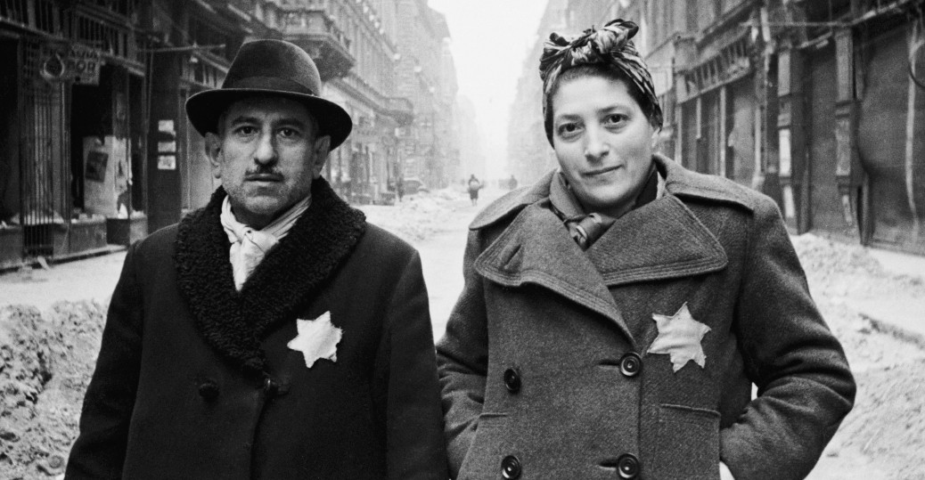
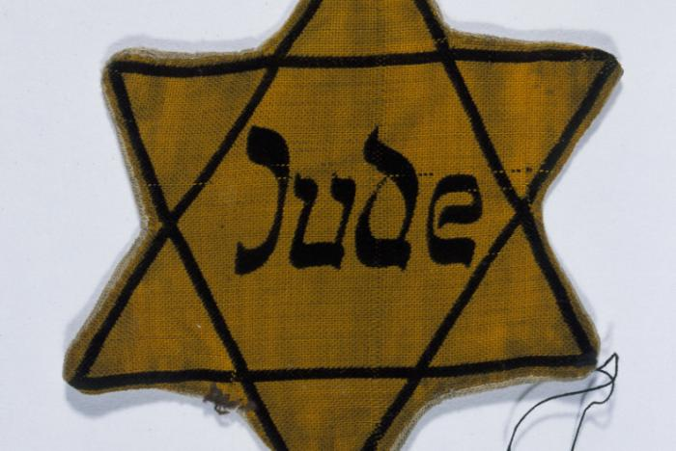
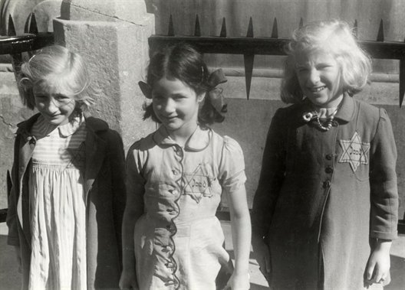
The Nuremberg Laws
A series of laws that made it so Jews were no longer considered German citizens
Jews had to wear a yellow Star Of David on their clothes in order for Nazis to identify them easier

Slide 5
Kristallnacht
November 9-10, 1938: Known as “Night of the Broken Glass”
Nazi storm troopers attacked Jewish homes, businesses and synagogues
100 Jews were killed during this and hundreds were injured
30,000 Jews were arrested
Hundreds of synagogues were destroyed
Nazis blamed the Jews for this destruction

Slide 6
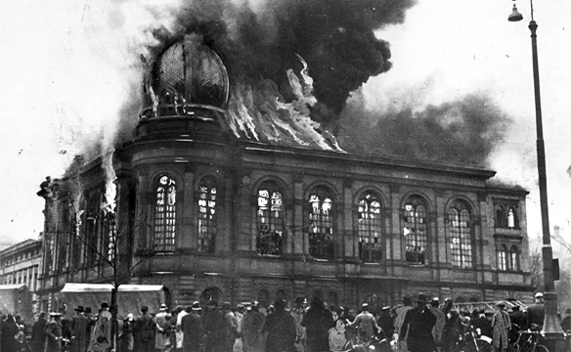
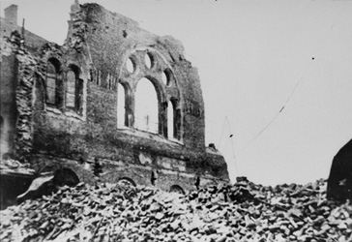
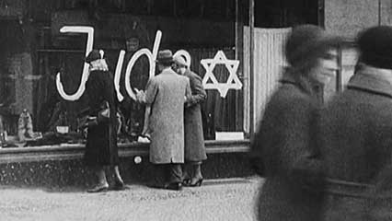
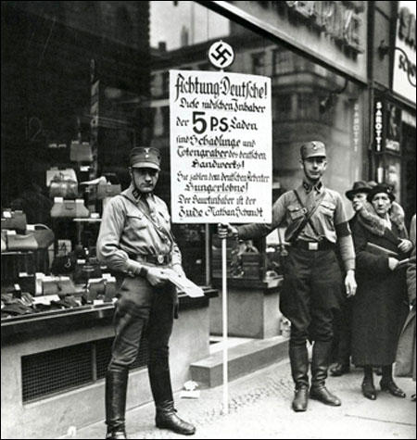

Slide 7
A Flood of Jewish Refugees
Nazis wanted and tried to speed up emigration of Jewish people
Many Jewish people were not able to emigrate quickly since many countries would not let them
France: 40,000 already, did not want more
Britain: Thought anti-Semitism would increase and only let 80,000 in
German foreign minister: Basically said everyone wanted to get rid of Jews, could not find a place to take them. It was too difficult

Slide 8
US would only accept 100,000 and the person had to be of exceptional merit
Many Americans did not want to let any in, very Anti-Semitic at the time

Slide 9
Hitler’s Final Solution
The Condemned
Nazis wanted racial purification at all costs
Were able to reduce Jews and others to slavery and death
Nazis silenced anyone who did not agree with them: liberals, socialists, communists
Other groups included: Gypsies, freemasons and Jehovah’s Witnesses
Security squadrons: Would round up Jews and shot them on the spot. Did not matter if you were a woman or a child

Slide 10
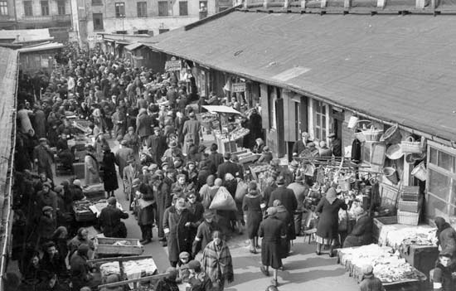
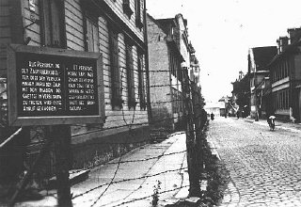
Forced Relocation
Jews had to relocate to overcrowded areas, called ghettos
Were sealed off with barbed wire to prevent escape
Ghettos were awful places, people were forced to work for German factories
Bodies of the dead piled up

Slide 11
Concentration Camps
Anyone who had not died by death/security squadrons were forced to go to concentration camps
Originally intended to house opponents and protestors
Used to house “undesirables”
In the camps:
People had to work long hours, starved and were constantly humiliated until they were either killed or died
Wooden barracks that held 1000 people
Food was extremely scarce that people would eat mud to have something

Slide 12
Inmates of the concentration camps worked from sun up to sun down without a day off or even a break until they collapsed from exhaustion
Those who collapsed or proved they could not work were instantly killed

Slide 13
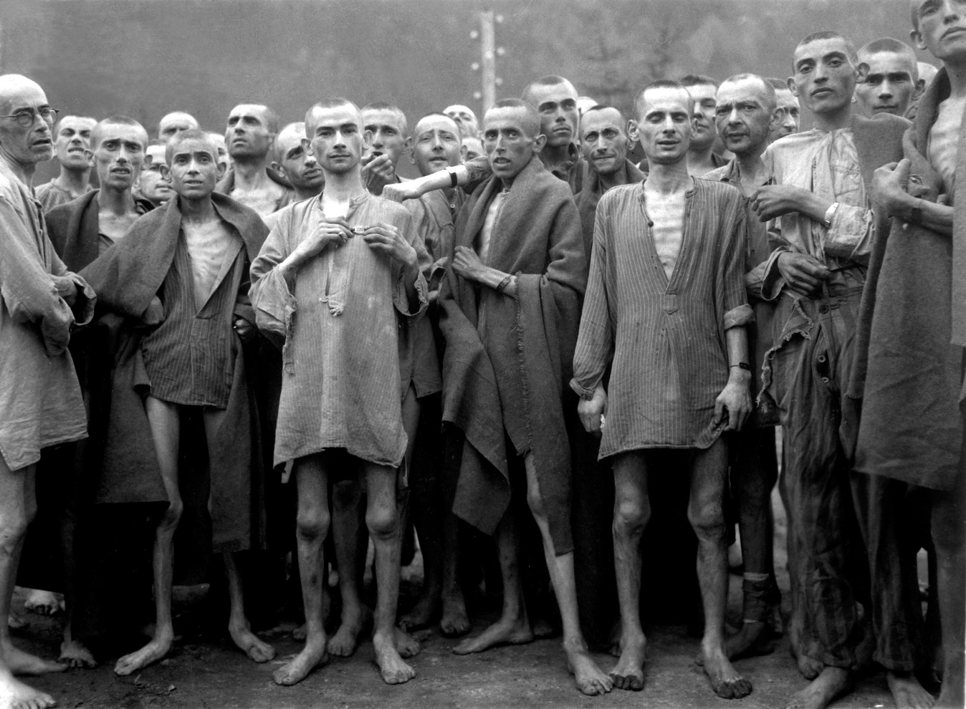
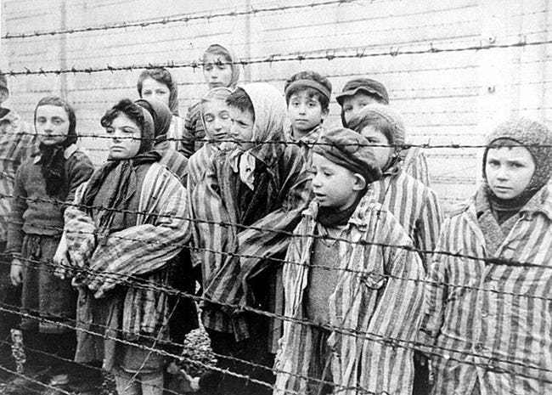
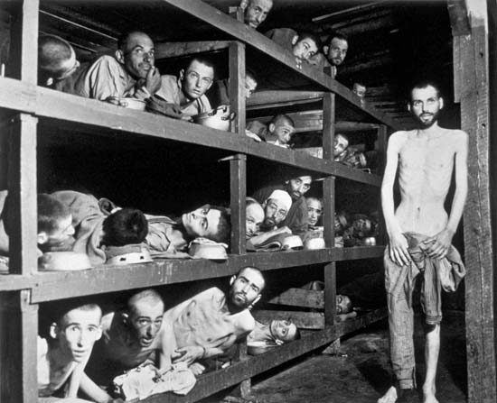

Slide 14
