Slide 1
Azure
By: Ms. McCombe

Slide 2
Flag of Azure
The flag represents two things important to Azure: the color blue and the star. The star is to the left of the flag because that is where your heart is, to the left.

Slide 3
Symbols and gestures
Symbols are things that represent something else.

Slide 4
Symbols and gestures in Azure:
Everyone greets one another by linking their thumbs, almost as if they were going to thumb wrestle

Slide 5
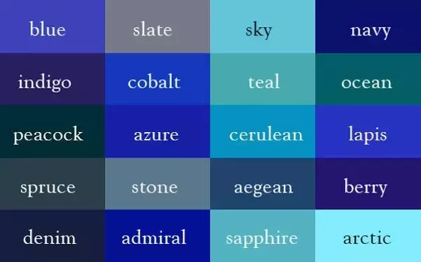
Blue is a huge color to the people of Azure. All the different aspects of their culture come from words that relate to water or the color blue.
The shades of blue are equally as important to the people. It is believed that the darker the shade of blue, the more important the person. For example: older people primarily wear darker blue clothing and have dark blue hair

Slide 6
A blue star is a huge symbol within Azure. Each point of the star represents a value of the country. The top point represents equality. The middle left represents loyalty. The middle right represents friendship. The bottom left represents family. The bottom right represents perseverance.

Slide 7
Material Culture: This is all the physical objects, resources and spaces unique to each culture.

Slide 8
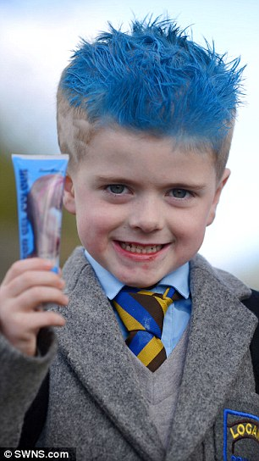
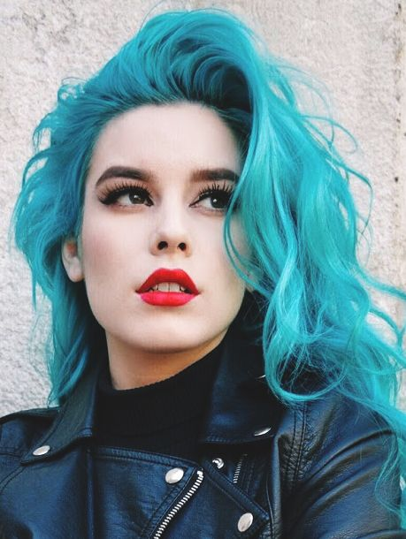
Hairstyle
Everyone in Azure wears their hair down to their back and it is colored various shades of blue. When you are young, your hair is dyed a pale, almost pastel blue, as you grow up, your hair is gradually dyed a darker shade of blue. When you have retired from working, your hair is dyed a midnight blue.

Slide 9
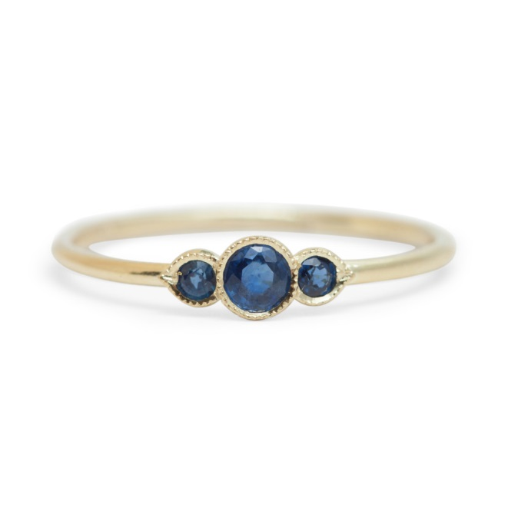
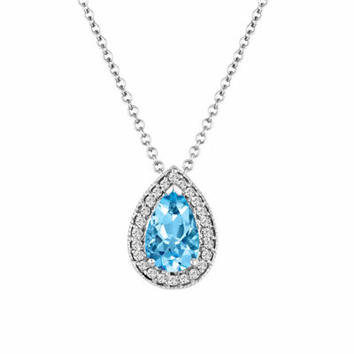
Jewelry
Everyone in the country wears jewelry as they see fit. Each female in the country receives an aquamarine necklace on their 13th birthday. This represents their transition into adulthood.
Each male receives a sapphire ring on his 13th birthday. This represents his transition into adulthood.
Every time a child is born, the mother receives an additional aquamarine charm for her necklace

Slide 10
Nonmaterial Culture
One aspect of the nonmaterial culture of Azure is their belief in family and friendship above all.
Their motto is even: “Family and friendship above all.”

Slide 11
Another aspect of nomaterial culture is the religion of the people of Azure. The name stems from the god Azura. They believe Azura created everything from water. They worship Azura for all he has given them.
They go to their place of worship, a laken, 3 times a week: Monday, Wednesday, Friday. While here, they sing and dance in rituals thanking Azura for all he has given them.
During their rituals, everyone wears the color blue that coordinates with their status in life. Babies wear an extremely light shade of blue, children wear pastels. This goes all the way until midnight blue, which is worn by the elderly.

Slide 12
The language of the people of Azura is called Aguana. There are different dialects throughout the country. The name Aquana comes from agua, which is the Spanish word for water. Aguana is similar to Spanish. In fact, some words within Spanish and Aguana are the same

Slide 13
Since water is so important to the people of Azure, it is no surprise that most of their food is primarily seafood.
The diet of the Azurean people

Slide 14
Holidays in Azure
There are multiple celebrations throughout the year for the people of Azure. They believe that life should be fun and be celebrated.

