Slide 1
Bell Work Week of 2-05 to 2-09
Name
McCombe
Hour
Date
2.)
Tuesday 2-06
Read through the selection from Winston Churchill’s speech
On page 538(It is in blue). What is Churchill trying to say?
When you have done this, write down any words you
Do not know the meaning of.

Slide 2
Syllabus signature is due tomorrow!! Do not miss out on easy points

Slide 3
Austria and Czechoslovakia Fall
November 5, 1937: Hitler meets with his advisors
Tells them in order for Germany to grow and prosper, they need to expand and take the land of their neighbors
In order to do this, his plan was to have Austria and Czechoslovakia absorbed into the Third Reich
Third Reich: “Third Empire” of Germany
By doing this, Hitler could cause war but he was dead set on it

Slide 4
Hitler first set his sights on Austria
It was relatively small and had become a country because of the Paris Peace Conference
Most Austrians were Germans who wanted to unite with Germany
The troops knew this and marched in to take Austria, without any conflict
This union became known as Anschluss
After Austria, Hitler looked towards Czechoslovakia
Like Austria, many Germans lived in a part of Czechoslovakia called the Sudetenland
Sudetenland was extremely mountainous and provided a natural defense against Germany
Hitler’s main reason for wanting to annex Czechoslovakia was that he wanted control of their natural resources and more living space for Germany

Slide 5
Hitler’s reasoning was that the Germans in Sudetenland were being abused by the people of Czechoslovakia
Nazis would make up headlines in order to build up support for their plan
France and Great Britain said that they were going to protect Czechoslovakia
However, Hitler met with Neville Chamberlain, British Prime Minister, and Edouard Daladier, French premier.
Hitler said that Czechoslovakia would be the last place he demanded to have
Chamberlain and Daladier wanted to avoid war at all costs. They believed by giving in to Hitler’s demand they would be able to do this and that Hitler would not seek more territory
Munich Agreement: Signed Sudetenland over to Hitler/Germany
Chamberlain wholeheartedly believed that war would be avoided now

Slide 6
Winston Churchill was Chamberlain’s political rival
Churchill believed that Chamberlain had appeased Hitler
Said that France and Britain had chosen dishonor over war and that there would still be war.

Slide 7
The German Offensive Begins
Hitler still pursued more territory
Despite getting the Sudetenland part of Czechoslovakia, he still wanted all of it
He marched his troops in to take what remained on March 15, 1939
Once this was done, he began looking for where else to pursue. He looked towards Poland
Poland, much like Czechoslovakia, had many German speakers as well
Just like with the Sudetenland, Hitler began lying about how the German speakers were mistreated there as well
If he attacked Poland, war was basically inevitable with France and Britain
Both countries had promised to provide aid to Poland
If war happened, Germany would be fighting on two fronts: France and Britain

Slide 8
While France and Britain waited to see what Hitler would do, he decided to sign a nonaggression pact with Stalin. They agreed to never attack one another. This pact also said that Poland would be split between them
The Luftwaffe, German air force, attacked Poland on September 1, 1939.
This was the first time Germany tested their new military strategy, the blitzkrieg. Blitzkrieg was also known as lightning war. This meant they were able to take the enemy by surprise.
Two days later, France and Britain declared war
Blitzkrieg was so effective that by the end of three weeks all major fighting was over and France/Britain weren’t able to defend Poland

Slide 9
The Phony War
French and British troops sat on the Maginot Line and waited for Germany to do something
German troops did the same thing
Because of the rapid attacks of Blitzkrieg, each side waited for the other to do something to provoke attack
Sitzkrieg: Sitting war
Stalin began to annex countries like Estonia, Latvia and Lithuania
He sent troops in to take Finland and they surrendered after three months

Slide 10
Hitler began attacking Denmark and Norway
Again, he used the excuse of protecting their freedom in order to gain support

Slide 11
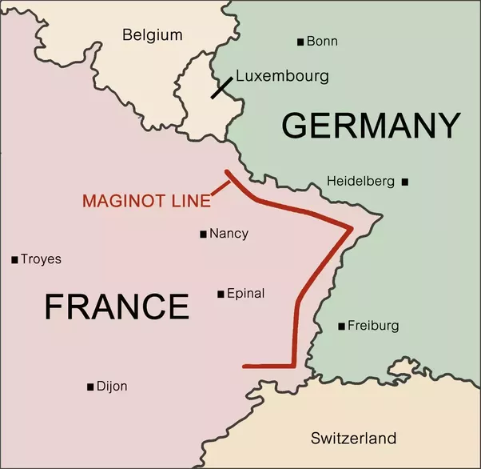
France and Britain Fight On
The Maginot line had not worked since Germany did not fear crossing it to attack Belgium
Hitler had tanks and troops go through woods in northeast France to avoid the French and British troops
French thought Ardennes were impassable
Germans passed through and took Belgium

