Slide 1
Bell Work Week of 1-29- 2-02
Name
Teacher
Hour
Date
1.)
Monday 1-29
My favorite activity from this class last semester was…

Slide 2
Bell Work Week of 1-29- 2-02
Name
McCombe
Hour
1-29-18
2.)
Tuesday 1-30
Copy the following table and fill it in with information from pages 528-531
Use the chart on page 531 to help you.
Name | Mussolini | Hitler | Stalin | Franco
Country
How did they come to power?
Beliefs
Fascism

Slide 3
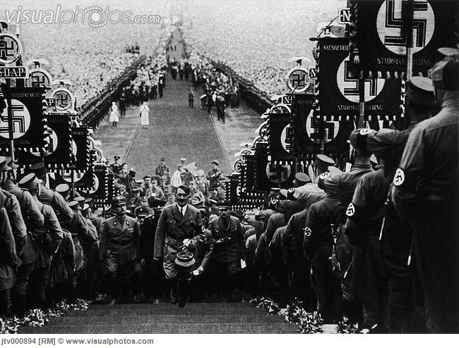
Place the #3 Bellwork under #2. You do NOT need a new sheet of paper.
3.)
Wednesday 1-30
Looking at the picture below, answer the following questions in complete sentences. What is happening in the picture? What do the details of the picture tell you about Hitler and the Nazis?

Slide 4
No Bellwork Thursday due to assembly

Slide 5
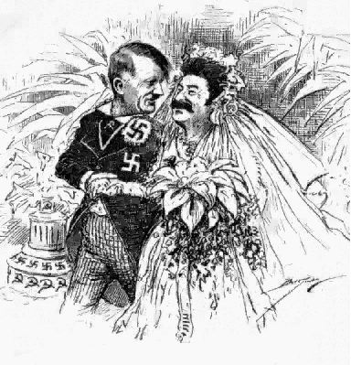
Write the #4 Bellwork under #3.
You do NOT need to start a new sheet of paper.
4.)
Friday 2-02
Look at the political cartoon to the right.
What do you think is happening? What is the artist trying to say?
What details do you notice?

