Slide 1
Chapter 23: Political Paralysis in the Gilded Age, 1869-1896

Slide 2
President Grant
  In the 1868 presidential election, the Republicans offered Gen. Ulysses S. Grant.
  Although he had no political experience, the idea was that his war-hero status would carry him to victory.
  The Democratic party was hopelessly disorganized.
  They agreed on their criticism of military Reconstruction, but little else.
  The Democrats nominated Horatio Seymour.
  Consequently, Grant won, narrowly.

Slide 3
Bloody Shirt Elect Grant
  His main technique was to "wave the bloody shirt," meaning to constantly remind voters of his military record and that he'd led the North to victory.
  The close victory signaled a couple of things for the future:
    tightly run and hard-fighting political parties
    narrow election margins of victory.

Slide 4
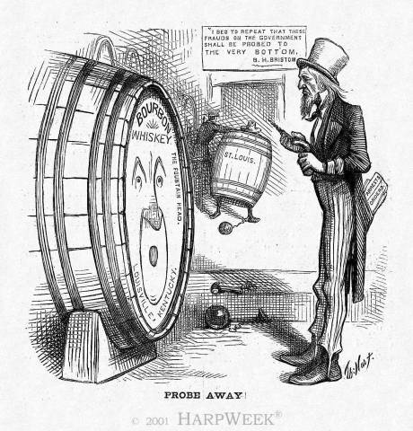
The Era of Good Stealings
  Corruption became all too common in the post-Civil War years.
    The corruption often came via the railroads, meddling with stock prices, and through corrupt judges.

Slide 5
Boss Tweed
  In New York City, Boss Tweed ran Tammany Hall, a local political district.
  Boss Tweed used bribes, graft, and rigged elections to mooch money and ensure continual power for himself and his buddies.
    Thomas Nast was a cartoonist who relentlessly attacked Tweed's corruption.
    Tweed despised Nast because, although many people in Tweed's district couldn't read about the corruption, they could understand those "them damn pictures."
    Nast's cartoon's brought down Tweed.
    Samuel J. Tilden gained fame in prosecuting Tweed.
    Tweed eventually died in jail.

Slide 6
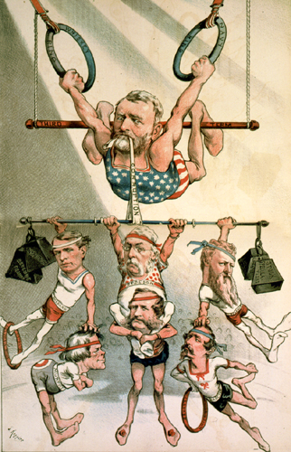
Carnival of Corruption
  President Grant was an honest man but there was much corruption underneath his administration.
  He either wasn't aware of it or failed to properly deal with it.
    Many in the Dent family, his in-laws, obtained government "jobs" for themselves.

Slide 7
Credit Mobilier Scandal
  One of the worst situations was the Crédit Mobilier scandal
    The company was constructing the trans-continental railroad and effectively sub-hired itself to get paid double.
    They also gave stock to Congressmen in order to avoid getting busted.
    A newspaper finally exposed the scandal, two Congressmen went down, and the Vice President of the U.S. had even taken payments.
    Though uninvolved, Grant's name was scarred.

Slide 8
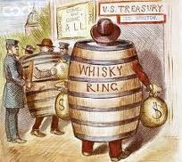
Whiskey Ring
  The so-called "Whiskey Ring" also looked bad for Grant.
  Folks stole whiskey tax money from the government.
  Grant's own secretary was involved and, despite him saying "Let no guilty man escape,"
  Grant helped let the thief off the hook.

Slide 9
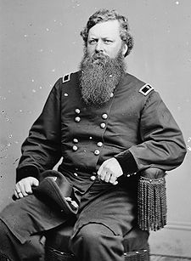
Belknap
  Lastly, the Secretary of War William Belknap was caught swindling $24,000 by selling trinkets to the Indians.

Slide 10
The Liberal Republican Revolt of 1872
  By the 1872 election, many people had had enough.
  Reformers started the Liberal Republican Party to clean things up.
  Greeley was called an atheist, communist, free-lover, vegetarian, brown-bread eater, and co-signor of Jefferson Davis' bail bond.
  Grant was called a drunk ignoramus and swindler.
  Grant won the election handily, 286 to 66.

Slide 11
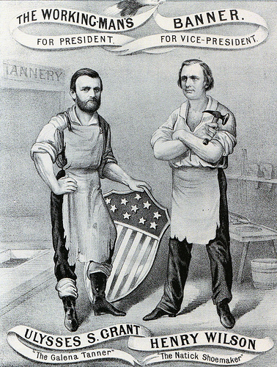
Effects of Liberal Republicans
  The Liberal Republicans did spook the Republican Congress into passing some reforms.
    An amnesty act was passed which removed restrictions that'd been placed on many Southerners.
    There was effort to reduce the tariff rates
    Clean up/out the Grant administration.

Slide 12
Depression, Deflation, and Inflation
  The Panic of 1873 brought economic troubles.
    It was started by over-spending with borrowed money, this time in railroads and factories.
    Growth was too fast and over-extended what the market could sustain.
    The causes of the panic were the same old ones that’d caused recessions every 20 years that century
    Initially, the panic was sparked when banks and businesses began to go bankrupt.
    The situation quickly snowballed from there.

Slide 13
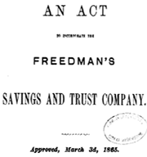
Impact on African Americans
    Blacks were hit especially hard.
    Always last-to-be-hired, and now the Freedman's Savings and Trust Co. went bankrupt, black Americans lost some $7 million in savings.

Slide 14
Debtors Hit Hard
  They wanted inflationary policies to be pursued.
  Specifically, debtors wanted paper money ("greenbacks") printed to create inflation and thus make it easier to pay off debts.
  This strategy was called soft money or cheap money policies.
  Opponents, usually bankers and the wealthy, favored hard money policies.
  That is, they favored keeping the amount of money stable (and backed by gold).

Slide 15
Grant’s Response
  To hike up inflation just to pay a debt would be unfair, they said, since the money paid back wouldn't be as valuable as when it was lent.
    Grant vetoed a bill to print more money.
    Also, the Resumption Act was passed to actually start to
    lower the number of greenbacks in circulation
    to redeem paper money at face value starting in 1879.

Slide 16
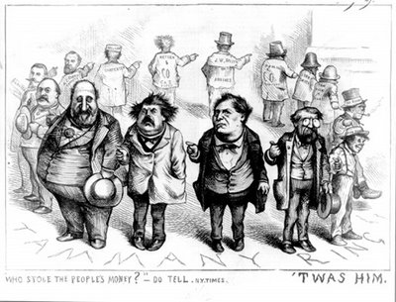
The Gilded Age
  The term "the Gilded Age" was a phrase coined by Mark Twain to describe the late 1800's.
  It hinted that the times looked good (as if they were gilded or gold-covered), yet if one scratched a bit below the surface, there were problems.

Slide 17
Politics in the Gilded Age
    The Gilded Age largely contained tight and hotly contested political races, much corruption, and shady business deals.
    The Republicans of the day hinted back to Puritan ancestry and were supported in the North and West.
    The G.A.R., the Grand Army of the Republic, was a military veteran group that supported Republicans.
    Democrats got most of their support from the South.
    They were supported by Lutherans and Catholics.

Slide 18
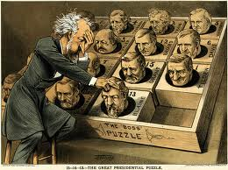
Split in Republicans
  A split developed in the 1870's and 80's within the Republican party.
    The Stalwarts were led by Roscoe Conkling.
    The Half-Breeds were led by James G. Blaine.

Slide 19
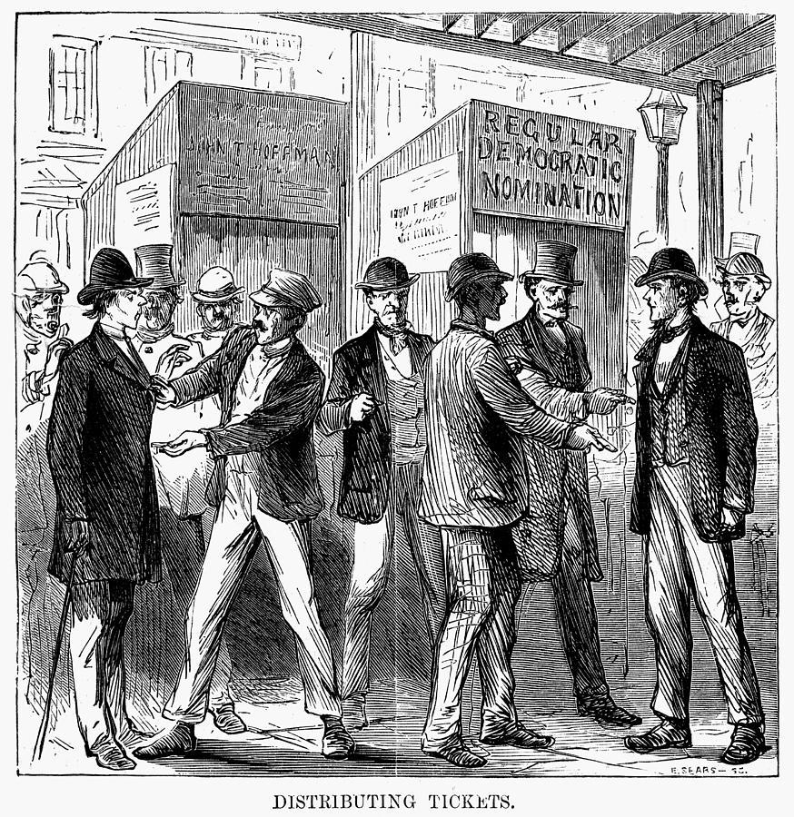
The 1876 Election
  Pres. Grant considered running for a third term in 1876.
  The House soundly voted down that option and Grant backed off.
  The Republicans nominated Rutherford B. Hayes.
  He was called the "Great Unknown", for obvious reasons.
    And, his greatest attribute, he came from Ohio, an important state in winning the race.

Slide 20
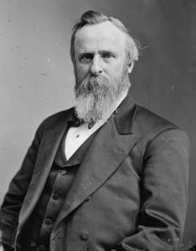
Democratic Nomination
  The Democrats nominated Samuel Tilden.
    Tilden's claim-to-fame was that he'd nailed Boss Tweed.
    Tilden got 184 electoral votes; he needed 185 to win.
    20 votes were hanging in the balance due to questionable returns.
    Picking up only 1 vote would see Tilden elected.

Slide 21
The Hayes-Tilden Standoff
  Both sides sent people to the questionable states (LA, SC, FL, and OR) and both men claimed victories there.
    The question then became, "Which branch of Congress would count the states' votes?"
    Depending on who counted, the Democratic House or the Republican Senate, the vote would likely go that way.
    Weeks passed and the election was at a stalemate.

Slide 22
Compromise of 1877
  With a president needed, Congress passed the Electoral Count Act that set up a commission to resolve the crisis.
    There were 15 men (from the House, Senate, and Supreme Court) on the commission.
    8 men were Republicans, 7 were Democrats
  The Republicans had the upper hand and were heading toward victory among the disputed states.
  Democrats were outraged and began to filibuster to tie up the process.

Slide 23
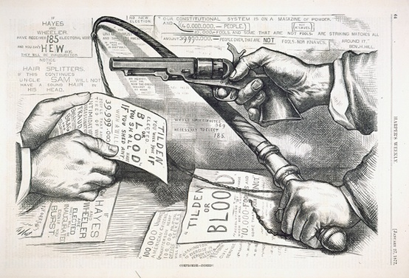
A Deal is Made in 1877
    The North…
      Got Rutherford B. Hayes elected as a Republican president.
    The South…
      Got a pledge that Hayes would removal of military occupation in the South.
      Additionally, money would be spent on the Texas and Pacific railroad.

Slide 24
The End of Reconstruction
      With the removal of military occupation, Reconstruction ended.
      The bad news for the freedmen was that Southern blacks were now effectively left alone to fend for themselves.
      The Civil Rights Act of 1875 supposedly gave equal rights to blacks, but the Supreme Court had struck much of it down.
      Also, white Southerners began to reclaim a strong hold on power.

Slide 25
Birth of Jim Crow Laws
  With the military gone, white Southerners reasserted their power over blacks.
  Fraud and intimidation were the tools.
  Most blacks had no option but to become sharecroppers/tenant farmers.
  They farmed land they didn't own, then paid hefty fees to the landlord come harvest time.
  The system was stacked against them so that they'd never get out of debt.
    Now "free", blacks likely farmed the same land for the same man as before the Civil War.

Slide 26
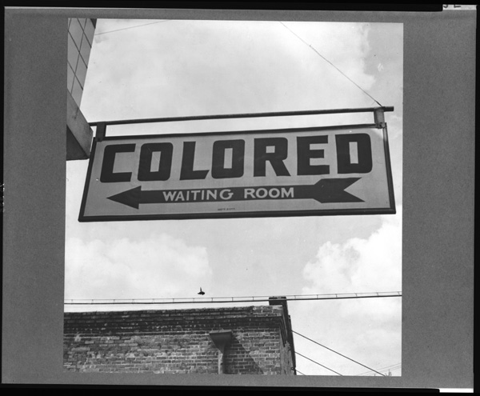
Segregation of Races
    First, the states enacted codes called Jim Crow laws that legalized the segregation.
    Then, the U.S. Supreme Court gave the federal okay. Plessy v. Ferguson (1896) stated that "separate but equal" facilities for the races were legal.
    Violation of these codes could have legal penalties.
    Or, worse, lynchings of blacks reached a record level as whites "enforced" the codes themselves.

Slide 27
Labor Conflicts
  The 4 largest railroads got together and decided to cut employee wages by 10%.
  The workers fought back by going on strike.
    This railroad shut-down crippled the nation and President Hayes called in federal troops to stop the unrest amongst the striking workers.
    The trouble went on several weeks but eventually ended with the workers losing on the losing side.
    This failed strike showed the weaknesses of the labor movement at the time.

Slide 28
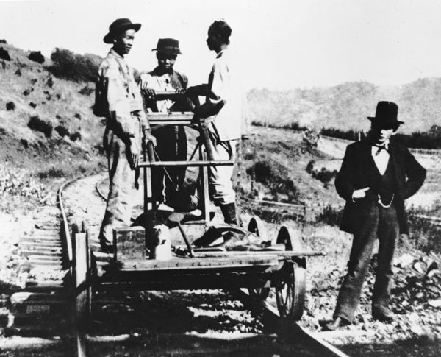
Ethnic Conflicts
    The clashes came when the Chinese competed for low-paying jobs, usually with the Irish.
    Most Chinese were young, poor men who'd emigrated to California.
    They frequently got jobs building the railroads.
    After the railroad boom, many returned to China, many stayed and looked for odd jobs.

Slide 29
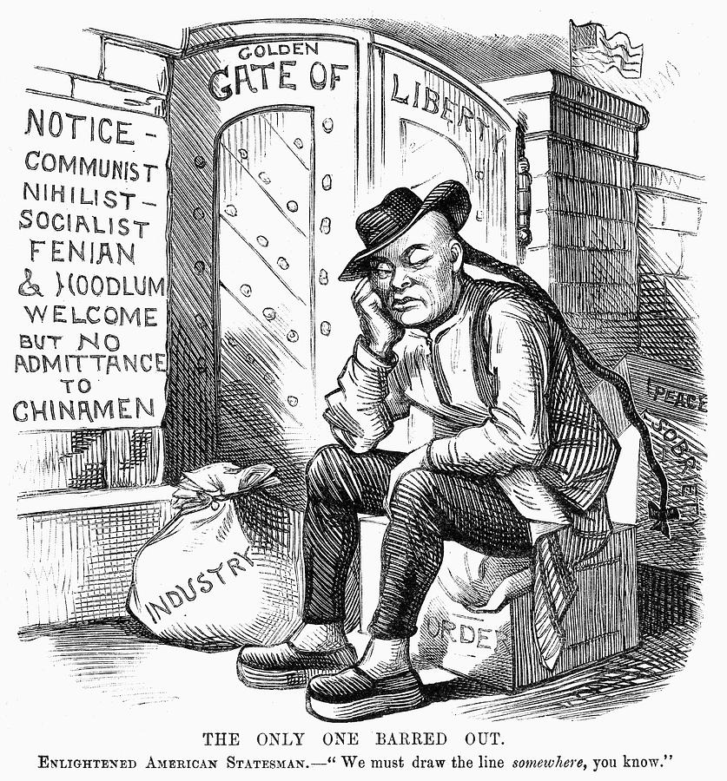
Chinese Exclusion Act, 1882
    Finally, Congress passed the Chinese Exclusion Act in 1882.
    It forbade the immigration of Chinese to America.
      This was the first immigration restriction America passed; until this point in history, immigrants simply came to America without hindrance.

Slide 30
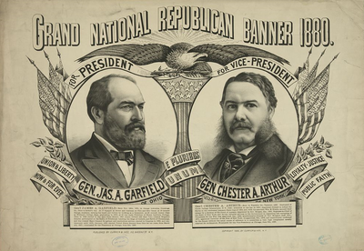
Election of 1880
    The Republicans nominated James A. Garfield and, as his running mate, Stalwart Chester Arthur.
    The Democrats nominated Gen. Winfield Scott, the Civil War hero.
    Garfield won the election, but found himself trapped in the middle of the Republican feud between the Stalwarts and Half-Breeds.

Slide 31
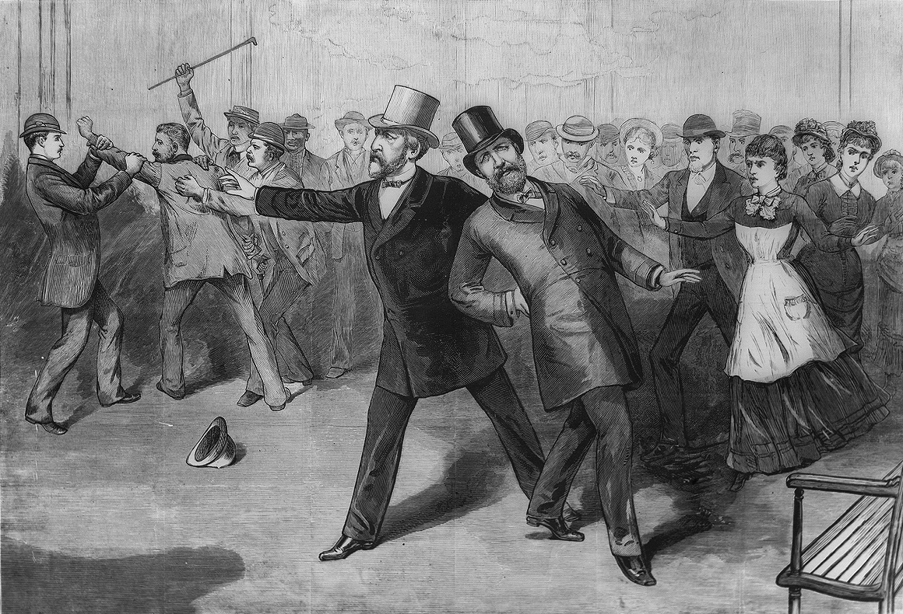
Garfield Was Assassinated
  By Charles J. Guiteau in 1881.
    Guiteau said he was a Stalwart
    He was found guilty and hanged.

Slide 32
Arthur Becomes President
    Despite being considered a partisan politician, Arthur was actually reform-minded.
    He largely stood firm against his Stalwart buddies in their quest for the riches that come with power
    The Pendleton Act was the height of political reform.
    It was civil service reform
      required merit to get jobs, not simply knowing someone in a high position.

Slide 33
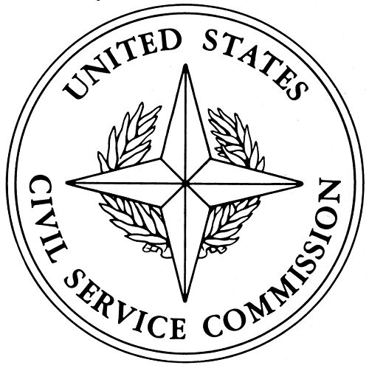
Civil Service Commission
    The Civil Service Commission awarded jobs based on performance rather than on how much "pull" a person had
    The Pendleton Act first affected only 10% of federal jobs, but it (
      stopped the worst offenses of giving jobs to buddies
      it set the tone for civil service reform in the future.

Slide 34
The Blaine-Cleveland Mudslingers 1884
  The Republicans nominated James G. Blaine for president in the 1884 election.
    Reform-minded Republicans didn't like this choice and went over to the Democrats.
    They were called "Mugwumps", supposedly with "their mug on one side and their wump on the other".
  The Democrats nominated Grover Cleveland as their candidate.
    The mudslinging reached the worst level up until that point during the campaign.
    A popular topic was Cleveland's affair and the child it had produced some 8 years earlier.
  Despite the drama Cleveland won the election.

Slide 35
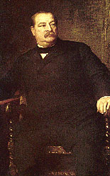
Grover Takes Over
  Grover Cleveland was a Democratic president during a string of Republicans in the White House.
  He had a laissez-faire capitalism mindset, which made business folks very happy.
  He helped bridge the North-South gap by naming two former Confederates to his cabinet.

Slide 36
Cleveland Battles for a Lower Tariff
  Cleveland had an unusual problem—a budget surplus.
  He couldn't justify the government profiting off of the people by taking in more than the government needed.
  There were two ways to get rid of the surplus:
    (1) increase the spending by inventing things to spend it on, or
    (2) taking in less by cutting taxes. Cleveland chose the second option.
  The extra surplus money largely came in from the tariff.
  Many people wanted it lowered.
  Businesses, which benefit from inflated foreign prices that a tariff provides, wanted to keep it high.

Slide 37
Congress Splits
    Pres. Cleveland asked Congress to reduce the tariff.
      The issue became a divisive one with Democrats favoring the lower tariff and Republicans favoring a higher one.
      Republicans began building their "war chest" of money for the next presidential campaign.

Slide 38
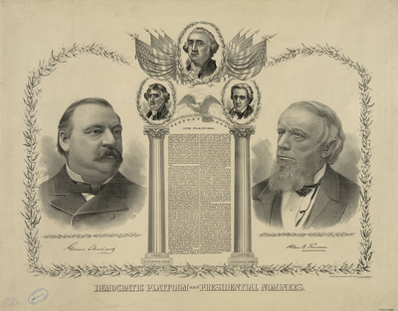
Election of 1888
  The tariff issue came to a full head of steam in the election of 1888.
    Cleveland was up for re-election by the Democrats, Benjamin Harrison was up as the Republican.
    Harrison won in a very close race in 1888.
    Cleveland became the first president voted out of office since Martin Van Buren.

Slide 39
The Billion Dollar Congress
  After being out of the White House for 4 years, the Republicans were eager to assert their power in Congress.
  The Republicans found their leader in Speaker of the House Thomas "Czar" Reed.
  Reed was a tall man, super debater, and had an acid-sarcastic tongue that cut at opponents.
  He ran the House of Representatives like a dictator.
    Democrats planned to fight back by not answering to roll call and thus not achieving a quorum (minimum number necessary for a meeting).
    Czar Reed solved the quorum battle by counting Democrats as present if they were there but hadn't answered the roll call.

Slide 40
Excess Spending
  With his quorum met, Czar Reed got down to business and had many bills passed…
    The first "Billion Dollar Congress" where the U.S. government doled out that much money for the first time.
    Pensions were liberally given to veterans.
    More silver was purchased.
    The McKinley Tariff (1890) hiked rates to roughly 48%, the highest peacetime rate ever.
      The tariff was a double-edged sword: business folks loved the protection it gave, but farmers disliked the fact that manufactured goods were now more expensive.

Slide 41
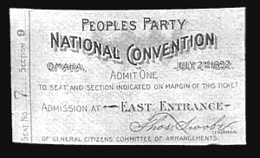
Discontent
  In 1892, a new political party emerged—the Populist Party (AKA the People's Party).
  It was made up of unhappy farmers and sprung out of the Farmers' Alliance.

Slide 42
Their Demands
    Inflation through "cheap money" policies of printing paper money and coining silver.
    They felt inflation would make it easier to pay off their debts. This was their top priority.
    Other desires were:
      a graduated income tax (a person pays more with a higher salary)
      government regulation of railroads, the telegraph, and telephone
      direct elections of U.S. senators by the people
      initiative and referendum (so people can propose and pass laws themselves)
      a shorter working day; and immigration restrictions.

Slide 43
Populist Party Wins Seats
  The Populist Party did surprisingly well in the election.
  They got 22 electoral votes by winning four western states.
  The South was reluctant to vote for the Populists due to race reasons.
  The Populists had reached out to Southern blacks so Southern whites turned away.
  After the election, Southern whites tightened the screws on blacks.
    Literacy tests and poll taxes were used more than ever to prevent blacks from voting.
    "Grandfather clauses" were employed to allow anyone to vote whose grandfather could (thus only whites were grandfathered in).

Slide 44
Cleveland and Depression
  "Old Grover" Cleveland won the election and became president again (after 4 years off).
  However, the Depression of 1893 soon began.
  It was the first recession or depression during the industrial age.
  This completed the almost predictable, every-20-year cycle of panics during the 1800s (panics occurred during 1819, 1837, 1857, 1873, and 1893).
    Nearly 8,000 U.S. businesses went out of business in 6 months.
    Railroads went under too and soup kitchens popped up to feed wandering hoboes.

Slide 45
Other Money Problems…
    Cleveland now had a budget deficit, whereas he'd enjoyed a surplus before.
    The nation's gold supply was getting dangerously low.
      The Sherman Silver Purchase Act (1890) had created a cycle: the government had to buy silver and print paper money to pay for it, the people could then turn in the paper money for gold, which they did.
      The nation's gold supply once dipped below $100 million, the safe minimum.
        Meanwhile, Cleveland had a malignant tumor removed from his mouth.
        If he'd died, Vice President Adlai Stevenson would've taken over.
        Stevenson was a "soft money" advocate and the gold problem would've likely worsened.

Slide 46
What Should Congress Do?
      Congress debated repealing the Sherman Silver Purchase Act.
        A young 30-year old named William Jennings Bryan became the foremost spokesman for silver and "cheap money."
        Despite the arguing, the Sherman Act was repealed.
      The exchange of paper money-for-gold continued still. This time the gold reserves fell to only $41 million.
        Finally, Cleveland turned to J.P. Morgan. Morgan and his banker-friends agreed to lend the U.S. government $65 million in gold (of course the bankers made $7 million in profit).
        This deal restored confidence and largely stemmed the problem.

Slide 47
Cleveland Breeds a Backlash
  Grover Cleveland, who'd been seen as a "common-man's president", looked sneaky in his dealings in gold and with J.P. Morgan.
  Cleveland was embarrassed again by the Wilson-Gorman Tariff.
    Democrats had promised lower tariffs.
    The Wilson-Gorman barely changed the McKinley Tariff at all.
    Worse, the Wilson-Gorman law allowed for a 2% income tax on income over $4,000.
    The Supreme Court struck this down, but it looked like Cleveland and the government was giving in to the rich "fat-cats."
  The Republicans began to benefit from Cleveland's recent actions.

