Slide 1
Chapter 21: The Furnace of Civil War, 1861-1865

Slide 2
JUMBO QUESTIONS 21
Periodization
  The authors characterize the Battle of Antietam as the “pivotal point” in the Civil War. Many other historians have formulated arguments for additional military or political turning points in the Civil War. What event would you select for the turning point in the Civil War?
Contextualization
  The authors observe as they evaluate the significance of the Emancipation Proclamation, “With a fateful stroke of the president’s pen, the Civil War now became more of a moral crusade as well as what Lincoln called a ‘remorseless revolutionary struggle.’” In other words, a war that began to preserve the Union in 1861 became a war to preserve the Union and end slavery in January 1863. How did the national context change from April 1861-January 1863? How does this change in national context help explain Lincoln’s decision to issue the Emancipation Proclamation?
Causation
  What were the long- and short-term effects of the Civil War? As you read this chapter and think critically about “Varying Viewpoints: What were the Consequences of the Civil War?” how many different long- and short-term effects fo the Civil War can you identify?

Slide 3
Bull Run Ends the 90 Day War
  The North (as well as the South) expected a short war, about 90 days.
  The Battle of Bull Run (AKA Battle of Manassas) squashed the short-war theories.
    Neither side was properly prepared.
    Many citizens picnicked along the edge of the battle as though tailgating at a sporting event.

Slide 4
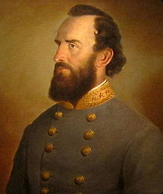
Stonewall Jackson
    The battle went back and forth at first but Gen. Thomas "Stonewall" Jackson's men held their line and earned him his nickname.
    The North fell into a hectic retreat. The South was just as disorganized and thus could not pursue.

Slide 5
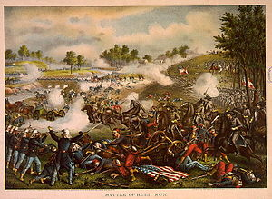
Impact of Bull Run
  On paper the South won, but the importance of Bull Run is that it showed each side the necessity of planning and preparation.
  The war then took a 9 month "time-out" for prep.

Slide 6
Tardy George McClellan
  34 year old Gen. George McClellan was a master organizer and planner. He was put in charge of getting the U.S. Army ready.
    McClellan's weakness was that he never felt as though he'd prepared enough.
    He was always preparing, never fighting.
    Lincoln got tired of waiting around, said McClellan had "the slows", and ordered him to take action.
  McClellan's plan was to take Richmond, VA, the capital of the South.
  He still felt the North could win in one large battle and by taking the capital would likely accomplish that goal.
  He nearly pulled it off.

Slide 7
The Peninsula Campaign
  The Peninsula Campaign ensued.
  The North moved by sea to and then up the historic Yorktown peninsula.
    Lincoln sent McClellan's reinforcements to guard Washington D.C. from Stonewall Jackson's bluff attacks.
    Confederate Jeb Stuart's calvary rode completely around McClellan (it was a major no-no to allow such a thing).
  Robert E. Lee struck back in the Seven Days' Battles and pushed McClellan back to the sea—a major win for the South.
  Casualties were in the ten-thousands and McClellan was demoted.

Slide 8
Lincoln’s Plan
  Lincoln began to move toward a draft to free the slaves. With the quick-strike plan a failure, the North now turned to total war. Summed up, the plan was to blockade, divide, and conquer. The specifics were to…
    Put a naval blockade the South.
    Free the slaves.
    Divide the South along the Mississippi River.
    Divide and crush the South by marching through Georgia and the Carolinas.
    Capture the Southern capital of Richmond.
    Engage the enemy anywhere possible and grind them into submission.

Slide 9
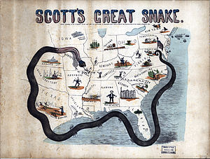
Anaconda Plan
  This plan was essentially Gen. Winfield Scott’s “Anaconda Plan” (a derogatory term that implied it was too slow).
  It was exactly what happened over the next four years.

Slide 10
The War at Sea
  The North's blockade had many leaks. As the war went on, the blockade tightened up.
    Britain could've run through it but chose to honor it. They didn't want to possibly get into a war.
  "Running the blockade", or sneaking goods through, was risky but profitable business.
    Smugglers often used the Bahamas as jumping-off points before entering the Confederacy. The ship papers would often have Canada as the destination but just sneak into the South.

Slide 11
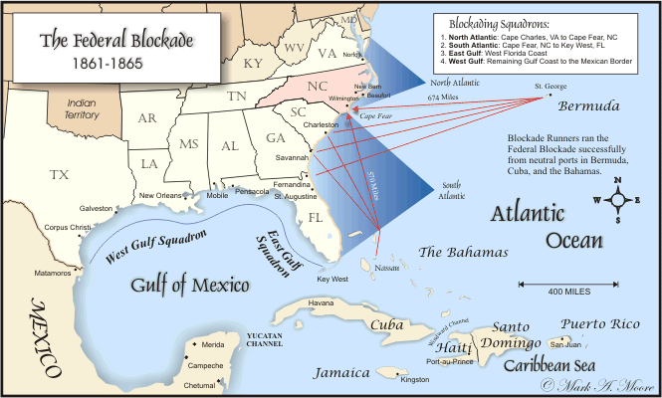
Blockade Problems
  Northern blockade-busters would often board British ships for an inspection.
  If the goods were thought destined for the South, they were seized.
  Britain complained, but never went beyond words.

Slide 12
The Merrimack and the Monitor
  Southerners created a legitimate threat to the blockade with the C.S.S. Merrimack.
    The Merrimack was an ironclad—a ship heavily armored with iron and thus greatly protected from cannon fire.
    The North responded with the Monitor, also an ironclad.
    The Monitor and the Merrimack battled in Chesapeake Bay March 9, 1862.
    The Merrimack was chased away.
    The battle was a turning point in naval history in that…
      …it showed that (a) the days of wooden ships were ending and (b) the days of sailing vessels were changing to steam.

Slide 13
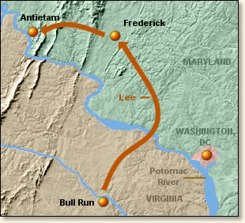
Antietam
  Shortly after the Peninsula Campaign, General Lee struck at Second Battle of Bull Run. Lincoln had placed Gen. John Pope in command.
    Gen. Pope "talked a good game", but was beaten badly by Lee and the South at Bull Run II.

Slide 14
  At this point, the South was clearly winning the war. But, Lee made his first mistake…he decided to invade the North at Antietam(AKA Sharpsburg, MD).
  The reasons for his decision were…
    (a) to perhaps lure the Border States to the South, (b) to draw the war out of Virginia during the harvest season,
    a victory on Northern soil would, (c) boost Southern morale and hurt Northern morale, and (d) perhaps stir up foreign/British support for the South.

Slide 15
  Lincoln put Gen. McClellan back in charge.
  Just prior to the fighting, Lee's battle plans were accidentally lost then luckily found by the North.
  Lee and the South lost the Battle of Antietam Creek, one of the largest battles of the war, on September 17, 1862.
    This battle was critical.
    If the South had won, they just might have won the entire war. And, the North's victory likely convinced Europe to stay out of the war.

Slide 16
What it Did For Lincoln
    Also, it gave Lincoln a much awaited victory and a platform to announce the Emancipation Proclamation to free the slaves.
      The Emancipation Proclamation gave the North's fight a moral foundation.
      The previous cause for the war was to force the South to remain with the North, against the South's will.
      After the Proclamation, the cause for war was to restore the nation and to end slavery.

Slide 17
Proclamation Without Emancipation
  The Emancipation Proclamation had a few "hiccups" tied to it.
    It freed the slaves only in the seceded Southern states. But, it did not free the slaves in the Border States.
    Lincoln specifically made this point because he did not want to anger the Border States and make them join the South.
    The South considered itself a separate nation from the North.
    Why would anything a "foreign" president says be binding over them?
    In order for the Proclamation to go into effect, the North would have to win the war.

Slide 18
Legal Issues
    Also, there were legal issues tied to the Proclamation.
    Did Lincoln actually have the authority to free the slaves?
    The short answer is, "No."
      The Constitution at the time did support slavery. A president cannot simply make a proclamation and undue the Constitution.
      This fact would be evidenced by the 13th Amendment right after the war, which freed the slaves.
      If the Proclamation had legally freed the slaves, there would've been no need for Amendment 13.
      Still, the Emancipation Proclamation was huge, if only symbolically, and gave the war its moral cause.

Slide 19
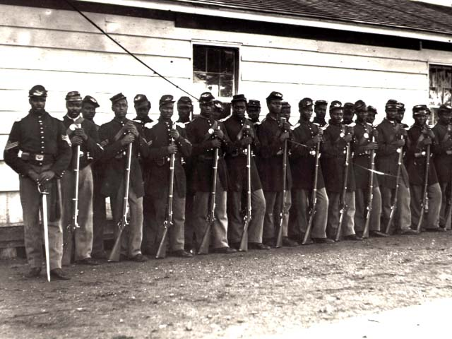
Blacks Battle Bondage
In the early years of the war, African-Americans were not allowed to enlist in the army.
But, as numbers declined, the North opened up the army to black soldiers.
They'd eventually comprise 10% of the Northern army.

Slide 20
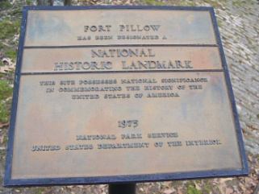
What the South Did
  Southern forces largely just executed black soldiers as opposed to the usual custom of treating captured enemies as prisoners-of-war.
  Black soldiers were even massacred after surrendering at Ft. Pillow, TN.
    This event sparked the outcry by African-Americans, "Remember Ft. Pillow!"

Slide 21
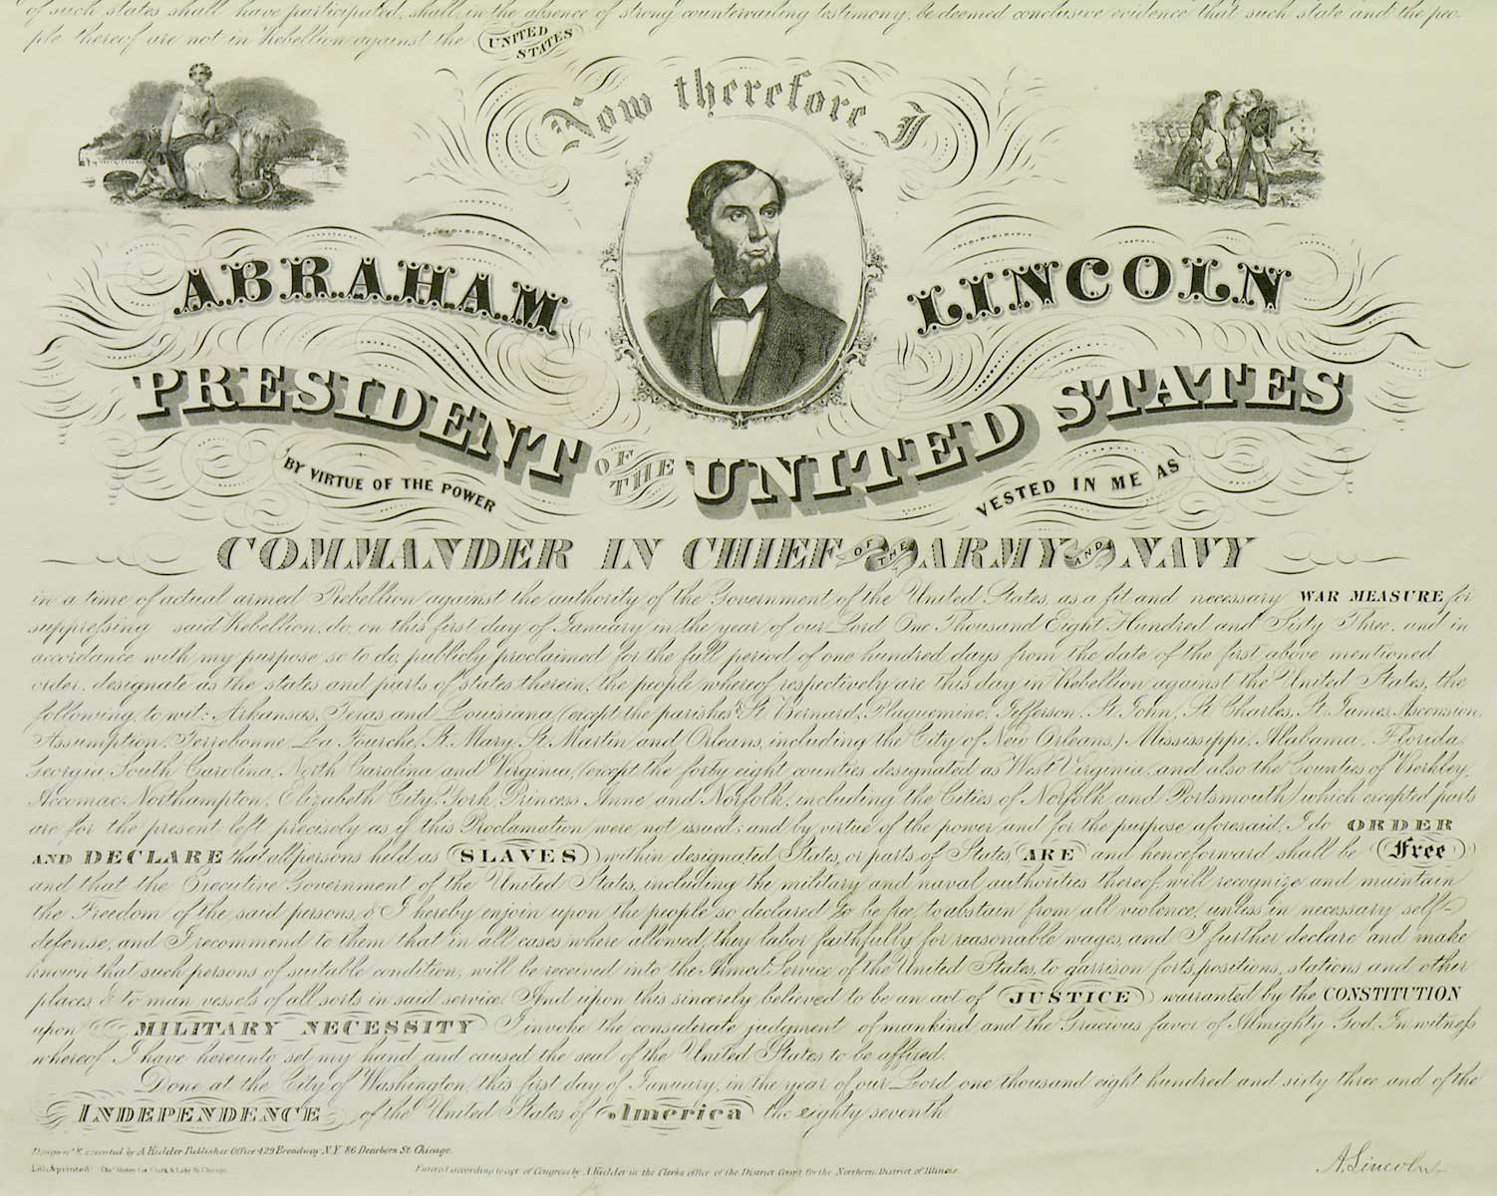
Emancipation of Slaves
  Emancipation came to Southern blacks when the Northern army came.
  The Emancipation Proclamation didn't simply release and allow slaves to walk off the plantation.
  The force of the U.S. army freed the slaves as it marched forward.

Slide 22
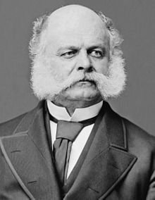
Southern Win
  Gen. A.E. Burnside (the originator of "sideburns") was put in charge of the Northern army following Antietam.
    He was defeated soundly at Fredericksburg, VA when Union troops tried to swarm up a hill held by Confederates.

Slide 23
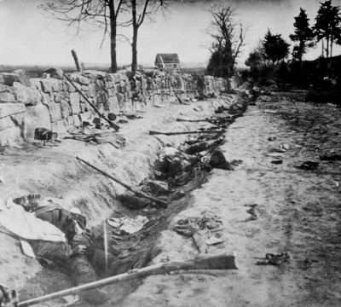
Southern Win
  Gen. Joseph Hooker was then placed in charge but was also defeated at Chancellorsville, VA.
    Gen. Lee was outnumbered but he out-maneuvered Hooker by splitting his forces and then sending Stonewall Jackson around to attack the flanks.
    Jackson was wounded by his own men there and later died.
    This battle is largely regarded as Gen. Lee's most impressive win.

Slide 24
Gettysburg
  Gen. George Meade was then placed in charge of the Northern army.
  Lee invaded the North again, met Meade at Gettysburg, PA.
    The Battle of Gettysburg lasted 3 days (July 1-3, 1863). The South won the first 2 days by pushing the North out of town and into the hills.
    The North won the 3rd day and the overall battle.
    The 3rd day was highlighted by Pickett's Charge where Gen. Lee futilely sent 15,000 Southern troops across an open field.

Slide 25
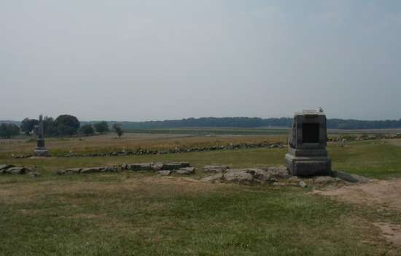
North Wins
  Gettysburg was "the big one".
  Although the war would drag on two more years, it essentially broke the back of the South and started the "countdown clock".

Slide 26
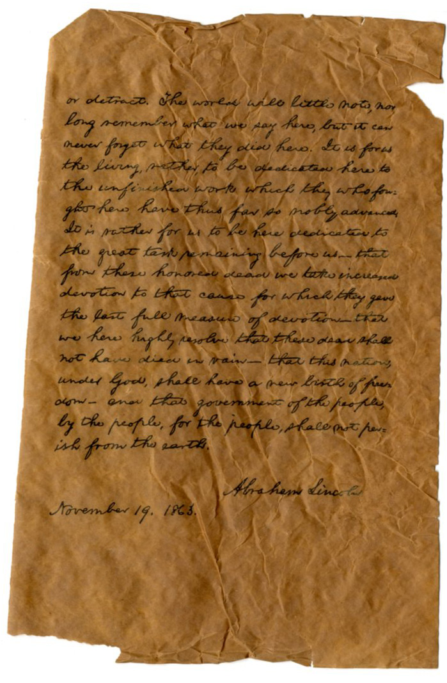
The Tide Has Turned
  In the autumn, Lincoln returned to Gettysburg to give the Gettysburg Address.
  The purpose of the 2 minute speech was to rally the troops, boost morale, and assert that the men who'd died hadn't die in vain.

Slide 27
The War in the West
  Lincoln was having terrible luck finding a general to get the job done.
  His answer was finally found in Gen. Ulysses S. Grant.
    Grant had been mediocre to slightly above average most of his career.
    He came on the scene by achieving "Unconditional Surrender" early in the western theater of the Civil War (the term stuck as his nickname due to his initials: U.S. Grant).

Slide 28
Grant Gets Better
  Grant was demoted after nearly getting wiped out at the Battle of Shiloh.
  His big break and redemption came at Vicksburg, MS where he circled around the city, took the capital of Jackson, MS, and then seized Vicksburg.
  Vicksburg came one day after Gettysburg and certainly pointed toward a Northern win.
  Also as certain, Southern hopes for foreign intervention were gone—no country helps the losing side in a war.

Slide 29
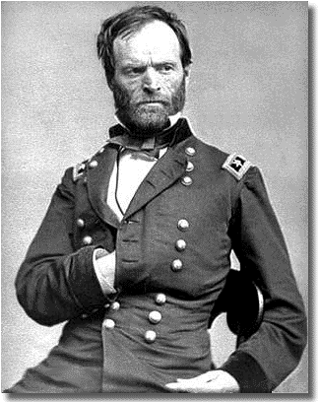
Sherman Scorches Georgia
  The plan of "blockade, divide, and conquer" was coming to fruition.
    The blockade was in place, the South was being divided down the Mississippi River, and now was to be divided through Georgia.

Slide 30
  Gen. William Tecumseh Sherman was put in charge of dividing the South by land.
    He pushed down from Chattanooga, TN and captured Atlanta, GA. Atlanta was burnt to the ground.
    Sherman then led his "March to the Sea".
    He spread out his men and scorched Georgia from Atlanta to Savannah on the coast.
    Everything was destroyed—farms, houses, crops, railroads, warehouses, fields, etc.

Slide 31
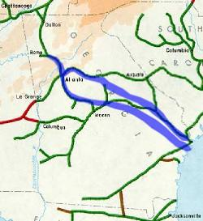
Sherman’s Total War
  Sherman declared "total war" meaning that even civilian property was to be destroyed.
  Thus the "conquer" part of the "blockade, divide, and conquer" plan was also being played out.

Slide 32
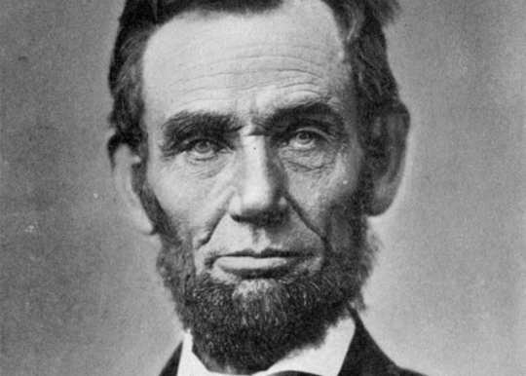
The Politics of War
  Lincoln had his opponents up North, even among his fellow Republicans.
    "Radical Republicans" felt Lincoln wasn't doing enough to win the war, help blacks, or punish the South.

Slide 33
Northern Democrats Are Now Split
  Northern Democrats split over the war.
    "War Democrats" supported Lincoln and the war.
    "Peace Democrats" opposed Lincoln (calling him the "Illinois Ape") and the "Nigger War" that he led.
      Clement L. Valandigham was Lincoln's loudest opponent.
      He leaned toward the South, was tried for treason, shipped down South, fled to Canada, there ran and lost a bid for governor of Ohio, then returned to Ohio.
      This odd scenario inspired the fictitious story "The Man Without a Country."

Slide 34
The Election of 1864
  War or not, elections go on.
  The 1864 presidential election saw Lincoln take on Gen. George McClellan (whom Lincoln had fired).
  McClellan was the Democratic candidate.
  His position was that Lincoln was mismanaging the war.
    Lincoln's most vicious opponents were called "Copperheads" since they "struck at Lincoln's heels."
    These critics usually came from the "Butternut Region"—southern Illinois, Indiana, and Ohio.

Slide 35
Why Lincoln Won Again
  Lincoln would come out victorious in his 1864 re-election because…
    He cleverly invented the "Union Party" which joined Republicans with War Democrats.
    He came up with the simple but clear slogan: "You don't change horses midstream."
    Union forces scored victories in New Orleans and Atlanta just prior to the election.

Slide 36
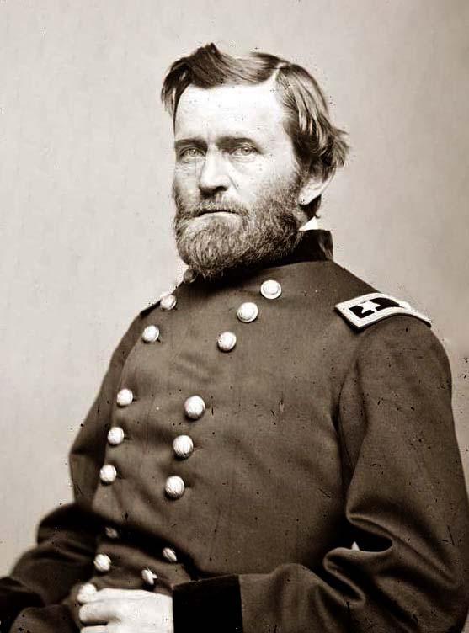
Grant Outlasts Lee
  Ulysses S. Grant was known as the "meat-grinder" because he was willing to keep sending his men into battle even though they'd be killed.
  His motto was, "When in doubt, fight."
    He was willing to sacrifice twice as many casualties as his enemy because he knew the South could not sustain the fight as long as he could.

Slide 37
The End of the War
  Grant outlasted Lee over a string of battles including: The Wilderness, Spotsylvania Courthouse, Cold Harbor, and Petersburg.
    These battles were known for being very bloody.
    They earned nicknames like the "Bloody Angle" and "Hell's Half Acre".
    At Cold Harbor, soldiers pinned their names and addresses onto their backs. 7,000 men died in a few minutes.
  Richmond, VA, the capital of the South, finally fell and was destroyed.
  In April of 1865, surrounded, Gen. Lee surrendered to Gen. Grant at Appomattox Courthouse in Virginia.

Slide 38
The Martyrdom of Lincoln
  Only a few days after the South's surrender, Lincoln was assassinated.
  He was shot by John Wilkes Booth in the head while attending a play at Ford's Theatre in Washington.
  Lincoln became an instant martyr—a hero who died fighting for the nation and freedom of blacks.
  Southerners were glad to be rid of Lincoln.
  But, as irony would have it, things would turn much tougher for the South without Lincoln.
  The Radical Republicans who replaced Lincoln's authority were much less forgiving than Honest Abe would've been.

Slide 39
The Aftermath of War
  The Civil War was immensely costly in many ways…
    It cost 600,000 lives, $15 billion, ripped away the best of a generation, instilled long-lasting animosity, and physically destroyed the South
  There were some benefits to the Civil War…
    It showed the resilience of the U.S.
    The nation had put itself through the ultimate test, and had survived.
    Slavery was erased from the United States.
    It put the U.S. onto the world stage as a major player and set up the U.S. to soon be the world leader.

