Slide 1
Chapter 20: Girding for War: The North and the South, 1861-1865

Slide 2
JUMBO QUESTIONS
Comparison
  In the early 1860s, both the Union and the Confederacy mobilized their economies and societies to fight the Civil War. Explain similarities and differences between the two mobilization efforts
Analyzing Evidence
  After reading “Contending Voices: War Aims: Emancipation or Union?, analyze the points of view of both excerpts
Argumentation
  In this chapter, the authors contend that “successful revolutions, including the American Revolution of 1776, have generally succeeded because of foreign intervention.” Yet, they also maintain that “at war’s end the Northern Captains of Industry had conquered the Southern Lords of the Manor.” Develop a historical argument that explains the economic and diplomatic reasons for the Union victory in the Civil War.

Slide 3
The Menace of Secession
  Abraham Lincoln was sworn into office March 4, 1861.
  At his inauguration, Lincoln made clear the primary goal of his presidency—bring the nation back together.
    He argued that dividing the country is impossible simply due to geographic reasons.
    If the South left, how much of the national debt should they take, Lincoln wondered? Or, what would be done about runaway slaves?
    And, Europe would love to see the U.S. split and therefore weaken itself. Was that something Americans were willing to allow?
  Again, Lincoln's goal throughout his presidency was to bring the nation back together.

Slide 4
South Carolina Attacks Fort Sumter
  The Civil War began at Ft. Sumter, S.C. (an island-fort at the mouth of Charleston Harbor).
    It remained a Northern fort, but its supplies were running out. Lincoln sent a ship to supply the fort, but before it arrived, Southerners opened fire on Ft. Sumter on April 12, 1861.
    The war was on.
    The fort was shelled for over a day, then had to surrender.

Slide 5
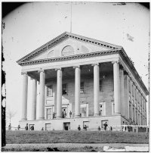
Lincoln’s Response to the Attack
    He issued a "call to arms" and called for 75,000 volunteers to join the military.
    He ordered a naval blockade of Southern ports.
    Lincoln's actions prompted 4 more states to secede
    The Confederate capital was then switched from Montgomery, AL to Richmond, Va.

Slide 6
Brother’s Blood and Border Blood
  In between the North and South were the Border States of Missouri, Kentucky, and Maryland. The were critical for either side, since they would've greatly increased the South's population and industrial capabilities.
  They were called “border states” because…
    They were physically on the North-South border and…
    They were slave-states that hadn't seceded, but at any moment, they just might.

Slide 7
What about Border States?
  To keep the Border States with the North, Lincoln took cautious steps.
  In Maryland, Lincoln declared martial law (rule by the military) in order to seize the railroad into the state.
  He simply would not allow Maryland to secede and thus leave Washington D.C. as an island in the South.

Slide 8
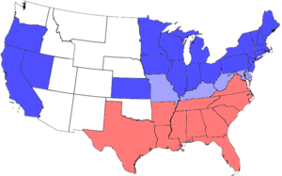
Lincoln’s Intent
    Lincoln made it extremely clear that his goal was to re-unite the nation, not to end slavery.
    He knew that to fight to end slavery would likely scare the Border States away.

Slide 9
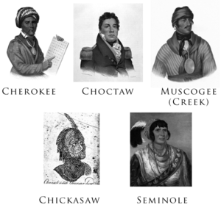
  The Indian nations also took sides. The "Five Civilized Tribes" of the Cherokee, Creek, Choctaw, Chickasaw, and Seminole largely fought with the South. Some Plains Indians sided with the North.

Slide 10
Brother vs. Brother
    Tennessee where the state officially joined the South but thousands of "volunteers" sided with the North. Hence, Tennessee is the "Volunteer State."
    West Virginia where the mountain Virginians had no need for slavery and sided against it. At the war's start, there was only "Virginia" on the South's side. Midway through the war, "West Virginia" broke away on the North's side.

Slide 11
Southern Advantages
    They only had to defend their land, rather than conquer land
    Geography was on the South's side—the land where the fighting would take place was familiar and friendly to the Southerners.
    The South's greatest advantage was in their leadership. At the top was Gen. Robert E. Lee and Thomas "Stonewall" Jackson.
      They proved to be head-and-shoulders above Northern generals.
      The South also had a military tradition that produced many fine officers of lower rank.

Slide 12
The North’s Advantages
    The population favored the North over the South by about a 3:1 ratio.
    Industry was almost entirely located up North. Resources, particularly iron, were likewise almost entirely up North.
    The North had most of the nation's railroads, the U.S. navy, and much more money than the South.
    The South planned to rely on cotton to sell and then buy whatever it needed. The North's naval blockade largely stopped this plan.

Slide 13
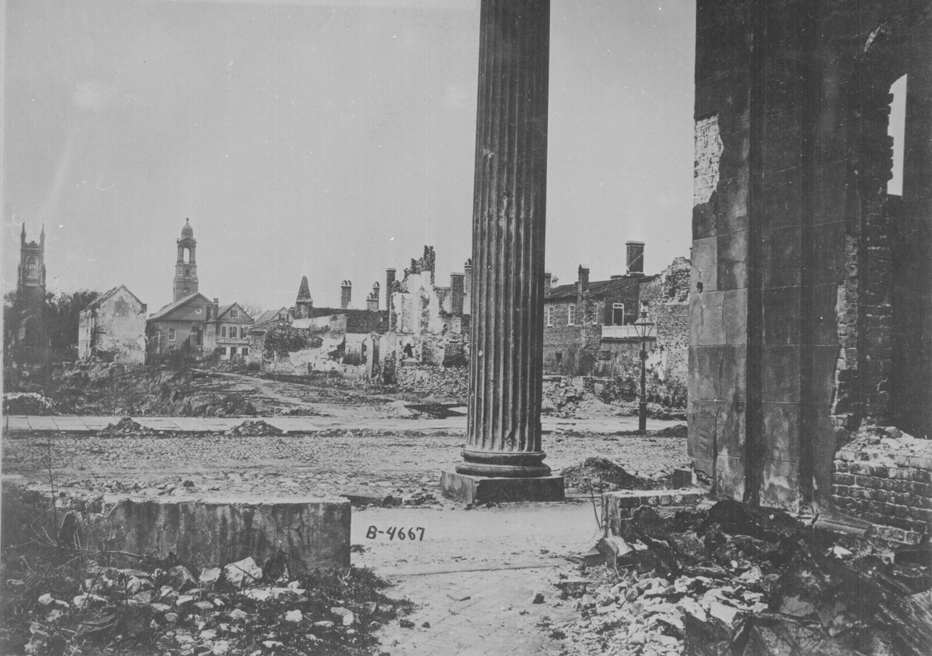
The North Wins….
  In the end, it was the South's shortages that caused its loss in the war.

Slide 14
Dethroning King Cotton
  The Southern "game plan" was to get aid from Europe, particularly England, due to their supposed need for Southern cotton.
  The help never came.
  Many in Europe actually wanted the U.S. to split. A split U.S. would strengthen Europe, relatively speaking.
  On the other side, many in Europe were pulling for the North.
  They had largely already moved against slavery and realized that the war might end slavery in the U.S.

Slide 15
Why it Fell
  The question remained about England's reliance of Southern cotton.
  However, in the years just prior to the war, England had a bumper crop of cotton down in India and Egypt.
  They'd saved the surplus and therefore weren't as "cotton-needy" as believed.
  The North also won points by sending food over to Europe during the war.
  Thus, the Southern King Cotton was defeated by the North's King Wheat and King Corn.

Slide 16
The Decisiveness of Diplomacy
Throughout much of the war, the South pushed for foreign help. Several instances at sea showed the unofficial, half-way support of England.
  The "Trent affair" illustrated the diplomatic trickiness of the day.
    A U.S. (Northern) ship stopped the British ship Trent in Cuba and forcibly took 2 Southerners.
    England (and the South) was furious and demanded their release.
    Lincoln had time to cool off and released the Confederates saying, "One war at a time."

Slide 17
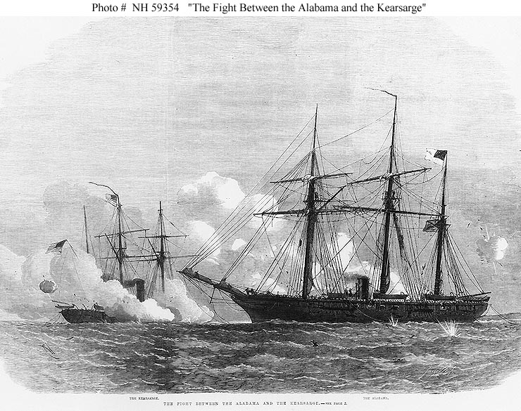
The Alabama
    The "Southern" ship was manned by Brits and never docked in the South.
    It traveled the world and captured 60+ vessels. Needless to say, the North was not happy about the situation.

Slide 18
The British Help Out
  The British also planned to build raider ships for the South.
    The raiders were halted (with the opposition led by Charles Francis Adams) as they were being built.
    The fear was that it might come back to haunt them.
    Still, it shows the desire to help the South even if it wasn't followed all the way through.

Slide 19
Foreign Flare-Ups
  The British built 2 Laird rams, ships designed to ram and destroy the Northern wooden ships.
  Minister Adams saw that delivering these ships would likely mean war with the U.S. and possible loss of Canada.
  Trouble started along the U.S.-Canada border.
  Canadians struck American cities and sometimes burnt them down.

Slide 20
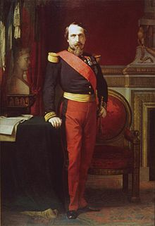
Meanwhile, Down in Mexico…
  Meanwhile, down in Mexico, Emperor Napoleon III had set up a puppet government in Mexico City.
    This was flatly against the Monroe Doctrine's "stay away" policy.

Slide 21
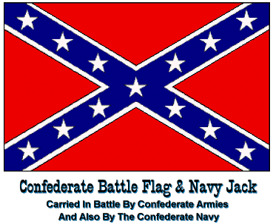
Problems with a Confederacy
  The South had a built-in problem with its government—it was a confederacy.
  That meant it was only loosely united.
  Any state, at any time, could break away, agree with the rest or not, unite or do its own thing.

Slide 22
Davis vs. Lincoln
Jefferson Davis
Abraham Lincoln
  President Jefferson Davis was never popular.
    He was all business, stubborn, and physically over-worked himself.
  Lincoln certainly had his troubles too.
    But, he was the head of an established and stable government and seemed to relax more as time wore on.

Slide 23
Limitations on Wartime Liberties
  "Honest" Abe Lincoln took several steps that were clearly against Constitution.
  He felt his steps were simply needed due to the split nation and emergency-like situation.
  Jefferson Davis was unable to exert similar power because of the loose nation of a confederacy.

Slide 24
What Lincoln Did
  Things he did against the Constitution:
  increased the size of the Army
  sent $2 million to 3 private citizens for military purposes,
  suspended habeas corpus so arrests could be made easily,
  "monitored" Border State elections so the vote would turn out his way
  declared martial law in Maryland.

Slide 25
Volunteers and Draftees
  As in most wars, volunteers came plentifully in the early days.
  Initially, the plan was to only use volunteers.
  As the war drug on and men died, enthusiasm died too. A
  military draft was started in both the North and South to conscript soldiers.
    Congress allowed the rich to buy an exemption for $300.
    That meant a poor person would have to fill those shoes.

Slide 26
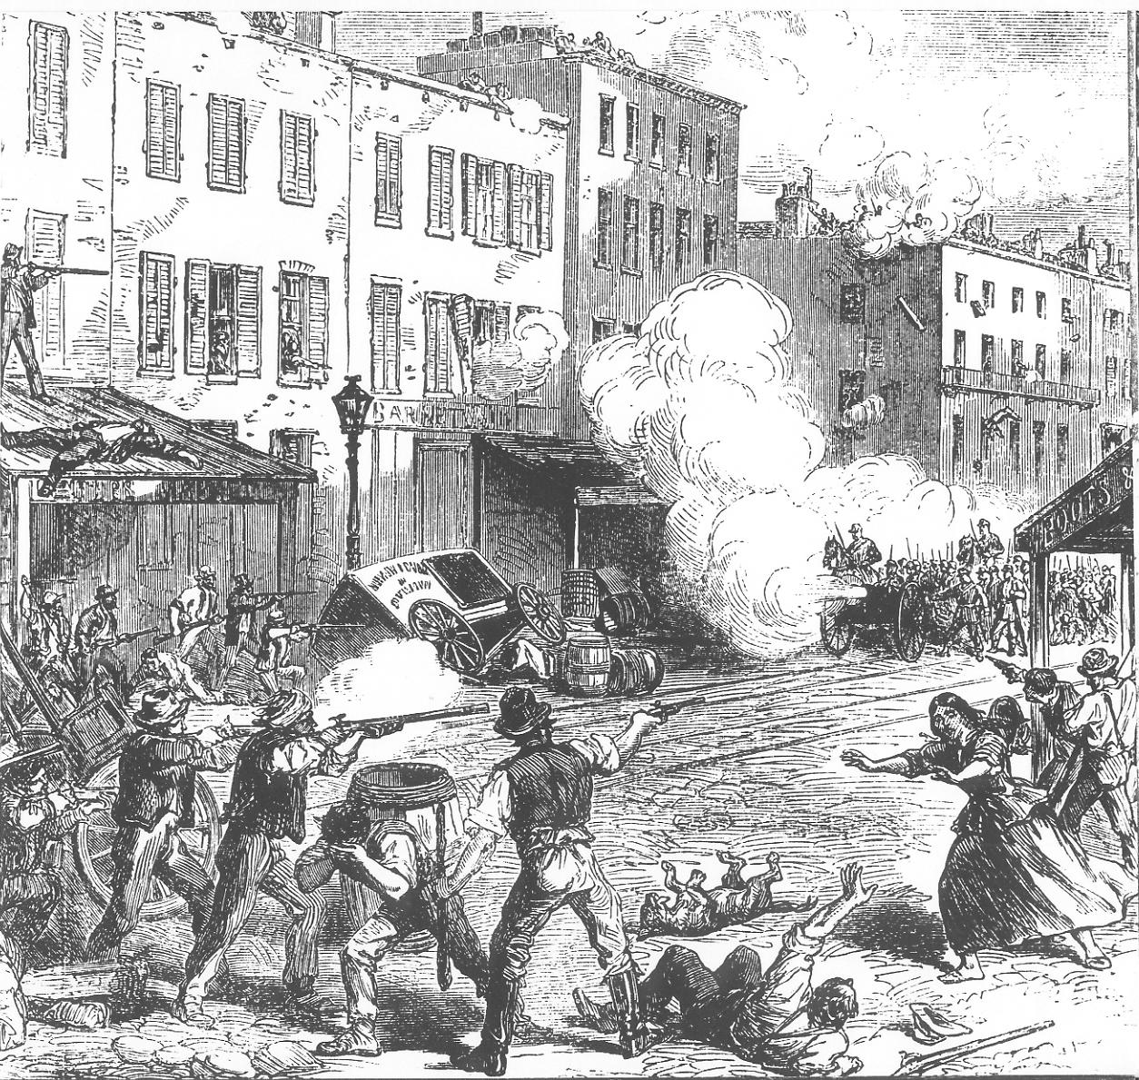
In the North
  The draft was protested strongly, especially in the Northern cities.
  New York City saw a riot break out in 1863 over the draft.
  90% of the Union soldiers were volunteers.
  This was due to patriotism, pressure, and bonuses for signing up.

Slide 27
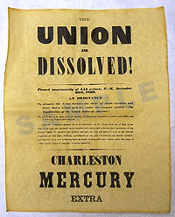
In the South…
  The South had fewer men and therefore went to draft earliest. The rich were also exempted down South (those with 20+ slaves).
    The saying was born: "a rich man's war but a poor man's fight."

Slide 28
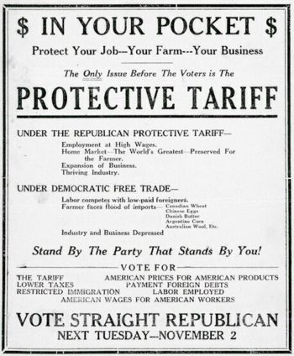
Economic Stresses of War
  The U.S. wanted more money and passed the Morrill Tariff Act which raised the tariff 5 to 10%.
  The rates then went even higher.
  The Treasury Department printed about $450 in "greenback" paper money.
  The money was not adequately backed by gold, thus creating inflation, at one point worth only 39 cents on the dollar.

Slide 29
Sale of Bonds
  The largest fundraiser was through the sales of bonds. The government brought in $2.6 billion through bond sales.
  An important change was the creation of the National Banking System. It was the 1st national banking system since Andrew Jackson had killed the Bank of the U.S. in the 1830's Reasons for its importance were…
    It established a standardized money system.
    It could buy government bonds and issue paper money. In other words, it regulated the quantity of money in the economy/circulation. This is called "monetary policy" today.
    It foreshadowed the modern Federal Reserve System of today.

Slide 30
It Was Worse in the South
  The Southern economy was even worse than the North.
    The Union naval blockade locked down the South.
    It stopped exports of cotton (and thus the income of money), and it cut off customs duties (no imports means no customs duties).
    Inflation was out of control.
    It went up an estimated 9,000% down South (compared to an 80% increase up North).

Slide 31
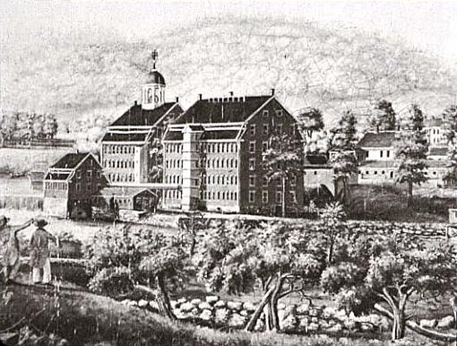
The North’s Economic Boom
The North’s Economic Boom
  Like many wars, the Civil War was a boom for business.
  Manufacturers and businessmen made fortunes and a millionaire class was born for the first time.
  Some "profiteers" scammed the government by supplying shoddy goods.

Slide 32
Women and Technology
  New machinery benefited production greatly.
    Standardized sizes of clothes were born.
    Mechanical reapers harvested bountiful crops.
    Oil was discovered in Pennsylvania.
  Women took on new roles too, often filling in for absent men in jobs.
    Some women posed as men and enlisted to fight in the military.
  Women helped considerably in health-related positions.
    Dr. Elizabeth Blackwell was the first female doctor.
    Clara Barton (founder of the Red Cross) and Dorothea Dix elevated nursing to a professional level.
    Down South, Sally Tompkins did the same.

Slide 33
A Crushed Cotton King
  The South was beaten down by the war.
    The Southern economy was zapped.
    Before the war, Southerners held 30% of the nation's wealth, afterward, it was down to 12%.
    Before the war, Southerners made 67% of Northern wages, afterward, it was down to 40%.
  Despite the bad news, Southerners showed quite a bit of character and self-respect in pulling together and putting together a strong fight.

